Slide 1

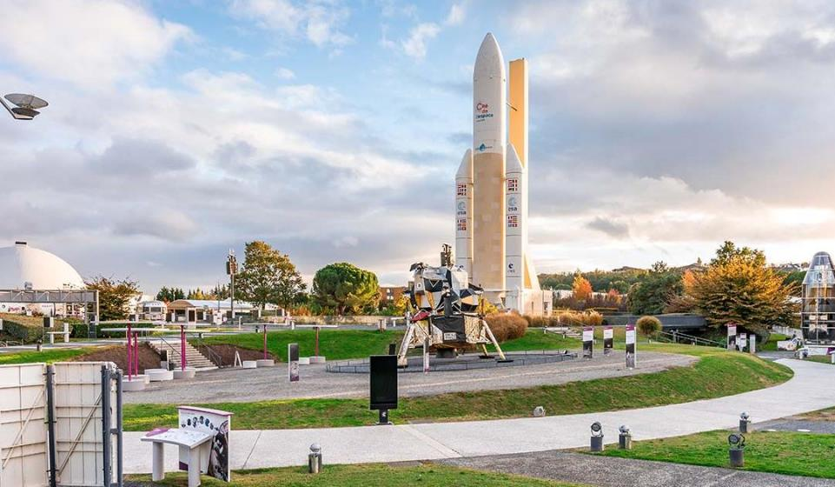
Your trip to Toulouse
School Name
DD–DD MM YYYY

Slide 2
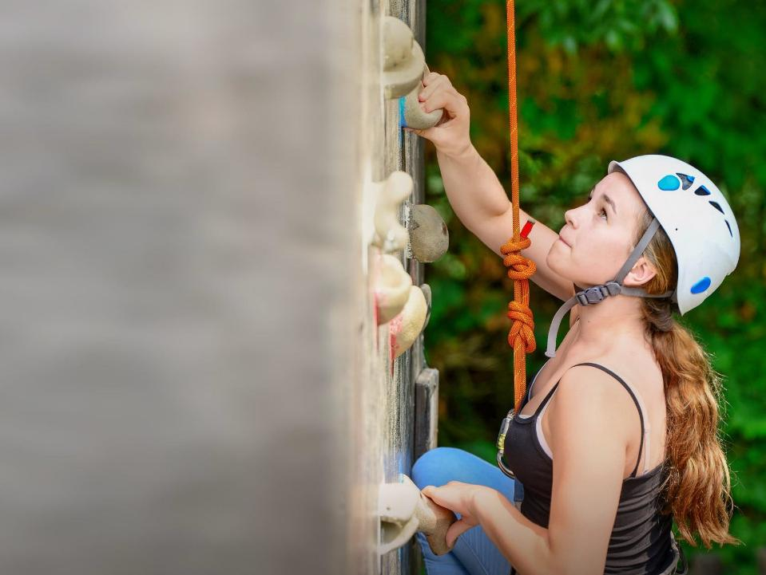
We help students reach new heights
Voyager School Travel specialises in educational school trips where students can learn, thrive and achieve their potential outside the classroom.
We believe that every school trip should provide students with new experiences, learning activities and exposure to local culture with genuine educational benefit.
Over 35,000 students travel with us each year

Slide 3


You’re in
safe hands
Your child’s safety is our priority and
we ensure the highest standards are met.
ABTA member
Protected by ATOL & ABTOT
School Travel Forum (STF) member
Hold the Learning Outside the Classroom (LOtC) Quality Badge
AAIAC Adventuremark holder
Externally audited safety management systems
All accommodation audited
More about accreditation.

Slide 4
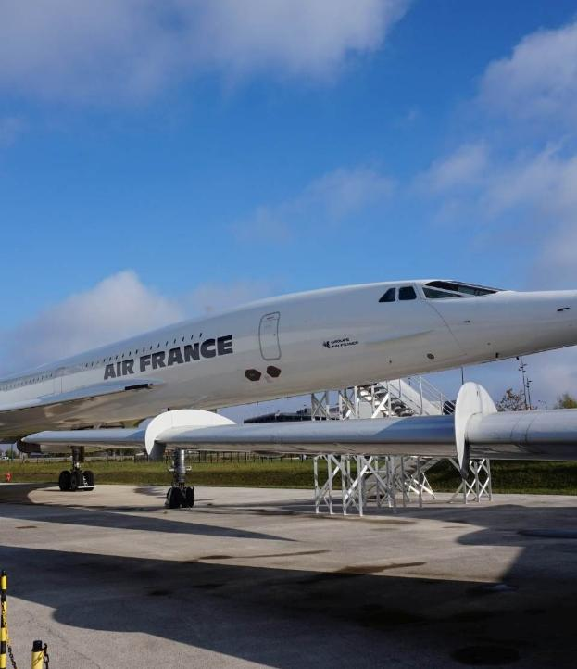
Aeroscopia
Learn about the history of aviation and see the last Concorde ever to fly in French aerospace, alongside interactive large exhibition halls filled with planes, cockpits, and displays showing the history of flight.

Slide 5
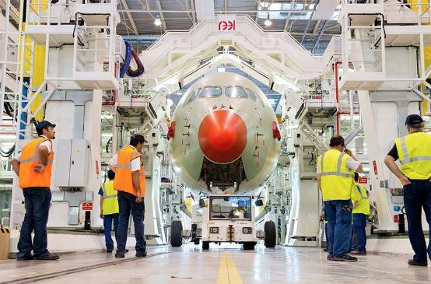
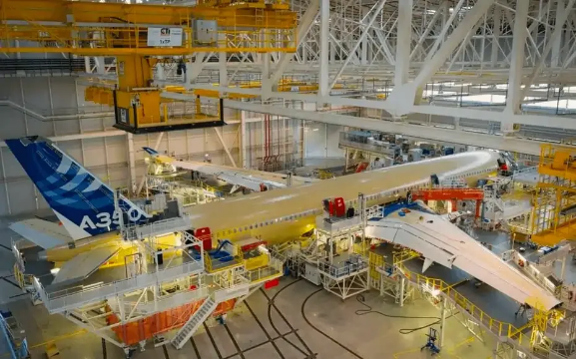
Airbus Factory
  Discover the history behind Airbus and its establishment in Toulouse, where students can see how modern assembly lines operate and gain a deeper understanding of large-scale engineering, innovation and the story behind iconic aircraft like the A300 series.

Slide 6
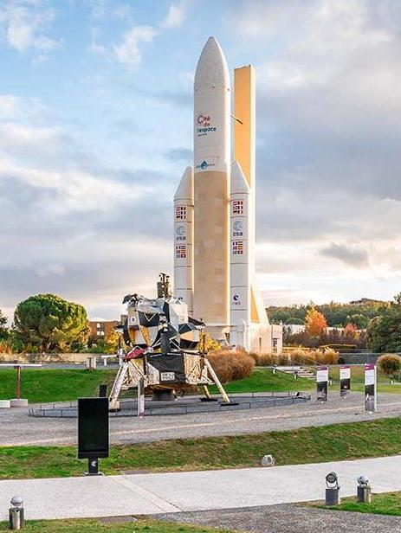
City of Space
Explore the wonders of space through interactive exhibits, engaging workshops and immersive shows to inspire your students.
This museum brings science to life, helping students understand how space research works while sparking curiosity about the universe.

Slide 7
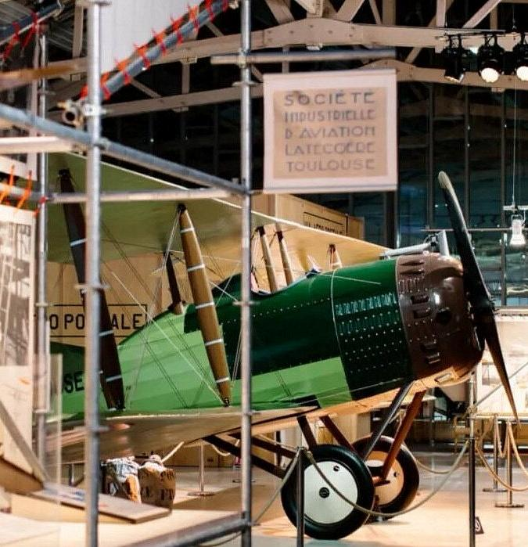
The Flight of
the Pioneers
Learn the story of the legendary Aéropostale mail route and the pioneers who made it possible.
Through exhibits, students will explore the roles behind this early aviation network and learn about iconic pilots, gaining insight into the challenges and achievements of early flight.

Slide 8
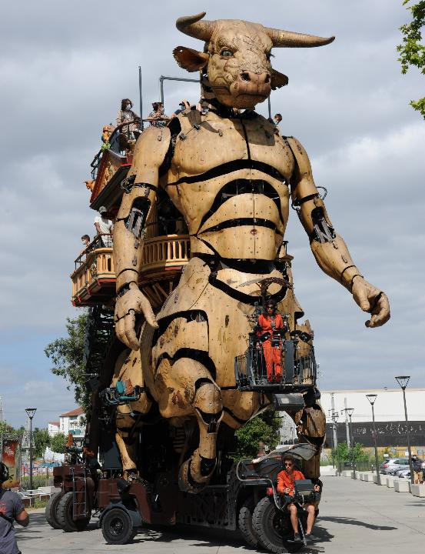
Halle de la Machine
Combining engineering and mythology, students will use interactive booklets to become experts in the vast collection of machines on show.
Students will wrap up the adventure by riding the giant Minotaur along the Giant’s Trail, an unforgettable experience that brings science to life.

Slide 9
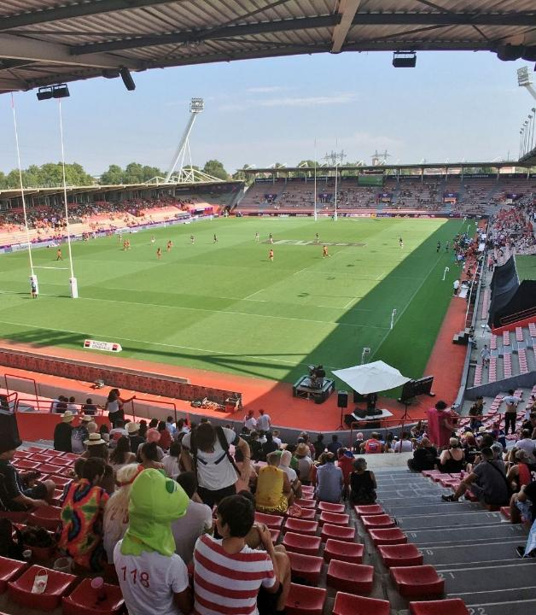
Toulouse Stadium tour
Step inside the temple of rugby! A tour of Stade Ernest-Wallon showcases Toulouse's vibrant sports culture.
The all-access tour includes indoor and outdoor facilities such as the wall of honours and the wall of internationals, as well as pitchside for the best views of the stadium!

Slide 10
Toulouse is waiting for you!
Click here for more information about the trip!
Find us on

