Slide 1

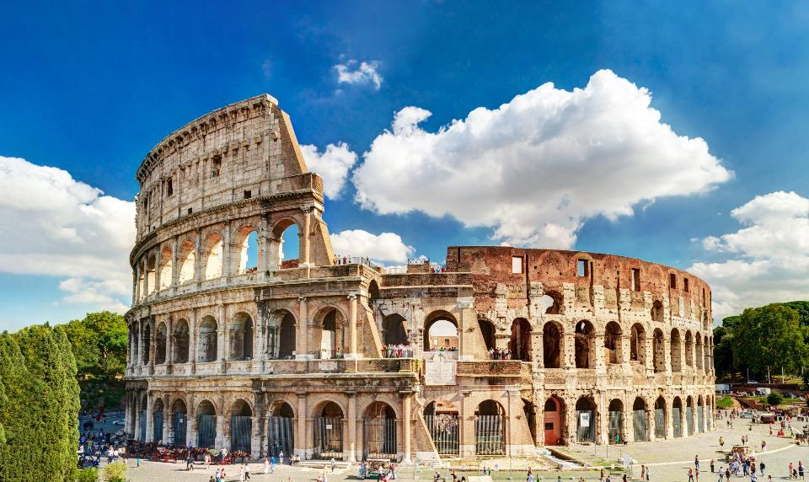
Your trip to Rome
School Name
DD–DD MM YYYY

Slide 2
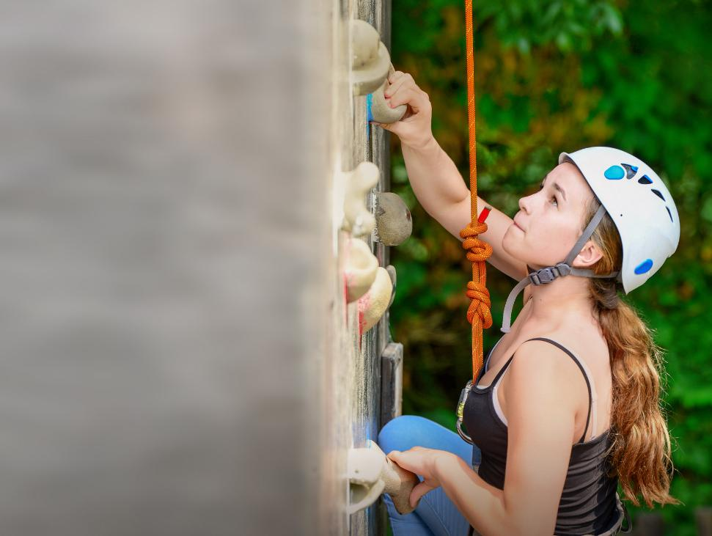
We help students reach new heights
Voyager School Travel specialises in educational school trips where students can learn, thrive and achieve their potential outside the classroom.
We believe that every school trip should provide students with new experiences, learning activities and exposure to local culture with genuine educational benefit.
Over 35,000 students travel with us each year

Slide 3


You’re in safe hands
Your child’s safety is our priority and we ensure the highest standards are met.
ABTA bonded
ATOL protected
School Travel Forum (STF) member
Learning Outside the Classroom (LOtC) Quality Badge holder
AAIAC Adventuremark holder
Audited safety management system
All accommodation audited
More about accreditation.

Slide 4
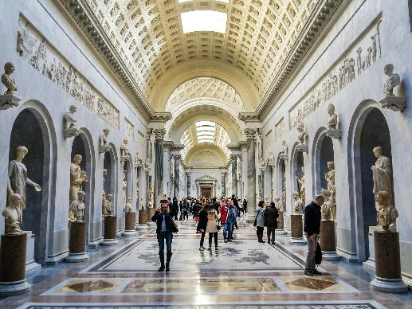
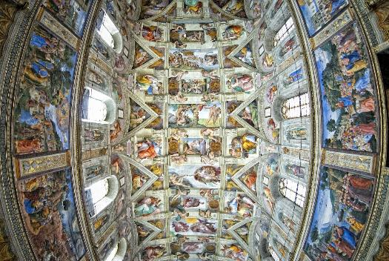
Vatican Museums
Within Vatican City, there is a complex of Christian art museums that display some of the most important collections of Roman sculptures and Renaissance-era masterpieces anywhere in the world. The works have been collected by popes throughout the centuries.
Explore the magnificent Sistine Chapel and more…
Boulogne Town Trail
Your animateur organises this activity with our tailor made Town Trail requiring the students to read, understand and speak French

Slide 5
Ancient sites
Experience Rome’s most famous landmark as well as impressive views from an ancient site
Step inside the Colosseum, which hosted epic gladiator battles for 50,000 Roman spectators
Examine the ruins of the Roman Forum
Stand upon Palatine Hill and enjoy the views over Rome
Boulogne Town Trail
Your animateur organises this activity with our tailor made Town Trail requiring the students to read, understand and speak French

Slide 6
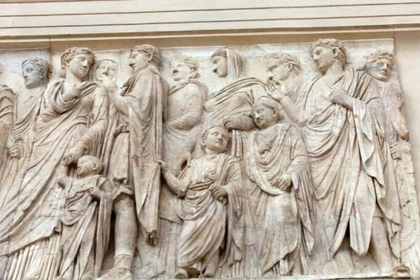
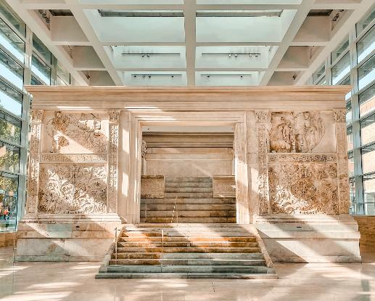
Ara Pacis
This museum houses an altar dedicated to the peace and prosperity brought by Augustus to Rome. The reliefs have representations of agriculture and animal sacrifices to signify piety.
Boulogne Town Trail
Your animateur organises this activity with our tailor made Town Trail requiring the students to read, understand and speak French

Slide 7
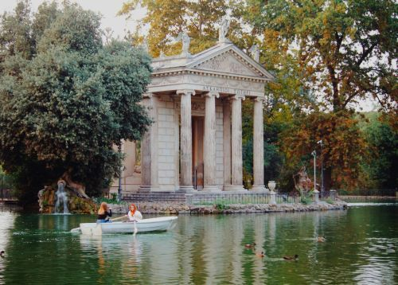
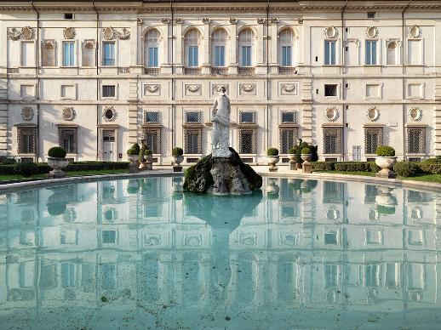
Villa Borghese
This large park is the perfect combination of nature and art, with architecture, sculptures and fountains as well as beautiful shady spaces for a break from the busier sites of Rome.
Boulogne Town Trail
Your animateur organises this activity with our tailor made Town Trail requiring the students to read, understand and speak French

Slide 8
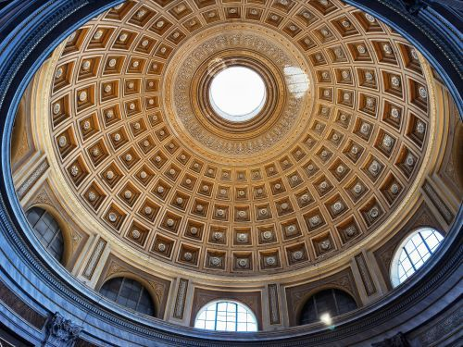
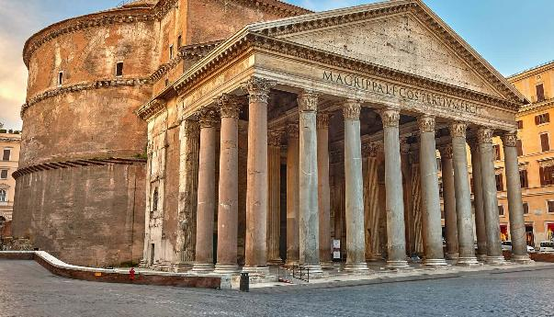
Pantheon
Built 2000 years ago, the stunning dome remains the world’s largest unreinforced concrete dome. It was built as a temple and converted to a Catholic church in the 7th century AD.
Boulogne Town Trail
Your animateur organises this activity with our tailor made Town Trail requiring the students to read, understand and speak French

Slide 9
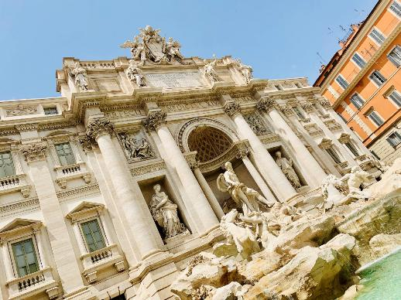
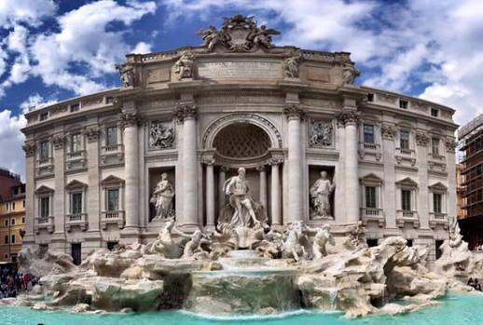
Trevi Fountain
The Fontana di Trevi or Trevi Fountain is the most famous and arguably the most beautiful fountain in all of Rome. This is definitely a spot that students will want to stop at for a photo opportunity!
Boulogne Town Trail
Your animateur organises this activity with our tailor made Town Trail requiring the students to read, understand and speak French

Slide 10
Return home
After a final breakfast at your hotel begin your journey home to the UK
Boulogne Town Trail
Your animateur organises this activity with our tailor made Town Trail requiring the students to read, understand and speak French

Slide 11


Slide 12
Rome is waiting for you!
Click here for more information about this trip!
Find us on

