Slide 1


Your trip to Normandy
School Name
DD–DD MM YYYY

Slide 2
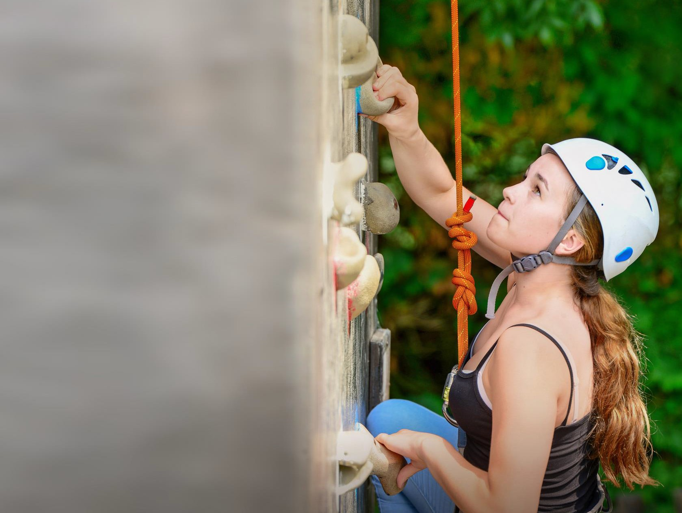
We help students reach new heights
Voyager School Travel specialises in educational school trips where students can learn, thrive and achieve their potential outside the classroom.
We believe that every school trip should provide students with new experiences, learning activities and exposure to local culture with genuine educational benefit.
Over 35,000 students travel with us each year

Slide 3





You’re in
safe hands
La Grand’Ferme is authorised to accommodate school groups by the French Ministry of Youth and Sport.
Our other Normandy centre, Château de la Baudonnière, is also accredited by the French Ministry of Education because we run language programmes for school groups from France.
All our animateurs hold UK-accredited instructor qualifications for climbing, fencing, archery, first aid and lifeguarding
More adventurous activities, such as kayaking, are supervised by professional sports instructors working beside our animateurs
ABTA member
Protected by ATOL & ABTOT
School Travel Forum (STF) member
Hold the Learning Outside the Classroom (LOtC) Quality Badge
AAIAC Adventuremark holder
Externally audited safety management systems
All accommodation audited
More about accreditation.

Slide 4
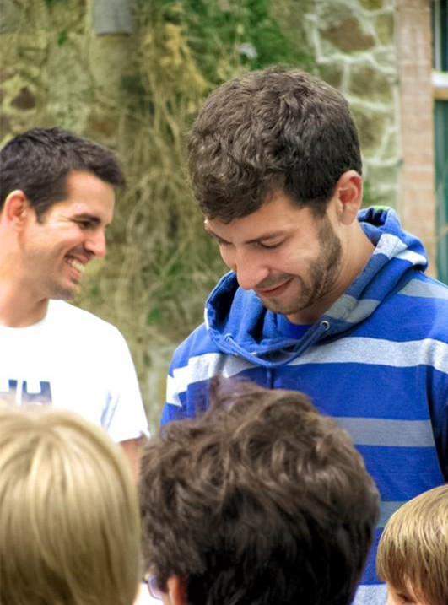
Meet your animateur
Upon your arrival you’ll meet your animateur!
Our specially trained French native animateurs will be speaking with and encouraging interactive responses from you throughout your stay to challenge you and improve your language skills

Slide 5
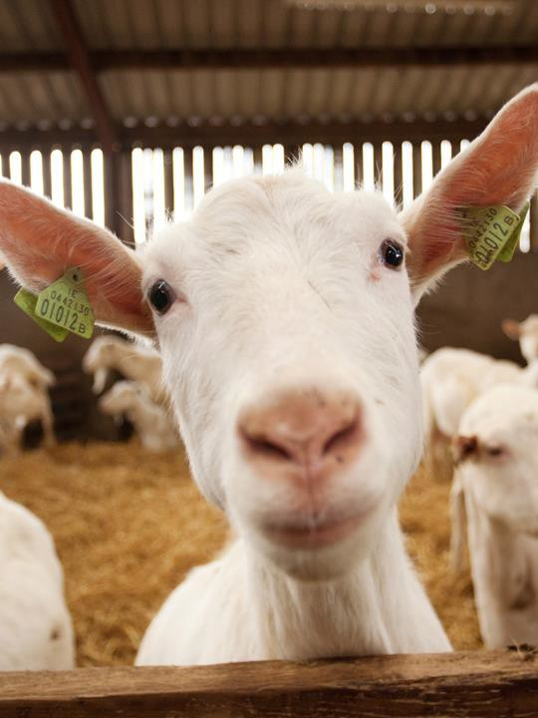
Goat cheese farm
An interactive visit of a local working goat farm and cheese producer (or similar alternative)
Includes the all important tasting of
the famous Normandy produce

Slide 6
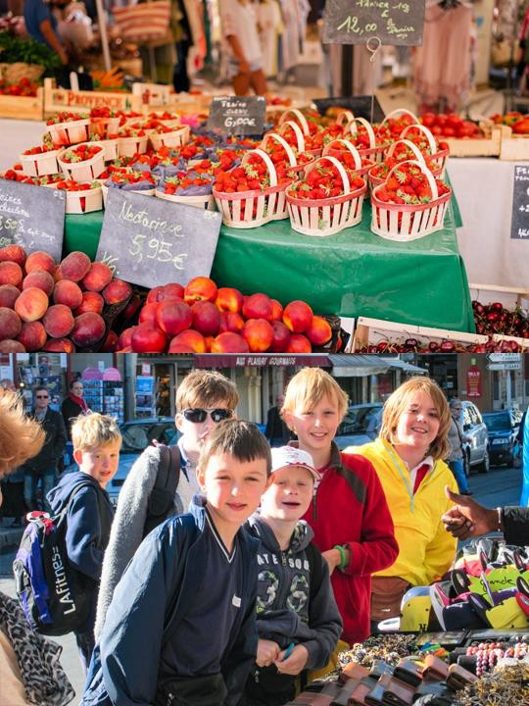
Market mission
Visit a local market with your animateur
Teams of students will be given money to buy ingredients for a packed lunch, and you will also have some general shopping time
Return to your accommodation where your animateur will organise a competition for the best lunch

Slide 7
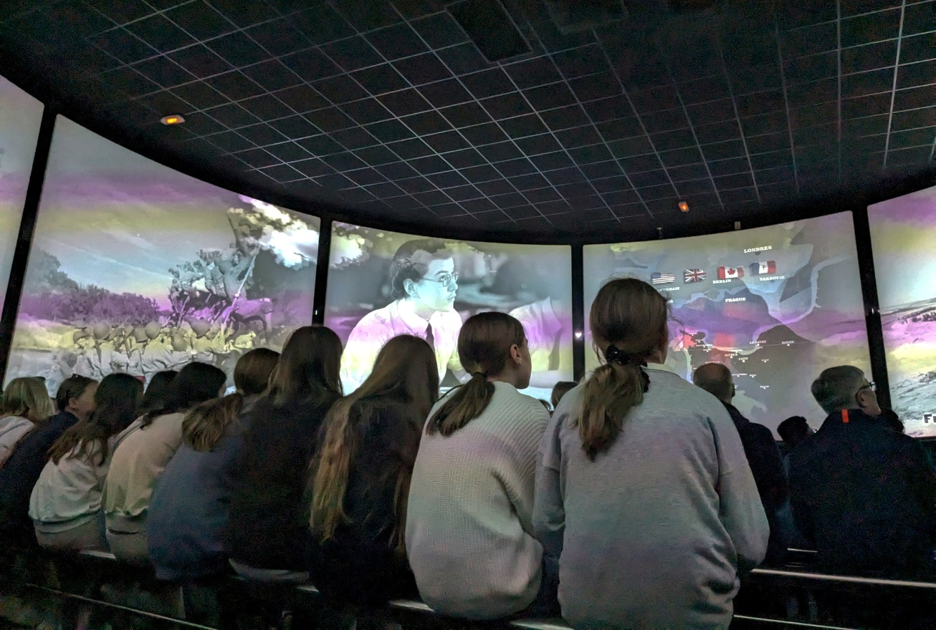
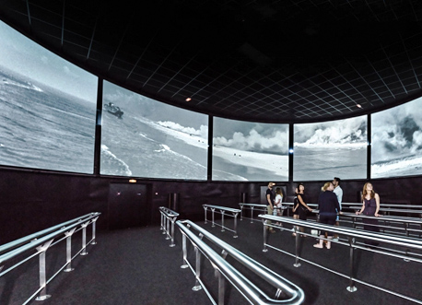
360° film at Arromanches Cinéma
Experience the 360° cinema in Arromanches, displaying brilliantly captured and informative footage from the war across multiple screens

Slide 8
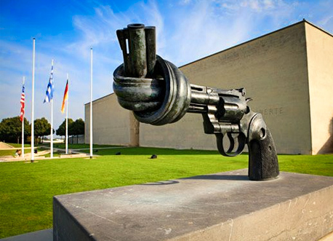
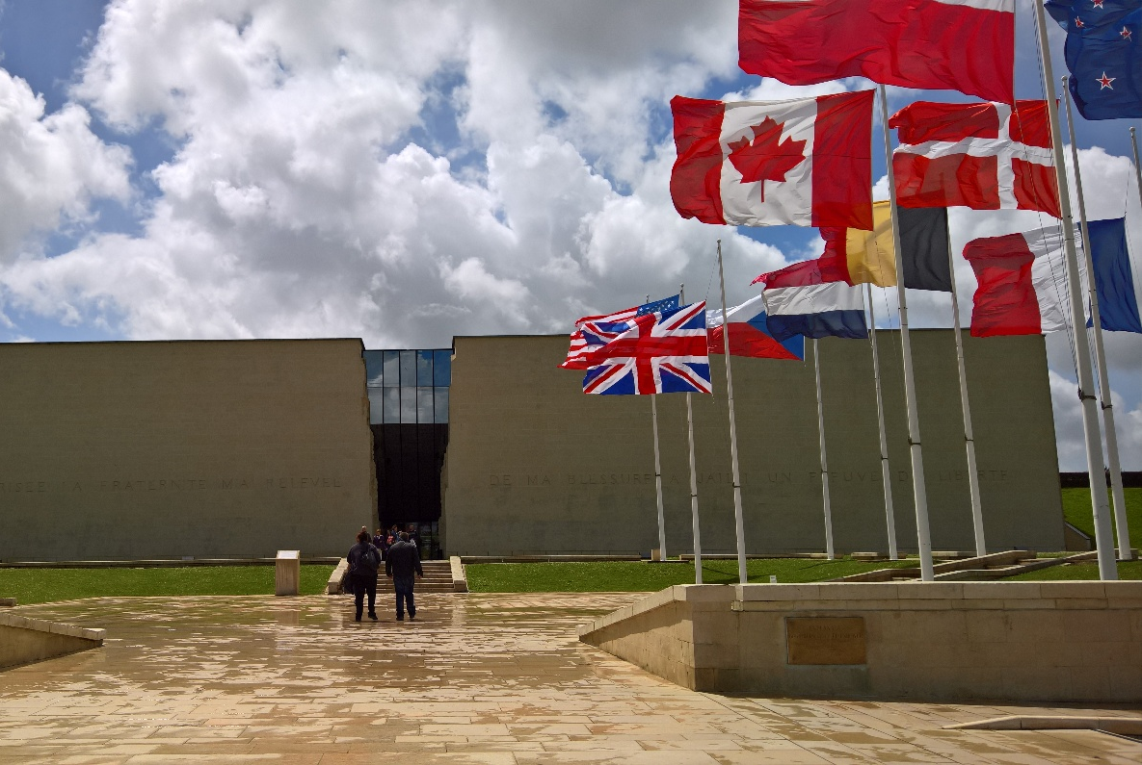
Caen Memorial Museum
With the mission of promoting peace, this emphasises the importance of learning from the atrocities of the Second World War and, in particular, the D-Day landings to prevent future conflicts. Expect an immersive experience featuring artefacts, films and interactive displays investigating the causes and consequences of WWII

Slide 9

Mont Saint- Michel
Mont Saint-Michel and its bay are part of the UNESCO list of World Heritage Sites and more than 3 million people visit it each year. Visit the Abbey, Monastery, Great Halls and shops and village housing
Outside the walls, there are fishermen and farmer houses

Slide 10
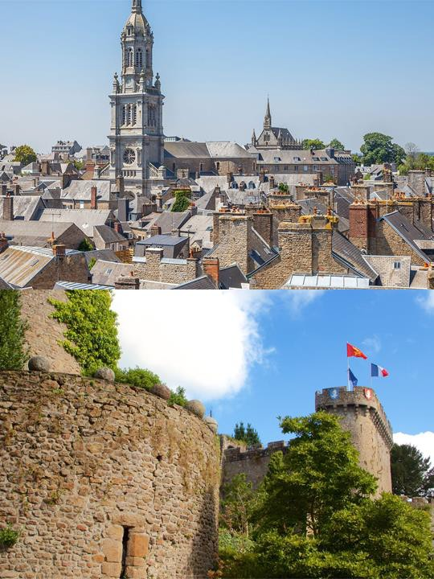
Avranches town trail
Your animateur organises this activity with our tailor made Town Trail requiring the students to read, understand and speak French

Slide 11
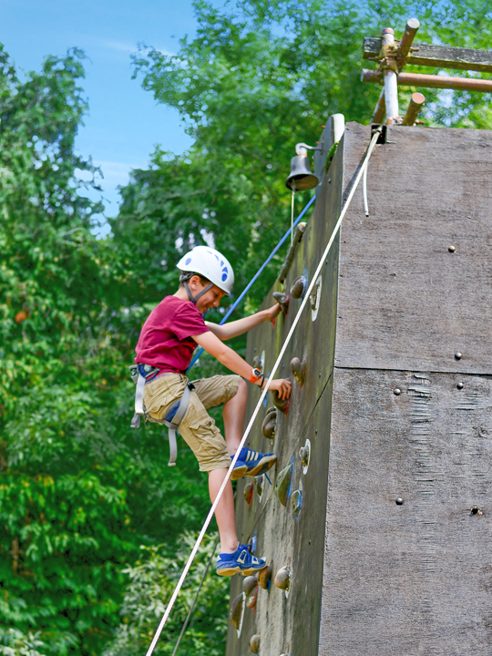
Day at the Château
Full day on-site at Château de la Baudonnière for a selection of fun-filled activities, such as fencing, climbing wall, bread making, French lessons, aeroball and archery.

Slide 12
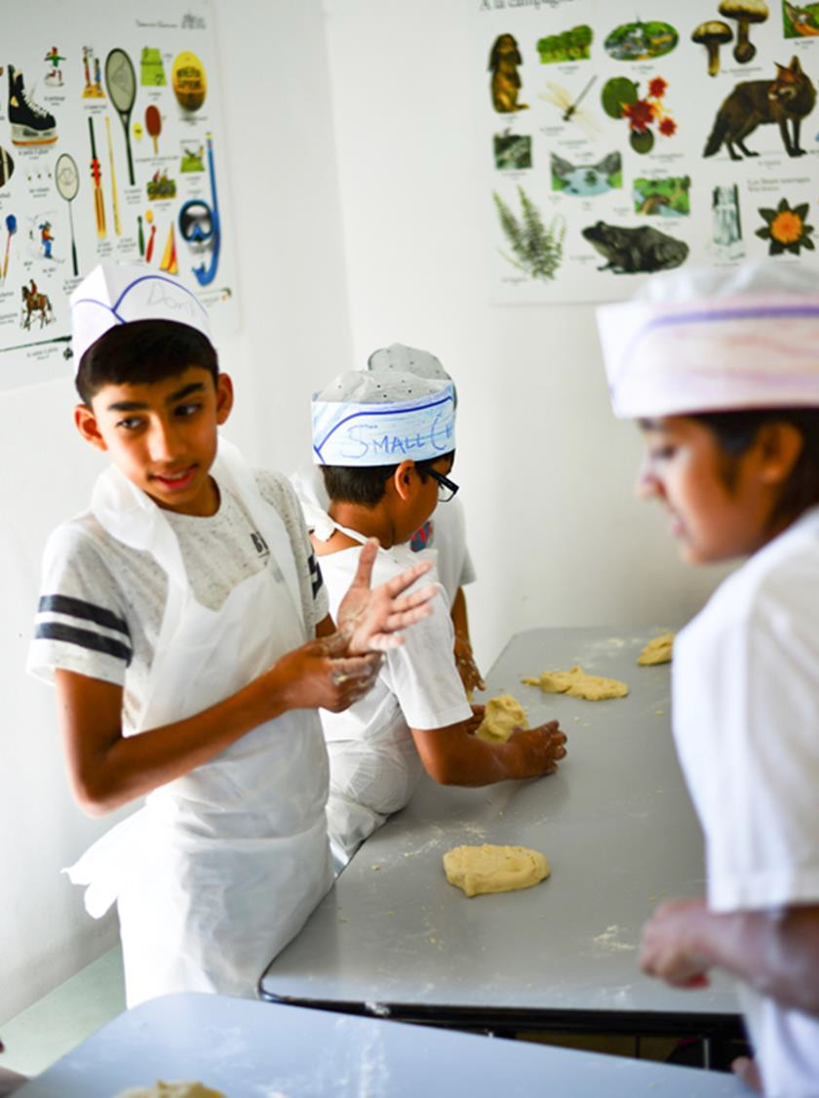
Bread making
Don your chef’s hat and unleash your inner baker.
During this activity you’ll learn vocabulary relating to weights and measurements as you follow the recipe. You’ll also enjoy a French singalong!
Try your best to follow the recipe because you’ll be enjoying the fruits of your labour later on.

Slide 13


Slide 14

Find us on
Click here for more information about the trip!

