Slide 1

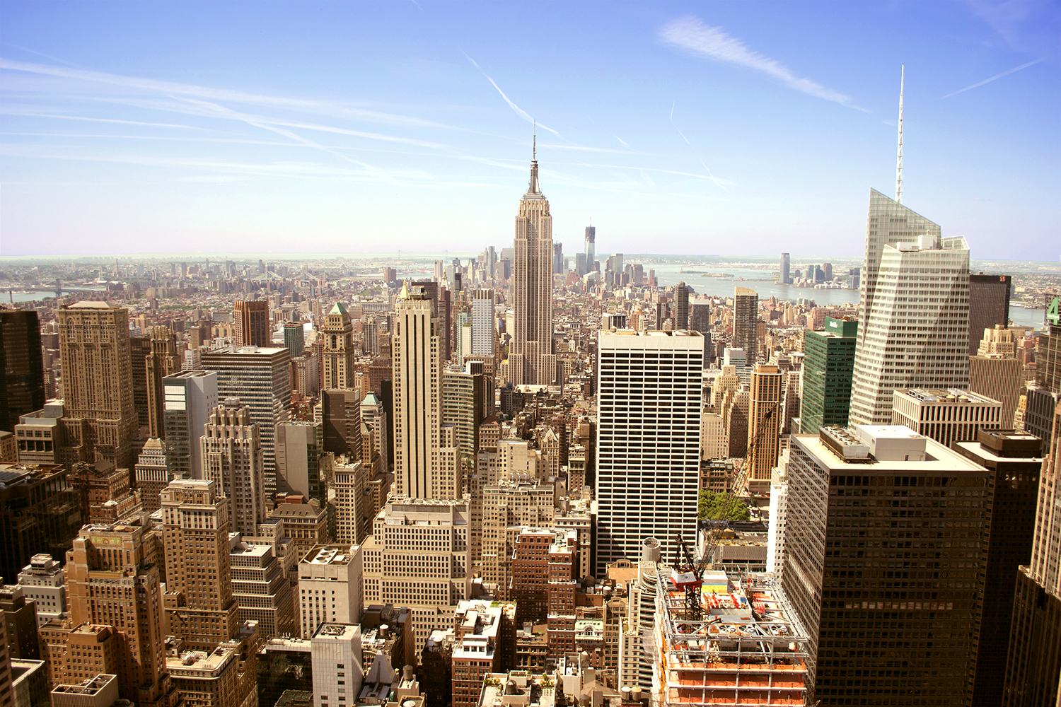
Your trip to New York
School Name
DD–DD MM YYYY

Slide 2
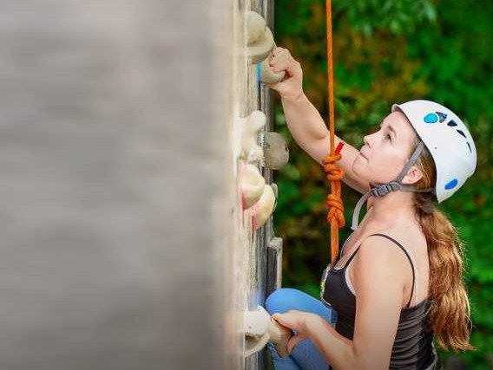
We help students reach new heights
Voyager School Travel specialises in educational school trips where students can learn, thrive and achieve their potential outside the classroom.
We believe that every school trip should provide students with new experiences, learning activities and exposure to local culture with genuine educational benefit.
Over 35,000 students travel with us each year.

Slide 3


You’re in
safe hands
Your child’s safety is our priority and
we ensure the highest standards are met.
ABTA member
Protected by ATOL & ABTOT
School Travel Forum (STF) member
Learning Outside the Classroom (LOtC) Quality Badge holder
AAIAC Adventuremark holder
Audited safety management system
All accommodation audited
More about accreditation.

Slide 4
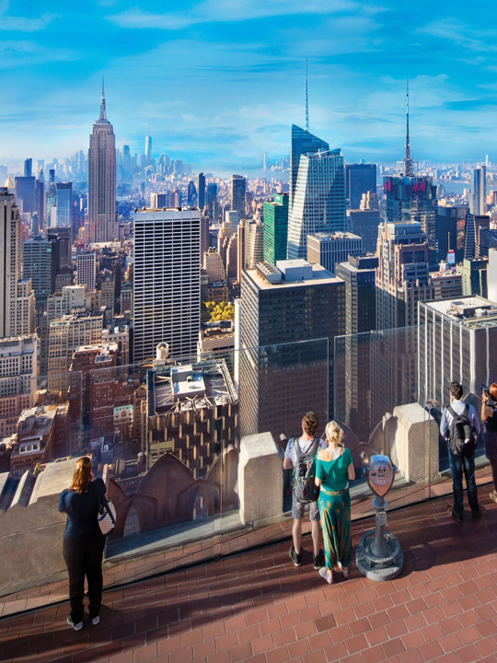
Top of the Rock
Visit the Top of the Rock observation deck atop the Rockefeller Centre for the quintessential view of New York City!
Gaze at Central Park, the Empire State Building, the Chrysler Building, the World Trade Centre and even the Statue of Liberty in the far distance.
Boulogne Town Trail
Your animateur organises this activity with our tailor made Town Trail requiring the students to read, understand and speak French

Slide 5
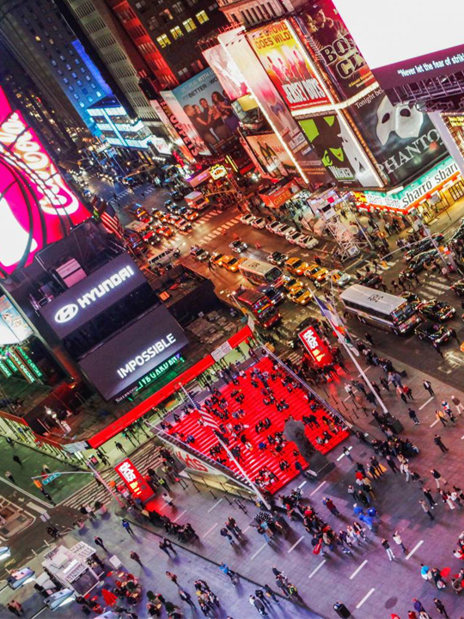
Times Square
Take some time to explore the world-famous major commercial intersection and hub of activity in Midtown Manhattan. With its giant lit up screens, shops and restaurants.
Boulogne Town Trail
Your animateur organises this activity with our tailor made Town Trail requiring the students to read, understand and speak French

Slide 6
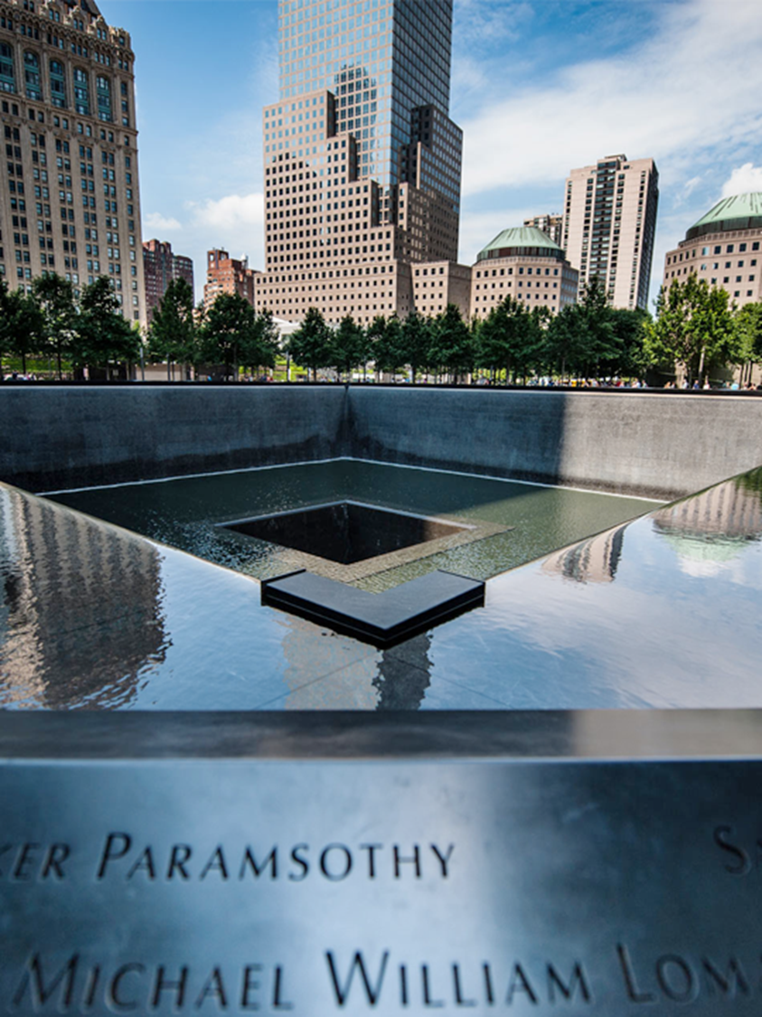
National September 11 Memorial
Boulogne Town Trail
Your animateur organises this activity with our tailor made Town Trail requiring the students to read, understand and speak French
Visit the moving national tribute of remembrance and honour to the nearly 3000 men and women who lost their lives in the 9/11 terror attacks which resulted in the collapse of the twin towers.
Infinity pools now stand in their massive footprint

Slide 7
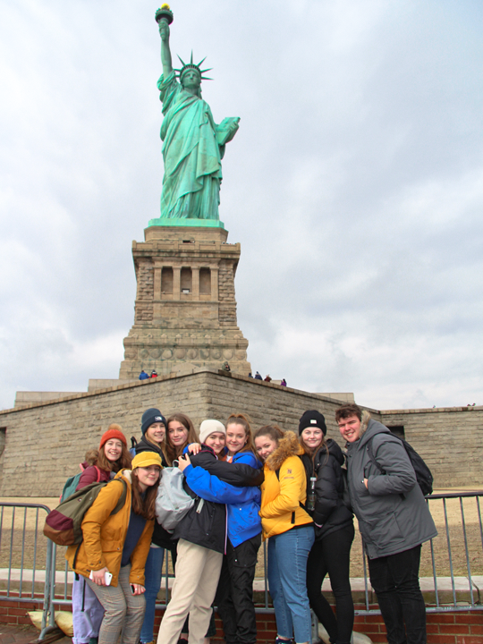
Statue of Liberty & Ellis Island tour
Boulogne Town Trail
Your animateur organises this activity with our tailor made Town Trail requiring the students to read, understand and speak French
Take a short ferry ride from Manhattan and visit one of New York's most iconic sites - the Statue of Liberty, located on historic Ellis Island and home to the Immigration Museum.

Slide 8
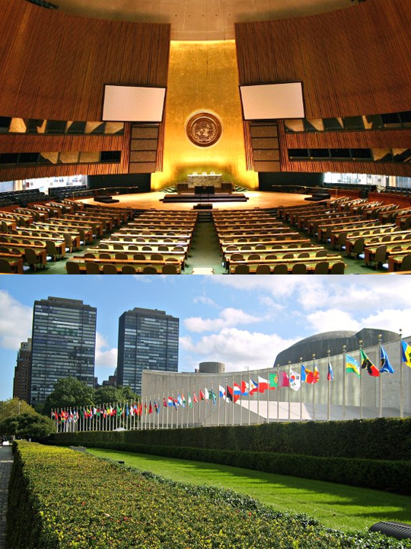
United Nations Tour
Take a guided tour of the United Nations headquarters and discover how the organisation operates, exploring its role in international diplomacy, peacekeeping and tackling global challenges.
Boulogne Town Trail
Your animateur organises this activity with our tailor made Town Trail requiring the students to read, understand and speak French

Slide 9
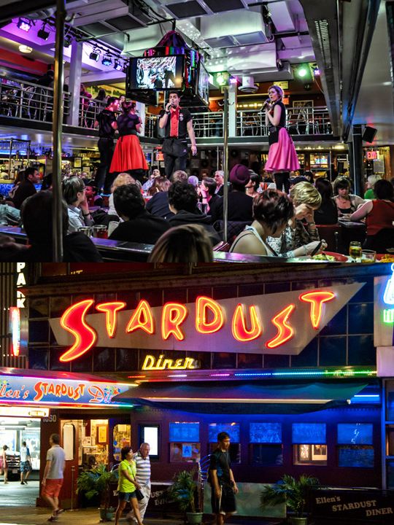
Ellen’s Stardust Diner
The home of the world famous singing waitresses and waiters and some of the best diner food in the country. Serving Breakfast, Lunch and Dinner for tour groups and locals alike since 1987!
Boulogne Town Trail
Your animateur organises this activity with our tailor made Town Trail requiring the students to read, understand and speak French

Slide 10
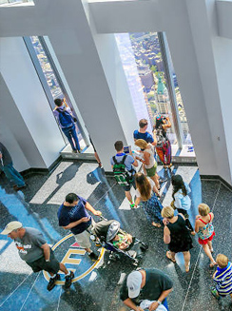
One World Observatory
Visit One World Observatory for spectacular 360° views across New York City from the top of One World Trade Center, one of the city’s most iconic skyscrapers.
Boulogne Town Trail
Your animateur organises this activity with our tailor made Town Trail requiring the students to read, understand and speak French

Slide 11
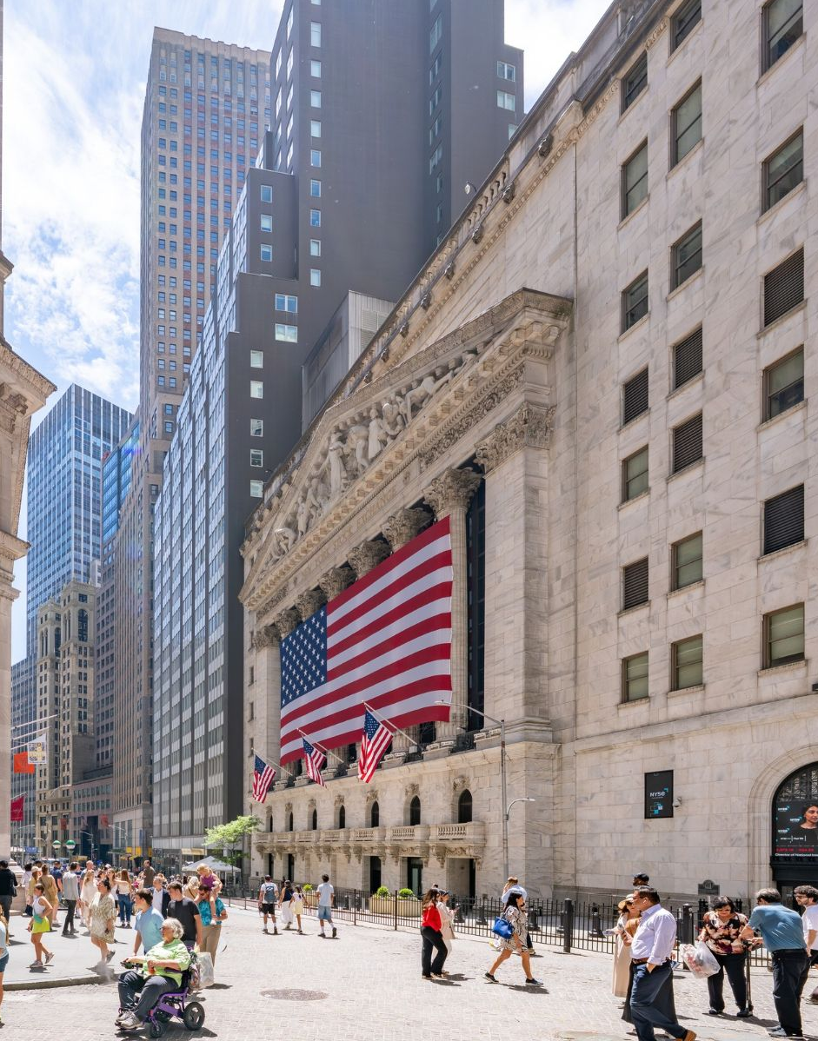
Wall Street Insider Tour
Go behind the scenes on the Wall Street Insider Tour and discover the history of American finance, exploring how financial markets operate and Wall Street’s influence on the global economy.
Boulogne Town Trail
Your animateur organises this activity with our tailor made Town Trail requiring the students to read, understand and speak French

Slide 12

Federal Reserve
Discover the role of the Federal Reserve System in the US economy and monetary policy, with a guided tour and visit to the gold vault.
Boulogne Town Trail
Your animateur organises this activity with our tailor made Town Trail requiring the students to read, understand and speak French

Slide 13
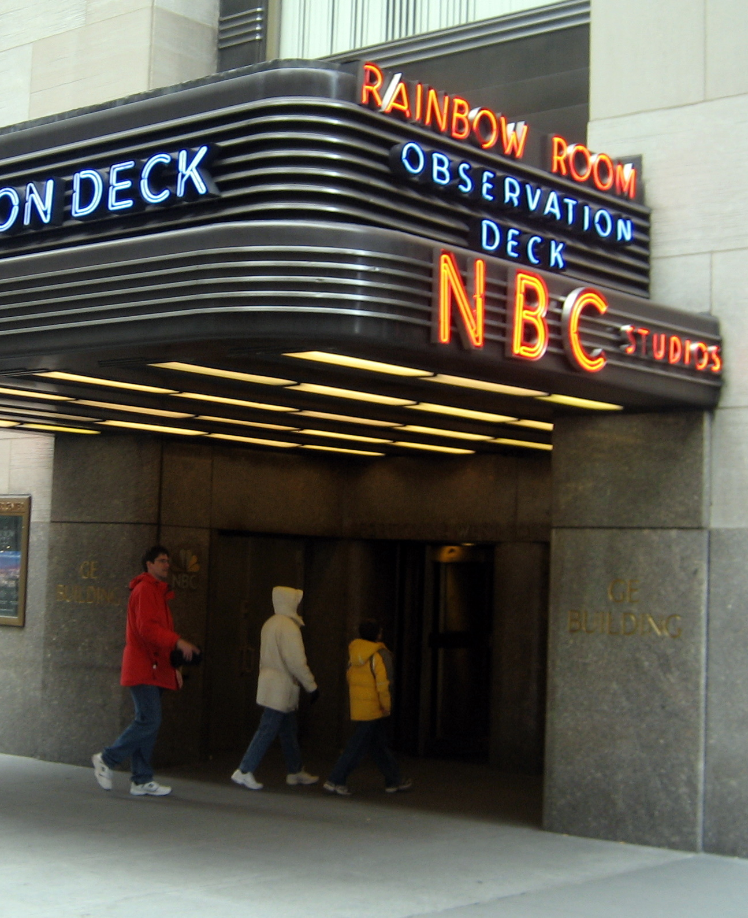
NBC Studio Tour
Go behind the scenes and discover how television programmes are made, exploring the production process from filming and editing to broadcasting, while learning about the technology and teams that bring shows to life.
Boulogne Town Trail
Your animateur organises this activity with our tailor made Town Trail requiring the students to read, understand and speak French

Slide 14
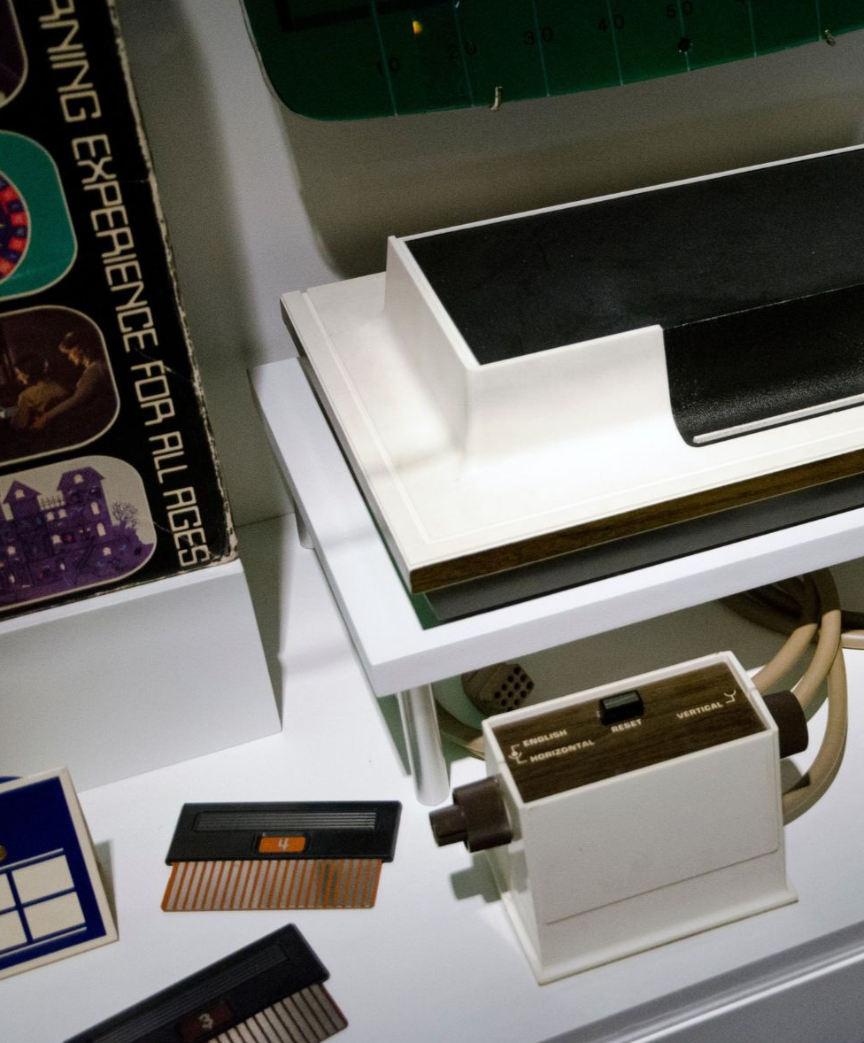
Museum of the Moving Image (MoMI)
Boulogne Town Trail
Your animateur organises this activity with our tailor made Town Trail requiring the students to read, understand and speak French
Discover the history and creative process behind film, television and digital media, exploring the technology and techniques that bring moving images to life.

Slide 15
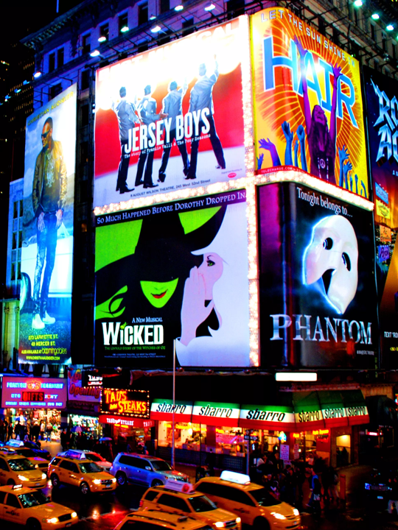
Broadway Show
The street and district famed for theatre, musicals and glamour, Broadway is the heart of performance in New York.
This is your opportunity to experience a live show!
Boulogne Town Trail
Your animateur organises this activity with our tailor made Town Trail requiring the students to read, understand and speak French

Slide 16
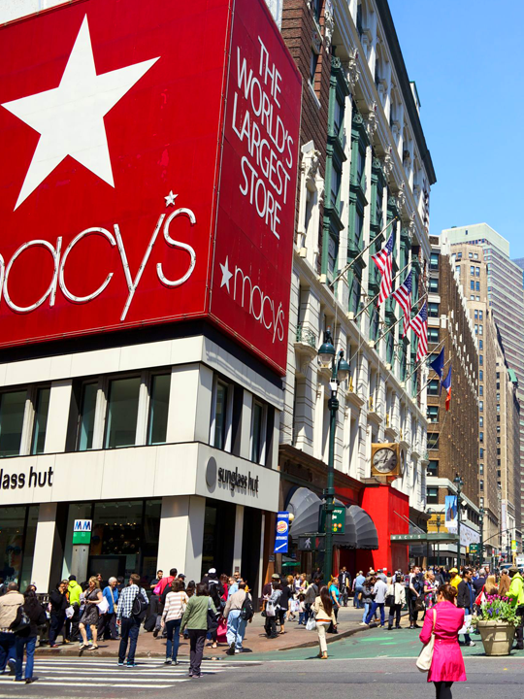
Macy’s Guided Tour
Sitting on Broadway between 34th and 35th streets, Macy's flagship store is a spot for tourists and residents alike. Covering an entire city block, the massive New York landmark is a must-see NYC attraction. You’ll have free time for shopping.
Boulogne Town Trail
Your animateur organises this activity with our tailor made Town Trail requiring the students to read, understand and speak French

Slide 17
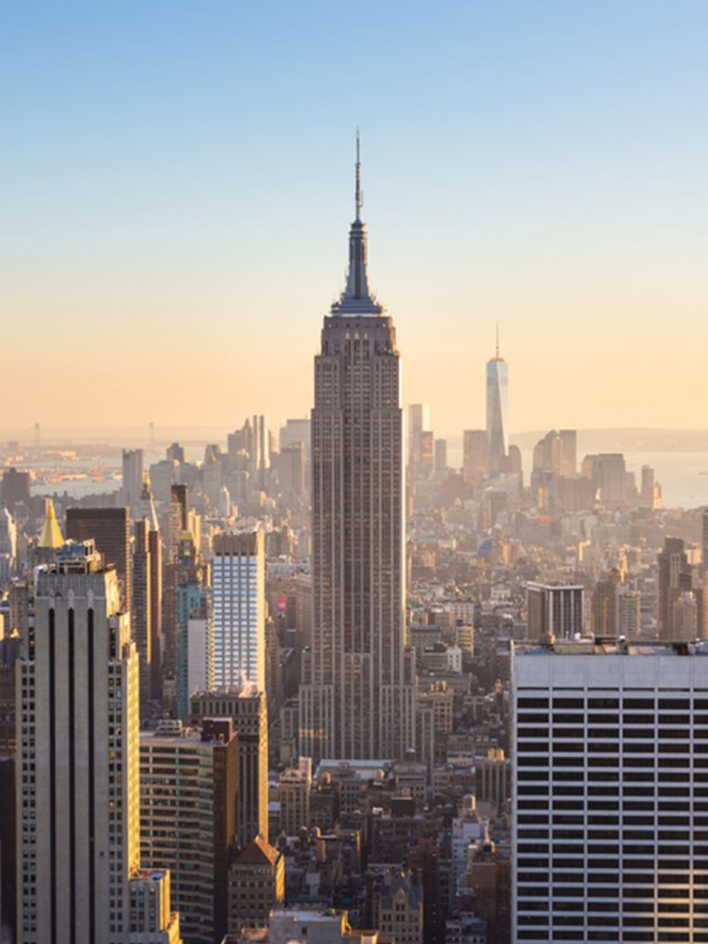
Empire State Building
Travel 102 stories up the Art Deco skyscraper. Learn the history of the building from its construction through to its place in modern-day New York.
Scatter to the observation decks on the 86th and 102nd floors for stunning panoramic views of the city below.
Boulogne Town Trail
Your animateur organises this activity with our tailor made Town Trail requiring the students to read, understand and speak French

Slide 18
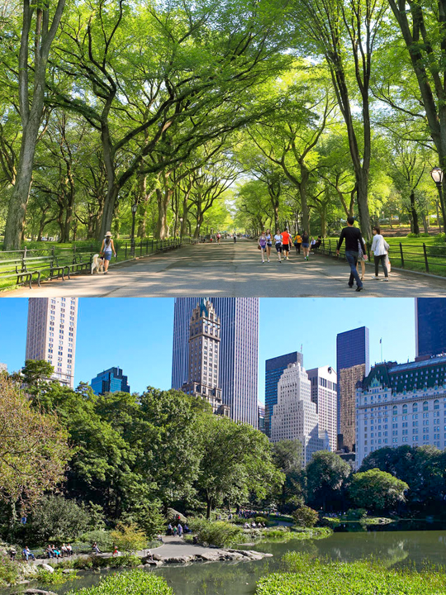
Central Park
Explore Manhattan’s largest urban park, which is nearly 6 times the size of Monaco and has been featured in over 350 films through the years.
Boulogne Town Trail
Your animateur organises this activity with our tailor made Town Trail requiring the students to read, understand and speak French

Slide 19

Click here for more information about the trip!
Find us on

