Slide 1


Your trip to Madrid
School
Date

Slide 2
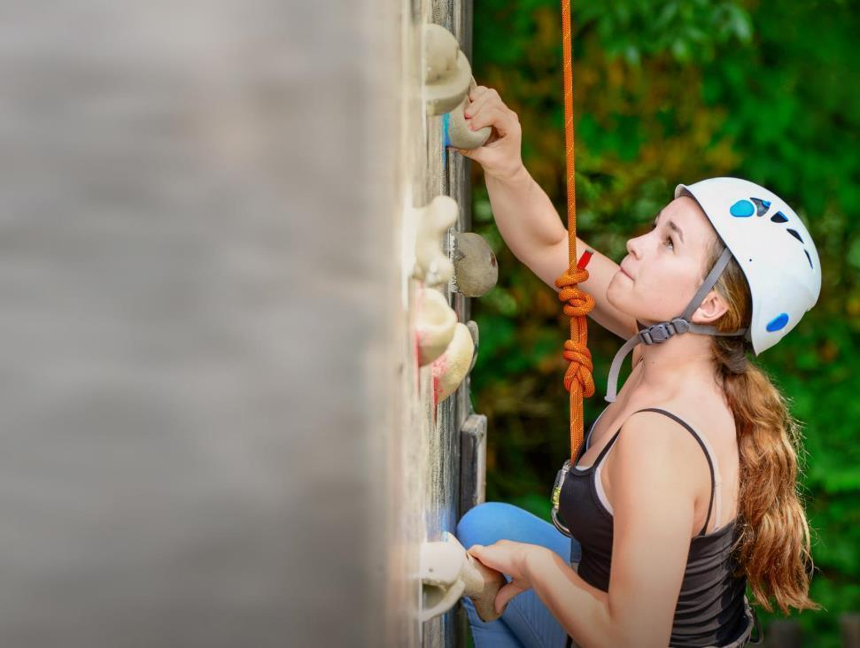
We help students reach new heights
Voyager School Travel specialises in educational school trips where students can learn, thrive and achieve their potential outside the classroom.
We believe that every school trip should provide students with new experiences, learning activities and exposure to local culture with genuine educational benefit.
Over 35,000 students travel with us each year

Slide 3


You’re in safe hands
Your child’s safety is our priority and we ensure the highest standards are met.
ABTA bonded
ATOL protected
School Travel Forum (STF) member
Learning Outside the Classroom (LOtC) Quality Badge holder
AAIAC Adventuremark holder
Audited safety management system
All accommodation audited
More about accreditation.

Slide 4

ACCOMMODATION
Hostel
Aguilar
Hostel Aguilar, is conveniently centrally located, close to Prado Museum and Plaza Mayor
All rooms feature air conditioning, TVs and there is free wifi in common areas
Address:
Carrera de San Jerónimo 32
2nd floor
Madrid, Spain

Slide 5
El Retiro
Park
The Buen Retiro public park is a beautiful gem amongst the urban landscape of Madrid. Its centrepiece is a huge monument and manmade lake, where students can rent a rowboat and soak up the Spanish sun!

Slide 6
El Rastro Market
If you're going to be in Madrid over a Sunday or public holiday, be sure to head down to Plaza de Cascorro to explore El Rastro, Spain's biggest flea market!
Soak up the local Spanish buzz and even hunt for some treasures yourself

Slide 7
Santiago Bernabéu Stadium tour
Set off on a self-guided tour of the Real Madrid home stadium
You can explore areas including the dressing rooms and there are also interactive exhibits to learn more about the club. Sure to be a hit for the football fans among your students!

Slide 8
Puerta
del Sol
If you want to get a feel of the hustle and bustle of Madrid, head to this large public square
It is one of the busiest places in the city for tourists and locals alike
There's a handful of statues and monuments to check out and also plenty of places to grab a snack or a drink

Slide 9
Plaza
Mayor
A hotspot for visitors, the main square is lined with souvenir shops, boutiques, bars, cafes and restaurants and is definitely worth a visit
You may also catch some live music from street performers while you're there!

Slide 10
Prado National Museum
The Prado National Museum boasts one of the largest collections of art in the world!
The collection mainly consists of historic religious and royal works but also includes artwork from Spanish masters Goya and Velázquez

Slide 11
Reina Sofía National Art Centre Museum
The home of 20th-century art, this museum features a mesmerizing collection, including paintings by Spanish-nationals such as Dalí and Picasso
You'll definitely want to get a look at the most impressive piece in the collection—Picasso's massive Guernica

Slide 12
San Fernando Royal Academy of Fine Arts
With a really interesting history as an academy for the arts, today the building is a museum housing a vast collection of artwork and sculpture
Amongst the most prominent features of the collection are 13 paintings by the master Spanish painter Goya

Slide 13


Slide 14
Spain is waiting for you!
Click here for more information about this trip!
Find us on

