Slide 1

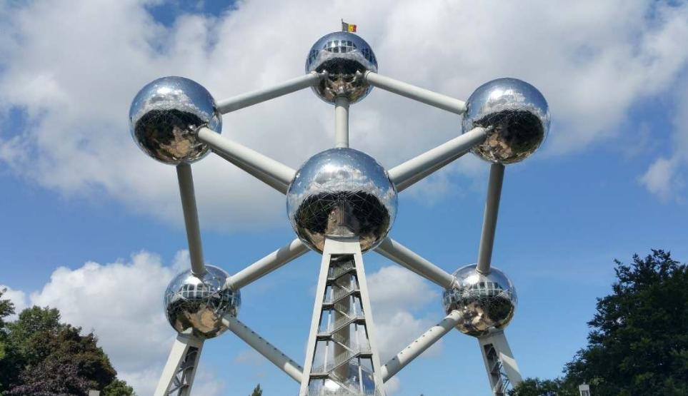
Your trip to Brussels
School
Date

Slide 2
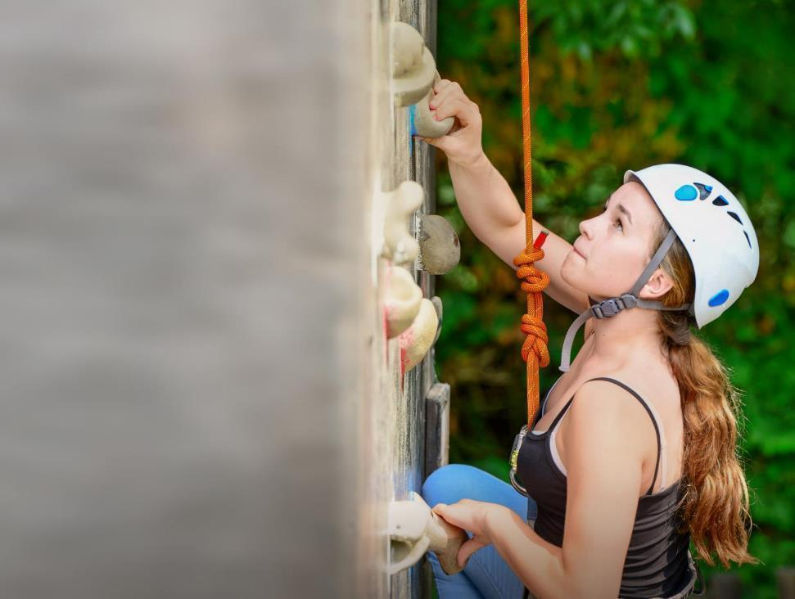
We help students reach new heights
Voyager School Travel specialises in educational school trips where students can learn, thrive and achieve their potential outside the classroom.
We believe that every school trip should provide students with new experiences, learning activities and exposure to local culture with genuine educational benefit.
Over 36,000 students travel with us each year

Slide 3


You’re in safe hands
Your child’s safety is our priority and we ensure the highest standards are met.
ABTA bonded
ATOL protected
School Travel Forum (STF) member
Learning Outside the Classroom (LOtC) Quality Badge holder
AAIAC Adventuremark holder
Audited safety management system
All accommodation audited
More about accreditation.

Slide 4
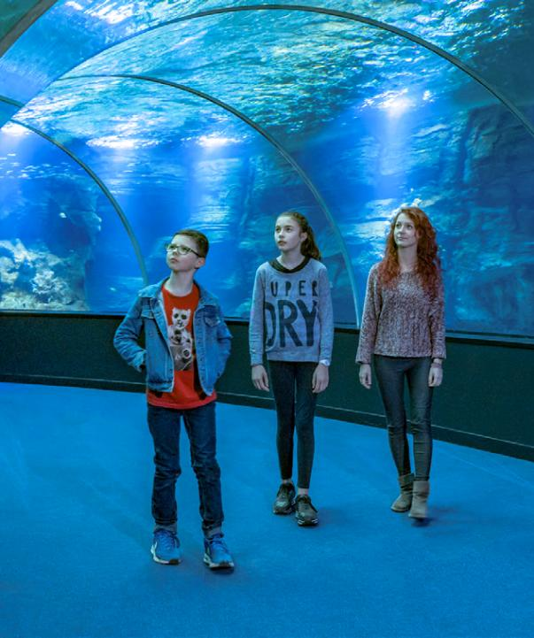
Nausicaá National Sea Centre
The largest marine life centre in Europe is home to 1,600 species and promotes sustainability and marine management. This is a fun and educational cross-curricular visit for groups.

Slide 5
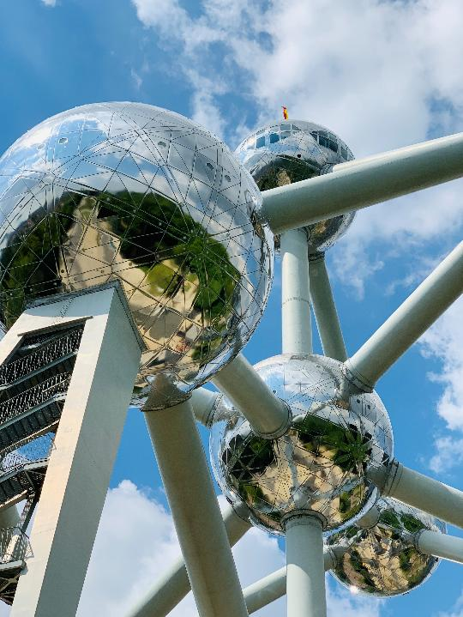
The Atomium
The Atomium is an iconic landmark built for the 1958 World Expo, designed to represent an iron crystal magnified 165 billion times.
Explore its futuristic spheres connected by tunnels, see exhibitions on science and design, and take in panoramic views of the city from the top.

Slide 6
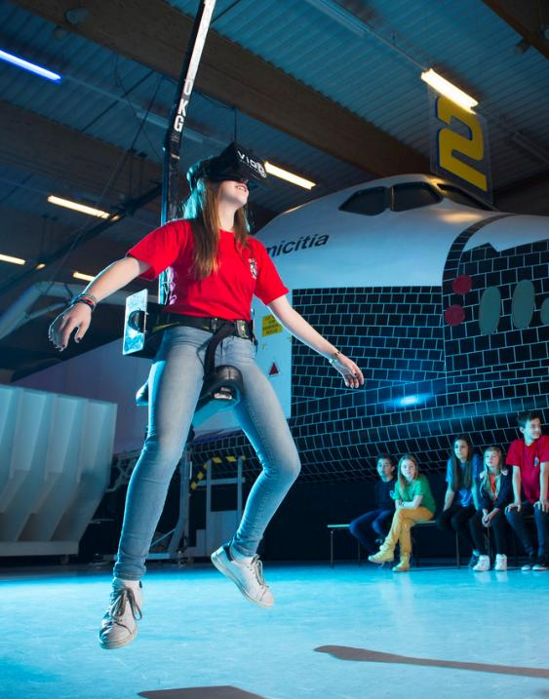
Euro Space Centre
The Euro Space Centre is an interactive science and space park where students can learn about astronomy, space travel, and astronaut training.
The centre includes simulators of space flight and micro-gravity and is home to the only full-scale mock-up of the US Space Shuttle existing in Europe.

Slide 7
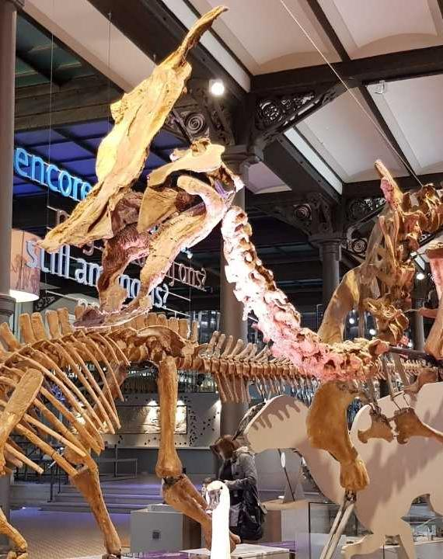
Royal Belgian Institute of Natural Sciences
The Institute of Natural Sciences is home to one of the largest dinosaur galleries in Europe, featuring impressive skeletons alongside exhibits on evolution, biodiversity, and the natural world.

Slide 8
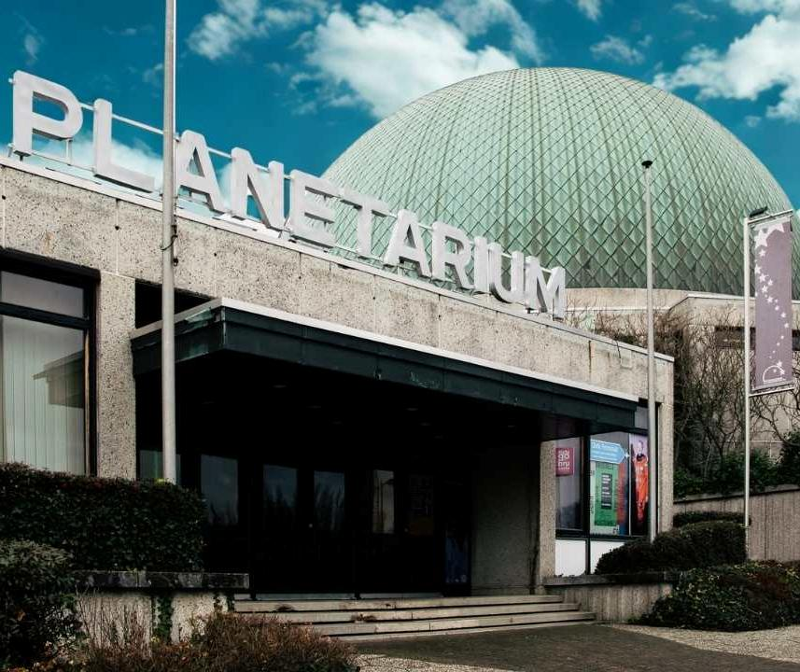
Brussels Planetarium
The Brussels Planetarium is one of Europe’s leading planetariums, featuring a 23-meter overhead dome displaying vividly realistic projections of planets, stars, and galaxies, immersing students in the wonders of the universe.

Slide 9
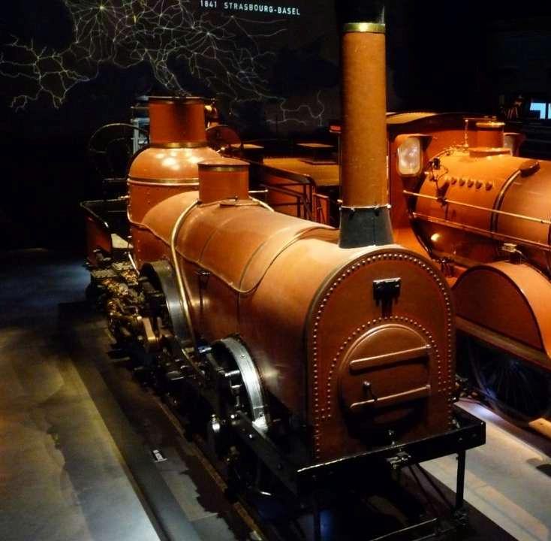
Train World
Discover the best of Belgium’s trains from the past, present, and future. Explore beautifully restored locomotives, interactive exhibits, and unique collections that highlight the country’s rich railway heritage and its role in shaping modern travel.
You can even climb aboard a train over 100 years old and experience what it's like to drive one!

Slide 10
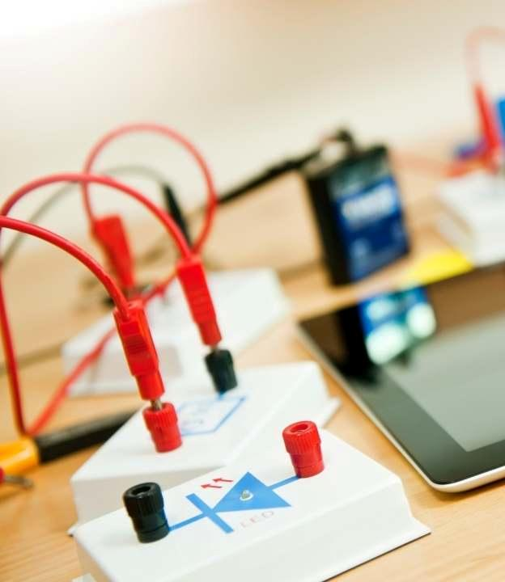
ULB Physics Experimentarium
The ULB Physics Experimentarium is a science museum where students can engage with hands-on experiments that make physics concepts fun and easy to understand. Installations and guided activities help bring topics like optics, electricity, and mechanics to life.

Slide 11
Belgium is waiting for you!
Click here for more information about this trip!
Find us on

