Slide 1

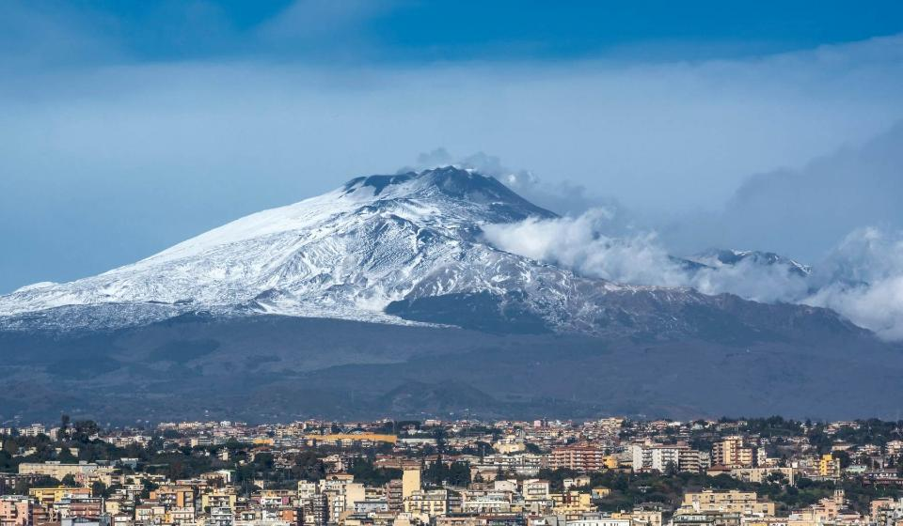
Your trip to Sicily
School Name
DD–DD MM YYYY

Slide 2
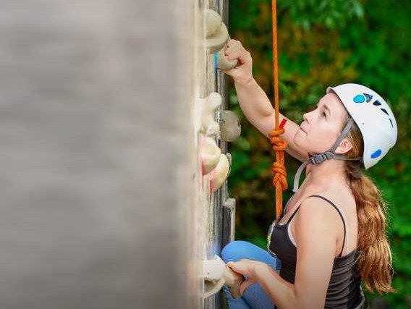
We help students reach new heights
Voyager School Travel specialises in educational school trips where students can learn, thrive and achieve their potential outside the classroom.
We believe that every school trip should provide students with new experiences, learning activities and exposure to local culture with genuine educational benefit.
Over 35,000 students travel with us each year

Slide 3



You’re in
safe hands
Your child’s safety is our priority and
we ensure the highest standards are met.
ABTA member
ATOL and ABTOT financial protected
School Travel Forum (STF) member
Learning Outside the Classroom (LOtC) Quality Badge holder
AAIAC Adventuremark holder
Audited safety management system
All accommodation audited
More about accreditation.

Slide 4
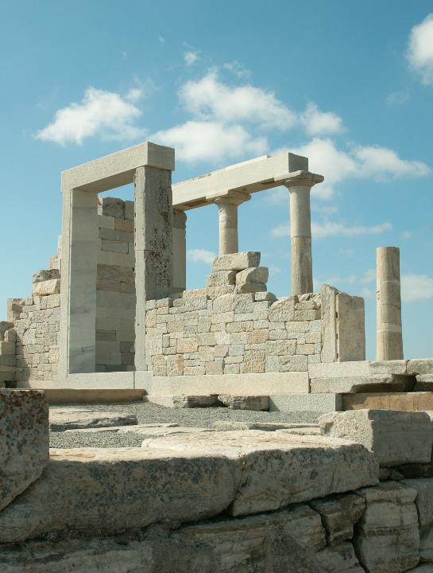
The Archaeological Park of Naxos
Your first stop will take you to the Archaeological Park of Naxos, which stands on the site of the first Greek colony in Sicily, founded in 735 BC. Students can explore the remains of the ancient settlement and defensive walls, before discovering artefacts from the excavations at the nearby museum.
Boulogne Town Trail
Your animateur organises this activity with our tailor made Town Trail requiring the students to read, understand and speak French

Slide 5
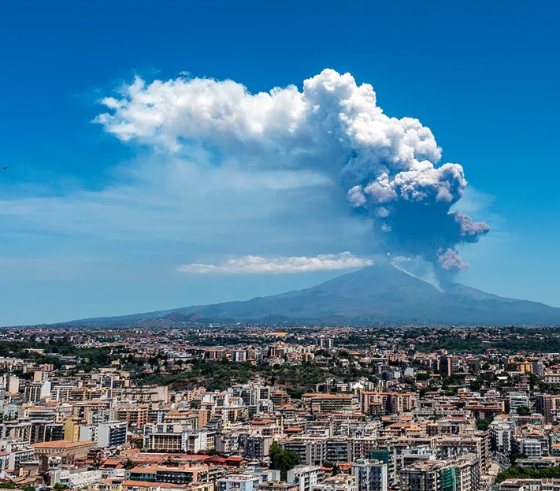

Mount Etna
Mount Etna is Europe’s highest active volcano and a highlight for students! Led by a specialist guide, walk up the mountain and explore the Silvestri Craters below, where you can find active craters and lava flows to observe how volcanic activity shapes the landscape.

Slide 6
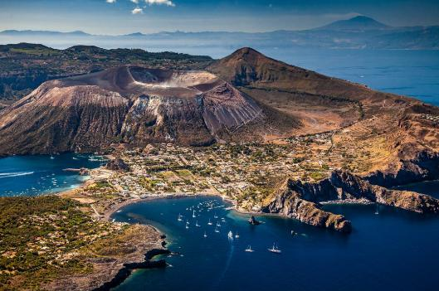

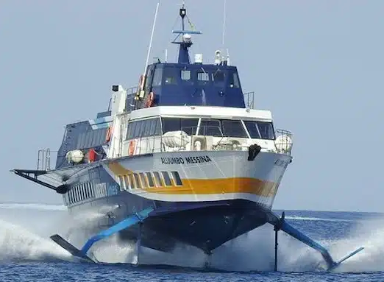
Vulcano Island
Travel by hydrofoil to Vulcano Island and take a guided trek up Gran Cratere, which allows students to observe active sulfur vents and steam clouds. This visit is a once in a lifetime experience, offering insight into volcanic processes and the island’s unique landscape.
Boulogne Town Trail
Your animateur organises this activity with our tailor made Town Trail requiring the students to read, understand and speak French

Slide 7
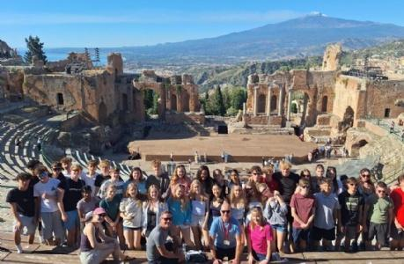
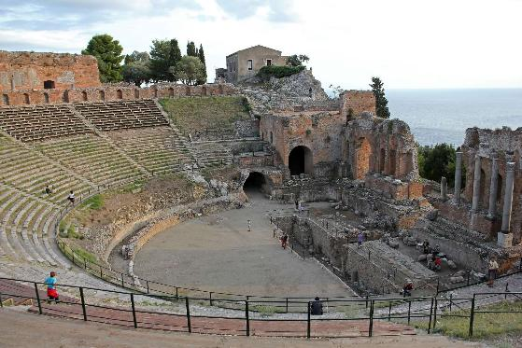
Taomina
Explore the historic town of Taormina and visit its ancient Greek Theatre, one of Sicily’s most famous historic sites. This impressive amphitheatre offers a glimpse into classical history with an incredible view of Mount Etna.
Boulogne Town Trail
Your animateur organises this activity with our tailor made Town Trail requiring the students to read, understand and speak French

Slide 8
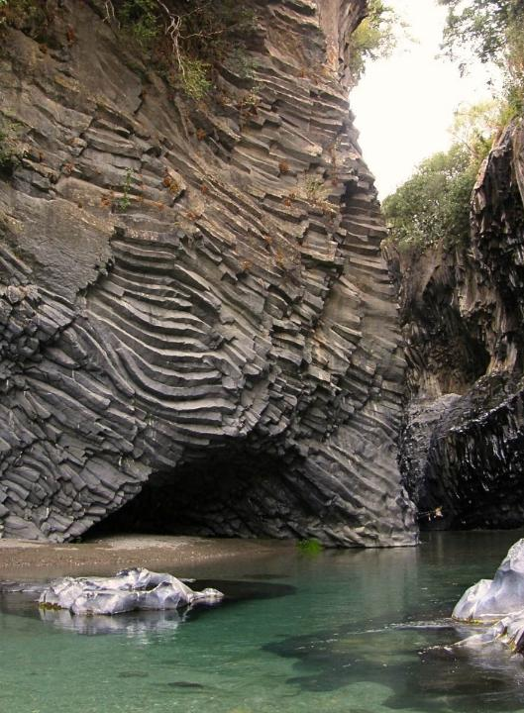
Alcantara Gorge
Alcantara Gorge is a 50-meter-high striking natural formation carved by Mount Etna’s ancient eruptions. Students will take a guided tour of the impressive basalt lava walls and learn about geological processes and the origins of the canyon.
Boulogne Town Trail
Your animateur organises this activity with our tailor made Town Trail requiring the students to read, understand and speak French

Slide 9
Sicily is waiting for you!
Click here for more information about the trip!
Find us on

