Slide 1
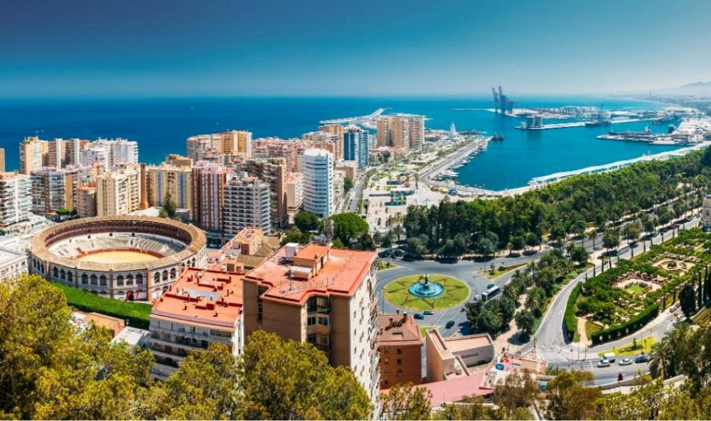
Your trip to Málaga
School
Date

Slide 2
We help students reach new heights
Voyager School Travel specialises in educational school trips where students can learn, thrive and achieve their potential outside the classroom.
We believe that every school trip should provide students with new experiences, learning activities and exposure to local culture with genuine educational benefit.
Over 36,000 students travel with us each year

Slide 3
You’re in safe hands
Your child’s safety is our priority and we ensure the highest standards are met.
ABTA member
Protected by ATOL & ABTOT
School Travel Forum (STF) member
Learning Outside the Classroom (LOtC) Quality Badge holder
AAIAC Adventuremark holder
Audited safety management system
All accommodation audited
More about accreditation.

Slide 4
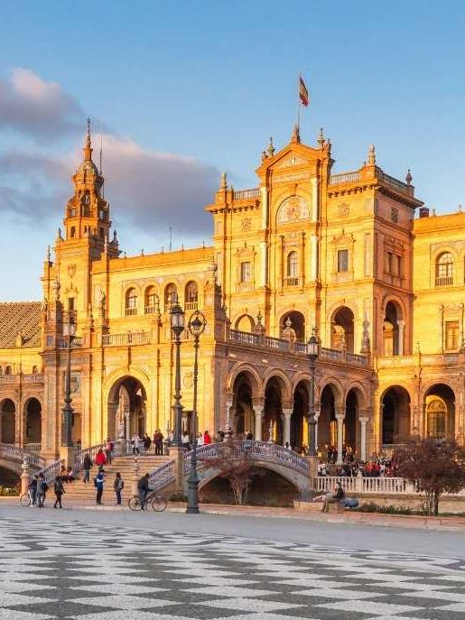
Seville guided walking tour
Enjoy a full-day guided walking tour of Seville, uncovering its rich history, striking architecture, and vibrant atmosphere as you explore landmarks like the Gothic cathedral, historic streets, and lively plazas with insights from a local expert.

Slide 5
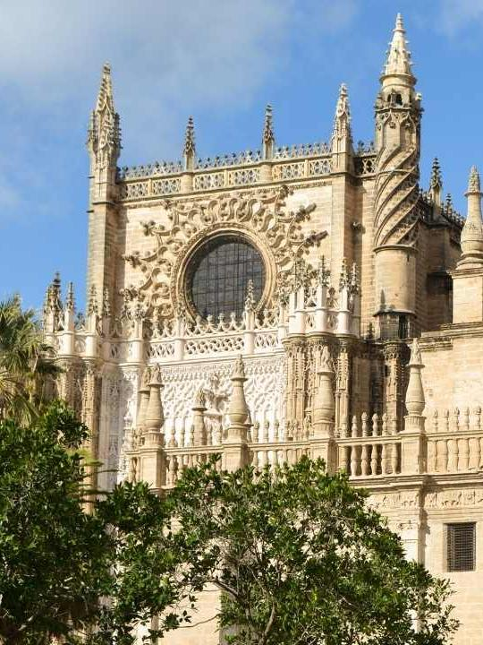
Seville Cathedral
Seville Cathedral is a stunning Gothic landmark and one of the largest cathedrals in the world. Designated a UNESCO World Heritage Site in 1987, it houses Christopher Columbus’s tomb and the iconic Giralda bell tower.

Slide 6
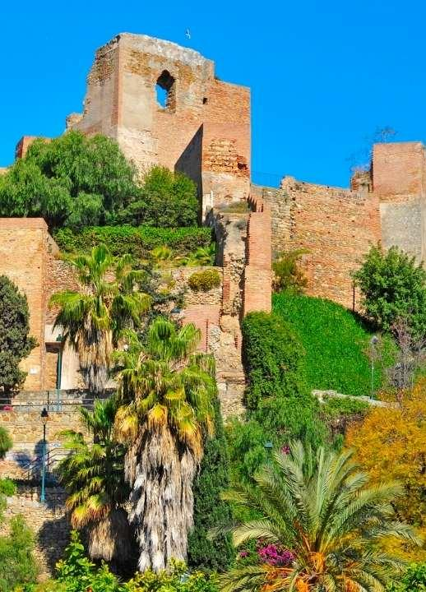
The Alcazaba of Málaga
The Alcazaba of Málaga is a beautiful palatial fortification built in the 11th century. Situated on a hillside overlooking the city, this well-preserved monument showcases Islamic military architecture, featuring lush gardens, ornate courtyards, and panoramic views of Málaga.

Slide 7
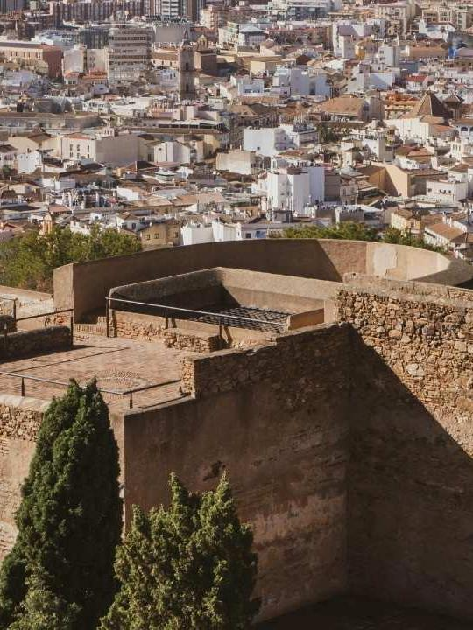
Gibralfaro Castle
Gibralfaro Castle is a historic hilltop fortress in Málaga, built in the 14th century to protect the Alcazaba below.
Dominating the city from its 132 m perch, its double walls and eight towers offer panoramic views of the port, cathedral, and the Mediterranean sea.

Slide 8
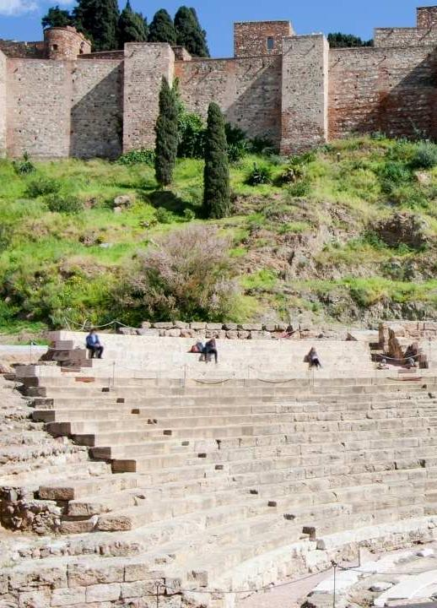
The Roman Theatre
Málaga's Roman Theatre is a 1st-century amphitheatre built into the hillside below the Alcazaba. Hidden for centuries until its rediscovery in 1951, it features three tiers of stone seating, a marble-clad orchestra, and a reconstructed wooden stage.

Slide 9
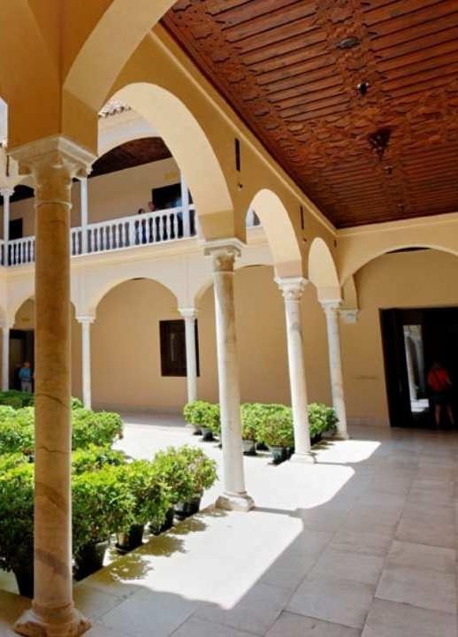
The Picasso Museum
The Picasso Museum is located in the elegant Buenavista Palace, a sixteenth‑century Andalusian palace in Málaga’s historic center.
It houses over 230 works gifted by Picasso’s family, spanning eight decades of his art, paintings, sculptures, ceramics, and drawings, providing an immersive experience into Picasso’s legacy right in his birthplace.

Slide 11
Málaga is waiting for you!
Click here for more information about this trip!
Find us on

