Slide 1

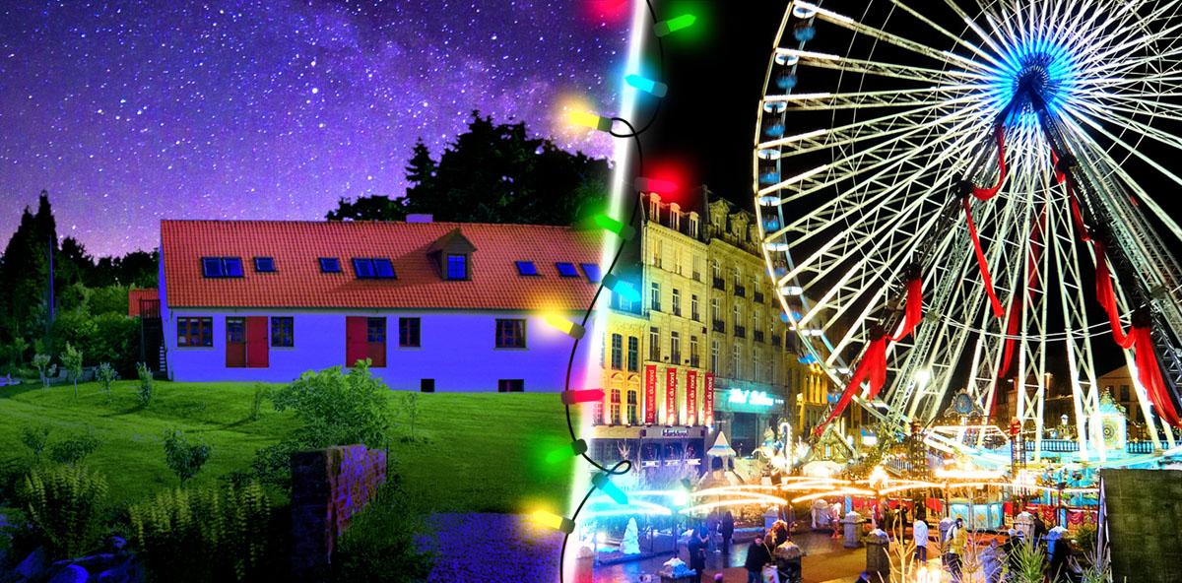
Your trip to
the Opal Coast of France
Winter Seasonal Special
School Name: Date:

Slide 2



You’re in
safe hands
Your child’s safety is our priority and
we ensure the highest standards are met.
ABTA member
ATOL and ABTOT financial protected
School Travel Forum (STF) member
Learning Outside the Classroom (LOtC) Quality Badge holder
AAIAC Adventuremark holder
Audited safety management system
All accommodation audited
More about accreditation.

Slide 3
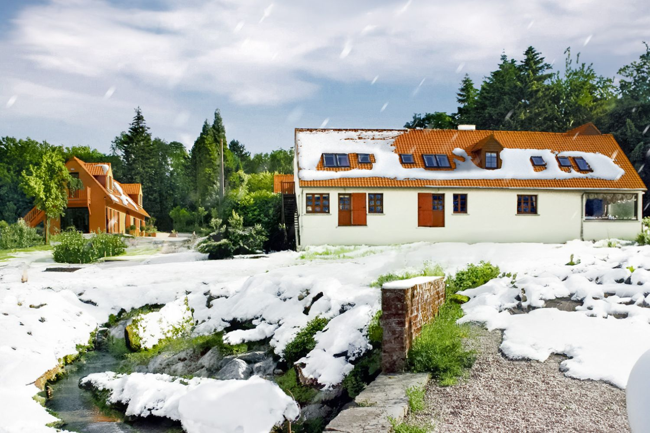
Welcome to the Moulin Centre
Check in to the Moulin aux Draps school centre where you will meet your instructor and get settled.
This centre is set in 22 acres of peaceful green fields with plenty of space to wander safely. During term time, it is exclusively for the use of school groups meaning there are few other distractions for students.

Slide 4
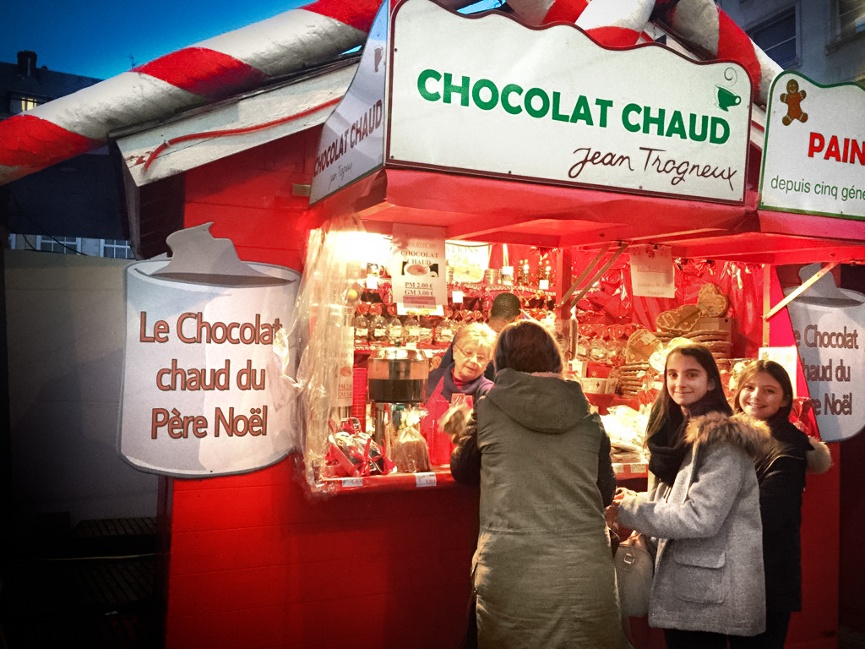
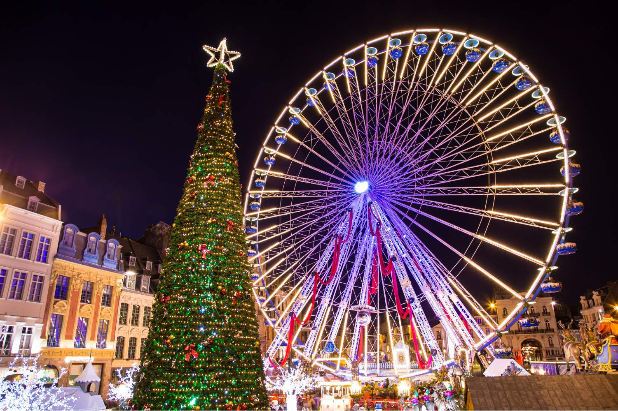
Lille Christmas Market
Lille Christmas market is perfect for a festive day trip.
With over 90 wooden chalets offering artisan gifts, festive decorations, and delicious seasonal treats. Stroll through twinkling lights, soak up the warm holiday atmosphere, and enjoy traditional carols as you browse.
Boulogne Town Trail
Your animateur organises this activity with our tailor made Town Trail requiring the students to read, understand and speak French

Slide 5
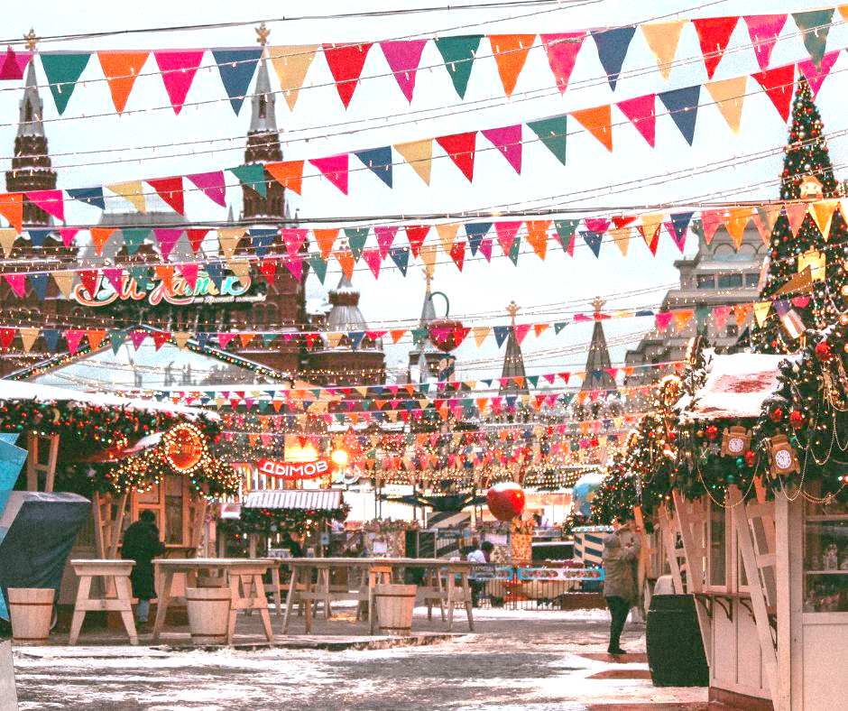
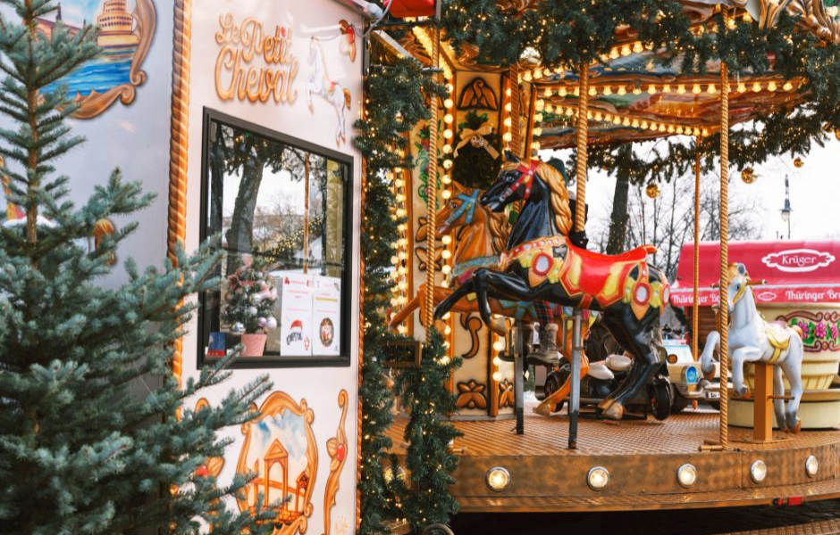
Arras Christmas Market
Set in front of the magnificent Grand Place, the Arras Christmas Market is another substantial event easily accessible in Northern France.
Around 90 stalls offer a smorgasbord of food, drink and gift ideas and are found in a dedicated market setting in the beautiful town square. other entertainment includes a skating rink, carousel, musical events and workshops.
Boulogne Town Trail
Your animateur organises this activity with our tailor made Town Trail requiring the students to read, understand and speak French

Slide 6
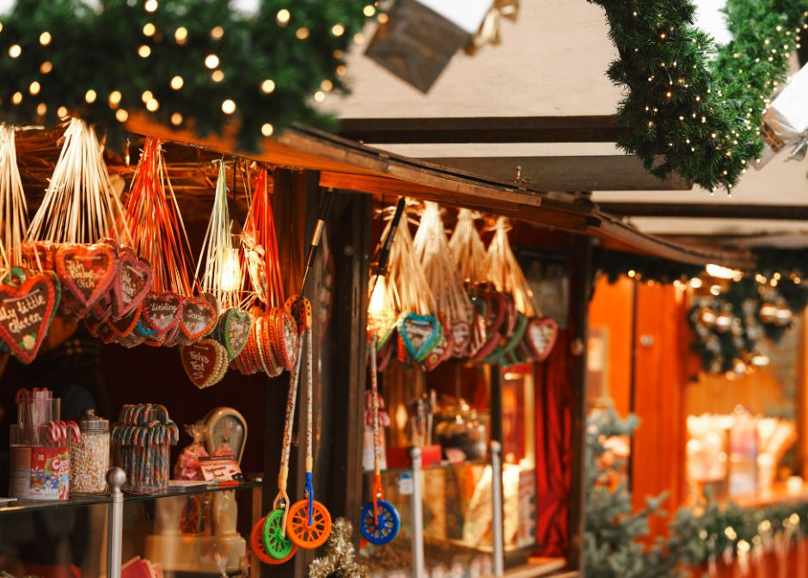
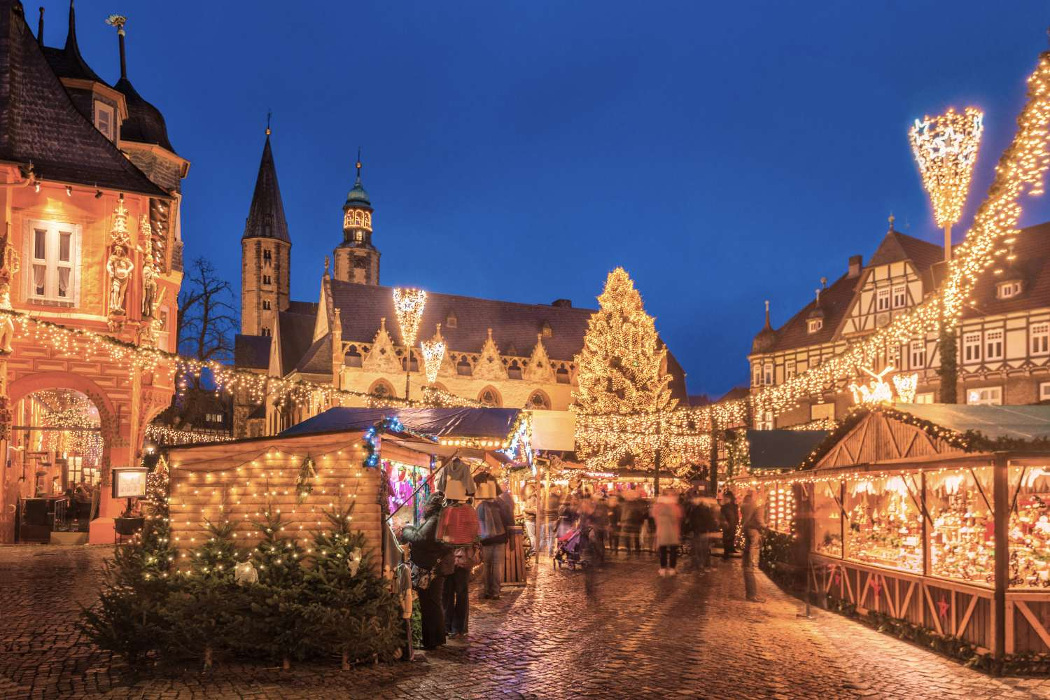
Boulogne-sur-Mer
The historic town of Boulogne-sur-Mer has a Christmas market for only one weekend in December. Nevertheless, it's a super event offering all the usual festive treats, plus local delicacies such as smoked herring and Christmas pudding
Ice sculptures, a jazz band, pottery demonstrations and local folklore all combine to make this something worth heading to
Boulogne Town Trail
Your animateur organises this activity with our tailor made Town Trail requiring the students to read, understand and speak French

Slide 7
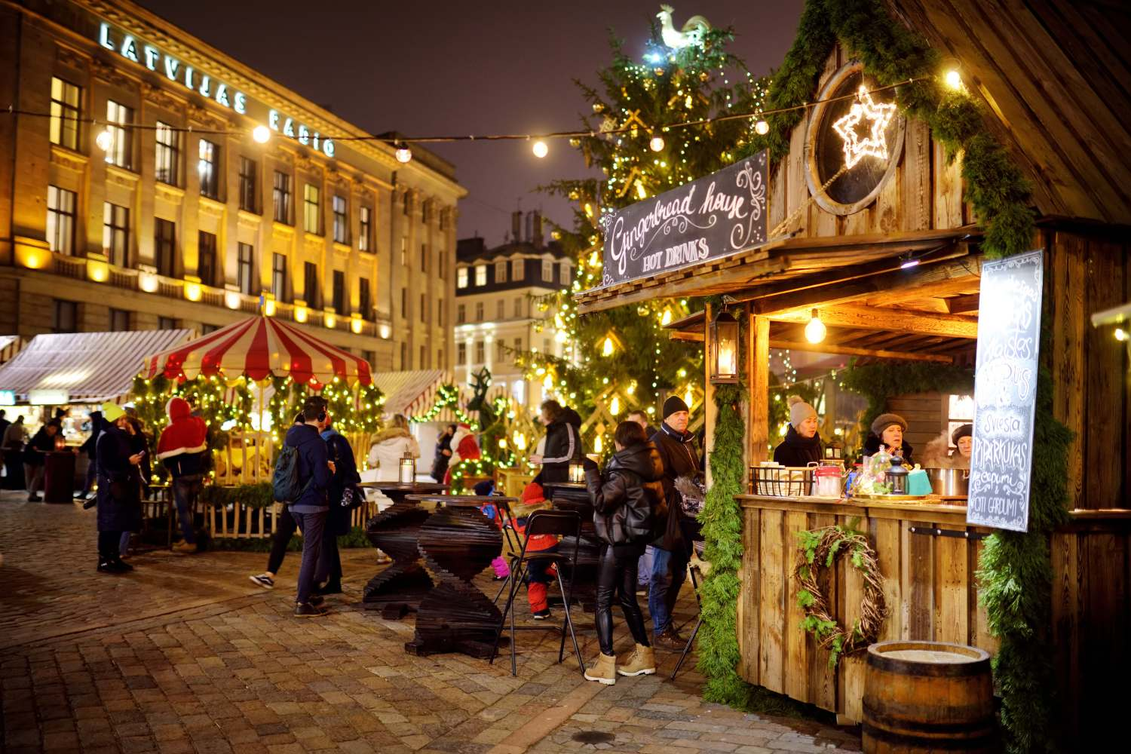
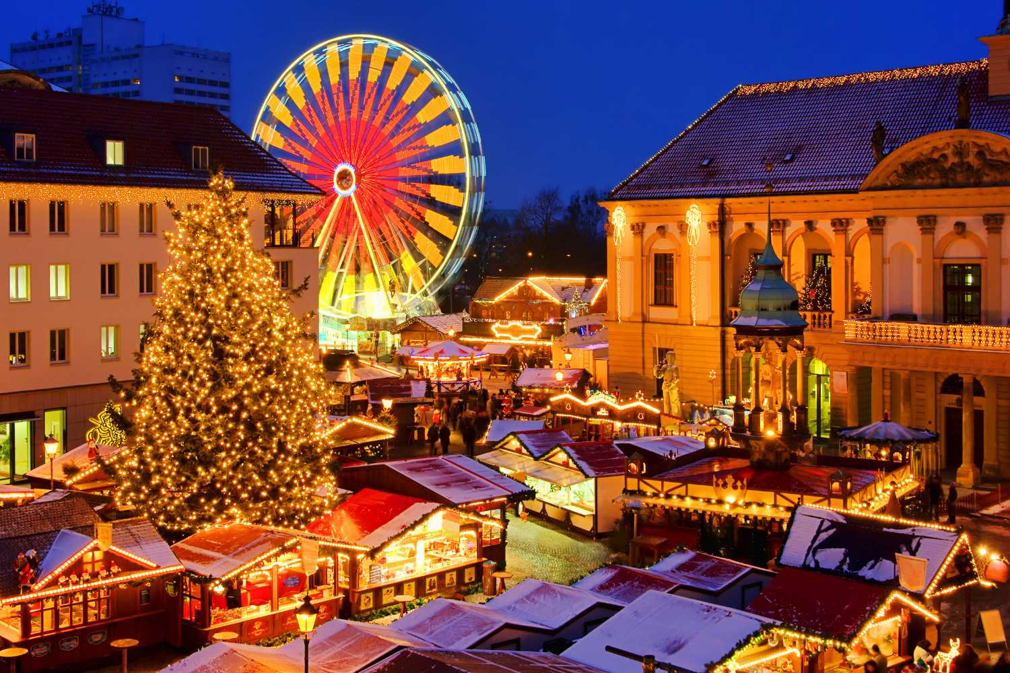
Amiens Christmas Market
Amiens Christmas Market is one of the biggest and best Christmas markets in northern France. With over 135 stalls, there is a wide variety of produce and gifts from lead crystal glassware to famous Amiens macaroons - definitely worth a try!
Other attractions include an open air ice rink, merry-go-rounds, singers and shows. Finally, "Cathedral in Colour" (La Cathédrale en Couleurs) - is a free light show from 1st December to 1st January.
Boulogne Town Trail
Your animateur organises this activity with our tailor made Town Trail requiring the students to read, understand and speak French

Slide 8
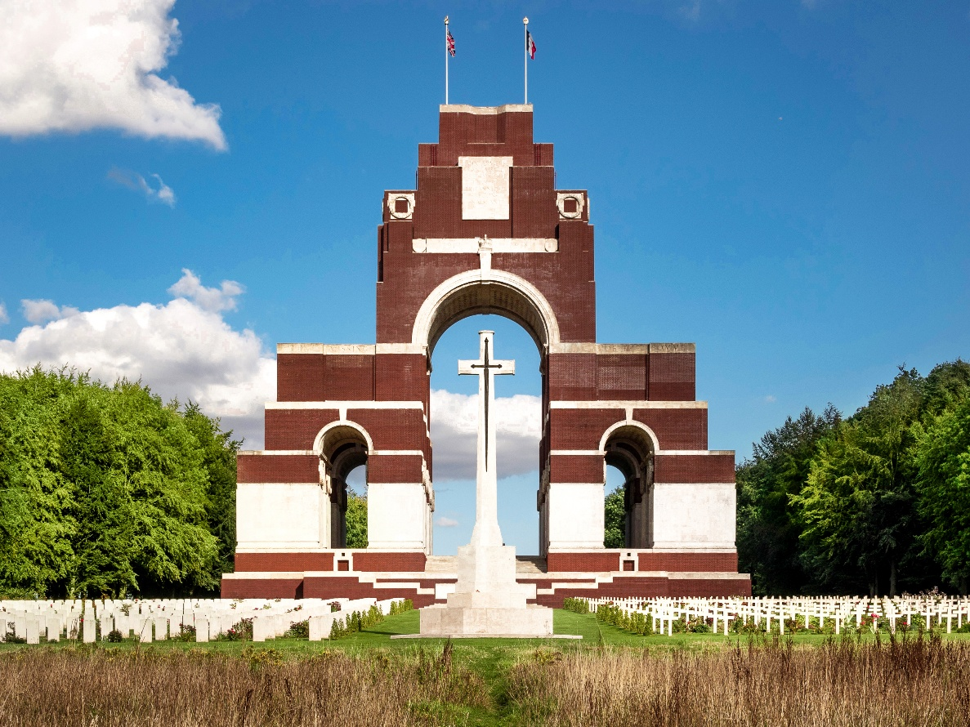
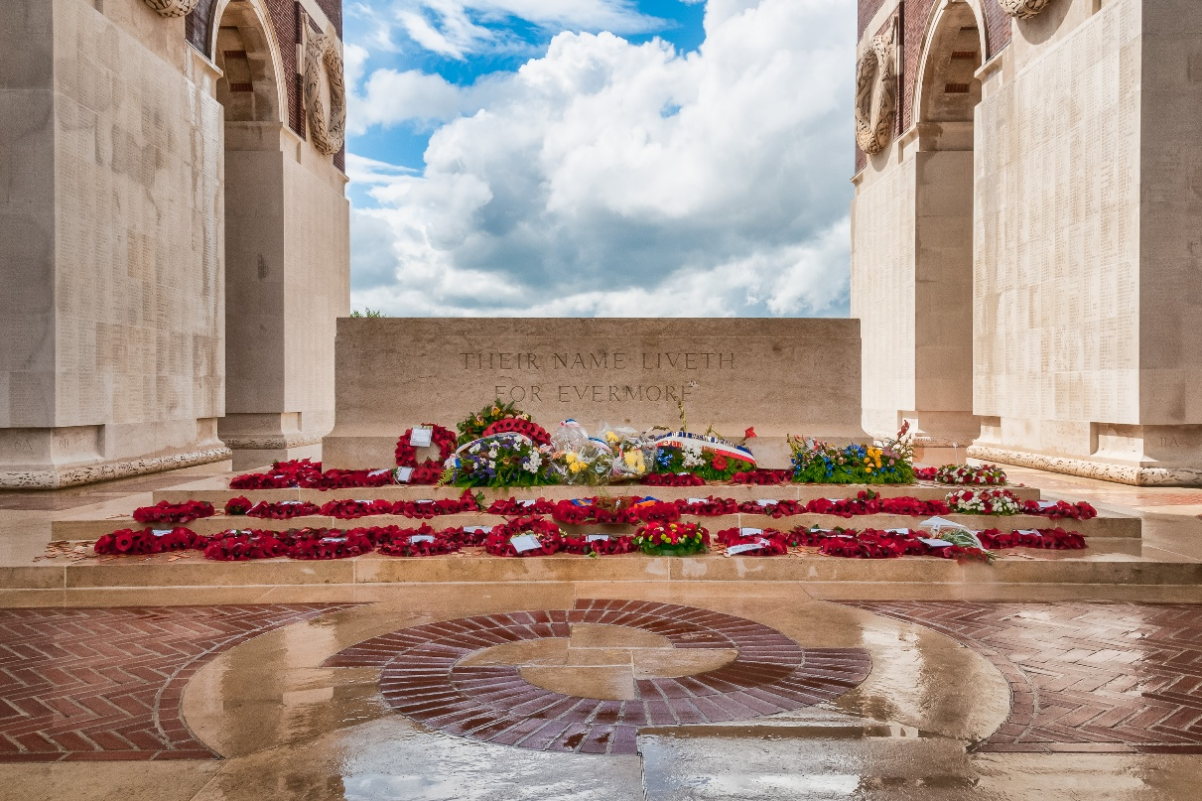
Thiepval Memorial
The largest British war memorial in the world is known as the "Memorial to the Missing".
A moving tribute to the 72,000+ servicemen who died in the Battles of the Somme in WWI
Boulogne Town Trail
Your animateur organises this activity with our tailor made Town Trail requiring the students to read, understand and speak French

Slide 9
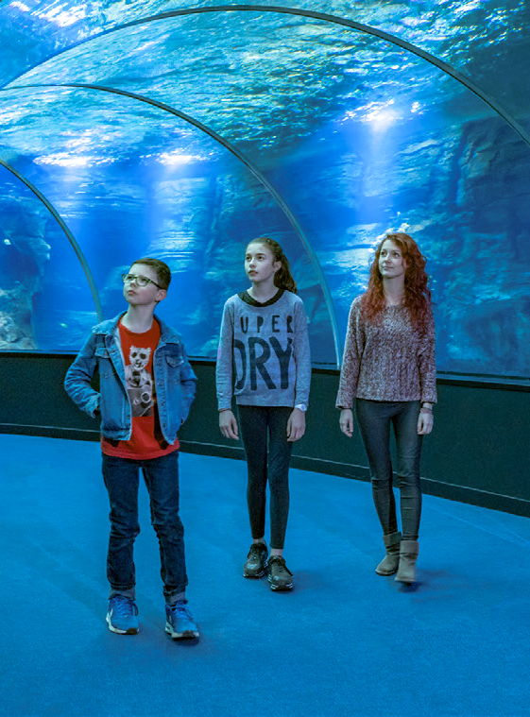
Nausicaá National Sea Centre
The largest marine life centre in Europe is home to 1,600 species and promotes sustainability and marine management. This is a fun and educational cross-curricular visit for groups.
Boulogne Town Trail
Your animateur organises this activity with our tailor made Town Trail requiring the students to read, understand and speak French

Slide 10
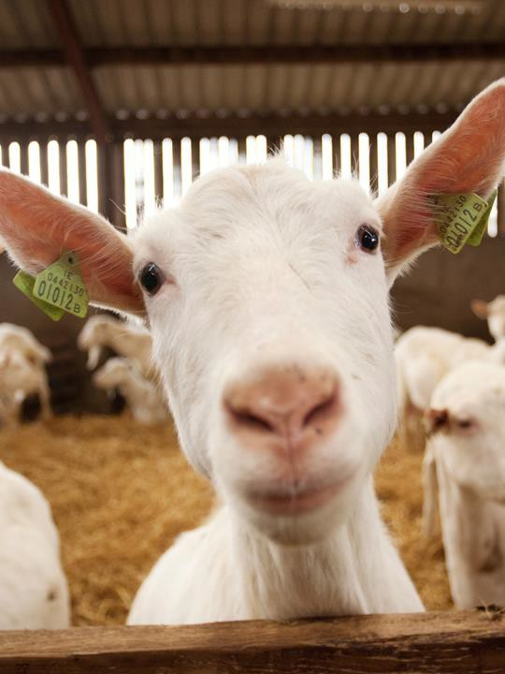
Goat cheese farm
An interactive visit of a local working goat farm and cheese producer (or similar alternative)
Includes the all-important tasting of
the famous Normandy produce
Boulogne Town Trail
Your animateur organises this activity with our tailor made Town Trail requiring the students to read, understand and speak French

Slide 11
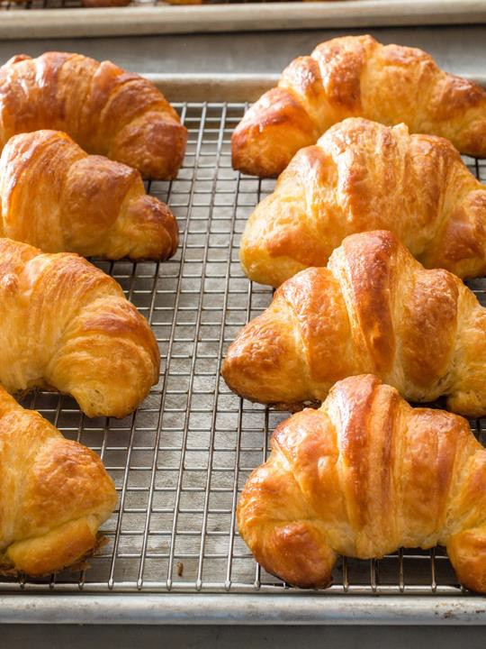
Local bakery
Visit a local French bakery or “Boulangerie” for a demonstration.
Experience a hands-on croissant making session under the expert guidance of a master baker, you’ll learn the secrets behind crafting the perfect buttery, flaky pastry.
Boulogne Town Trail
Your animateur organises this activity with our tailor made Town Trail requiring the students to read, understand and speak French

Slide 12


France is waiting for you!
Click here for more information about the trip!
Find us on

