Slide 1

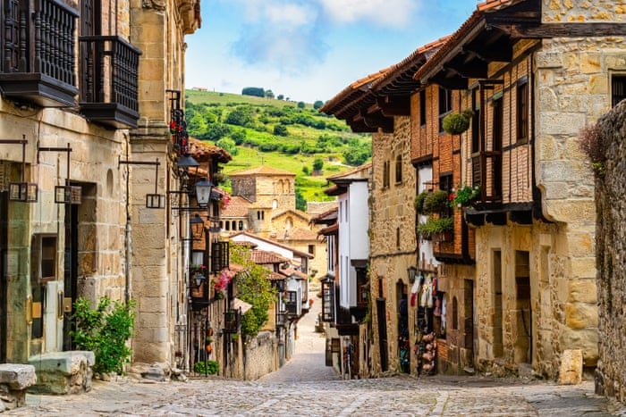
Your trip to Spain
School Name
DD–DD MM YYYY

Slide 2
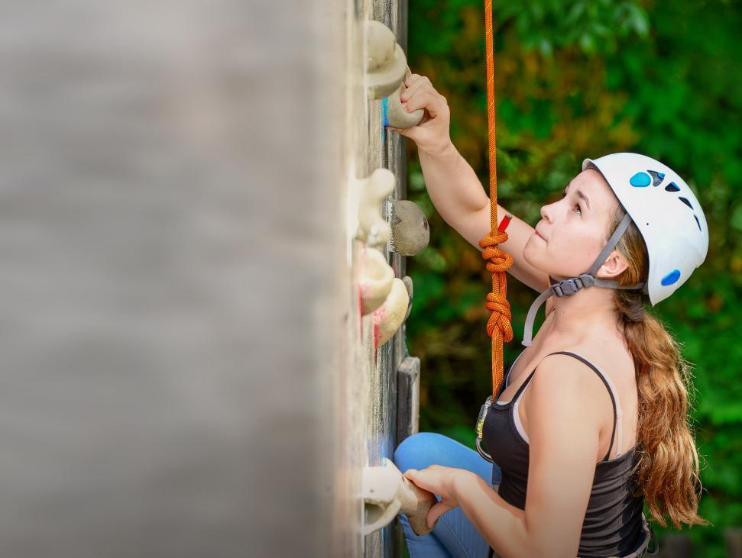
We help students reach new heights
Voyager School Travel specialises in educational school trips where students can learn, thrive and achieve their potential outside the classroom.
We believe that every school trip should provide students with new experiences, learning activities and exposure to local culture with genuine educational benefit.
Over 36,000 students travel with us each year

Slide 3


You’re in safe hands
Your child’s safety is our priority and we ensure the highest standards are met.
ABTA member
Protected by ATOL & ABTOT
School Travel Forum (STF) member
Hold the Learning Outside the Classroom (LOtC) Quality Badge
AAIAC Adventuremark holder
Externally audited safety management systems
All accommodation audited
More about accreditation.

Slide 4
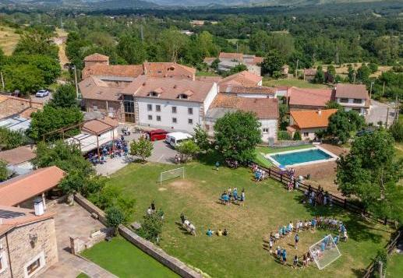
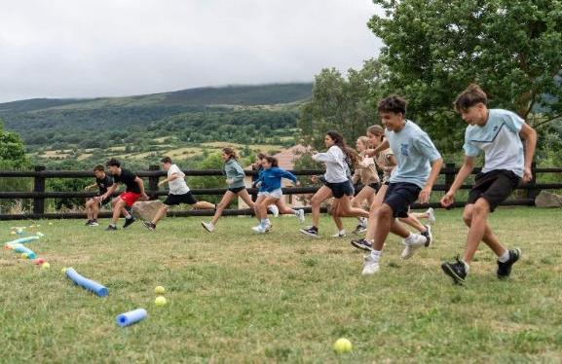
Welcome to
Albergue las Indianas!
A restored 19th-century typical Campurriana manor house, the Albergue las Indianas centre is a safe and authentic Spanish environment for school groups
The centre has a fantastic range of onsite facilities which we utilise to teach your students Spanish. Activities include climbing wall, archery tag, outdoor swimming pool, Masterchef, scavenger hunts, gymkana and salsa dancing

Slide 5
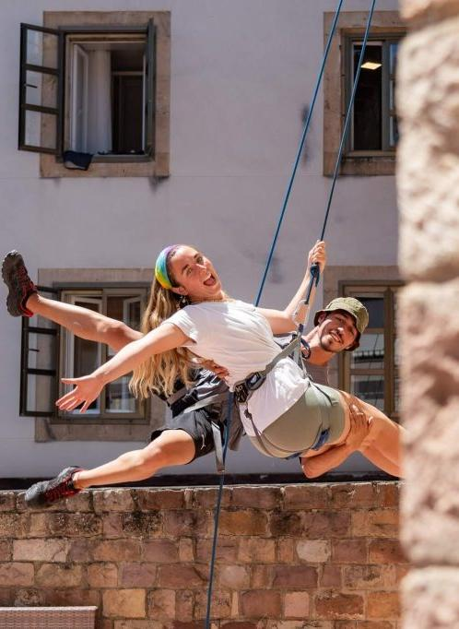
Meet your monitores
Upon your arrival you’ll meet your activity and language instructors called monitores
The experienced and friendly monitores will lead all activities, meal time and excursions during your stay - entirely in Spanish!
What better way to learn than while having fun and being immersed in Spanish culture?
What’s more, this immersive approach is proven to enhance language confidence, comprehension and vocabulary

Slide 6
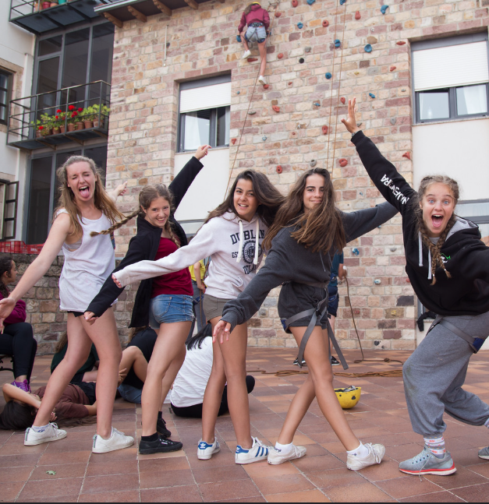
Team
games
Your monitores will get you working as a team and building your confidence speaking Spanish with a variety of fun team games including:
Ice breakers
Spanish trivia quiz
Scavenger hunt
Music games

Slide 7
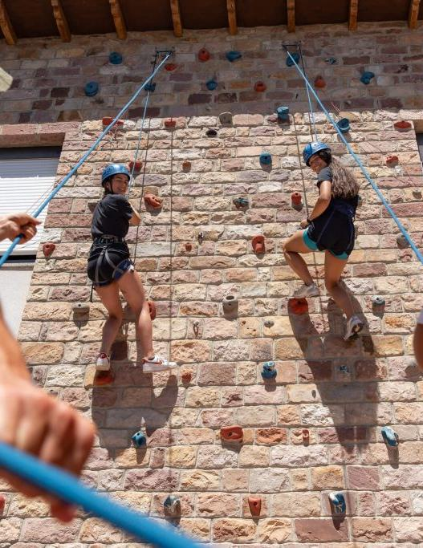
Climbing Wall
Taking place on our purpose-built wall, this activity is supervised by monitores who have received site-specific training, which covers all aspects of climbing, including the use of safety equipment, personal protective equipment, set ups and techniques, plus rope work

Slide 8
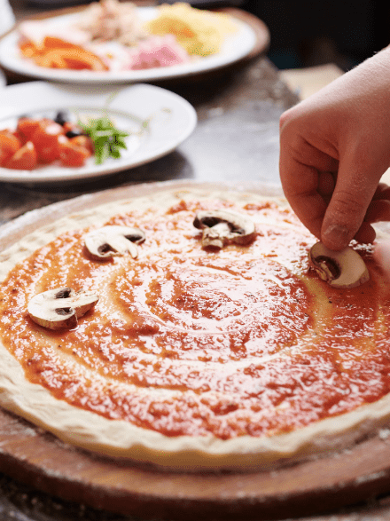
Masterchef challenge
Students work collaboratively in groups of 4–6 to design and create their own pizzas, selecting ingredients and toppings while considering flavour combinations. The kitchen team will then bake each group's creation for them to enjoy their handmade pizzas for dinner, celebrating their teamwork and creativity.

Slide 9
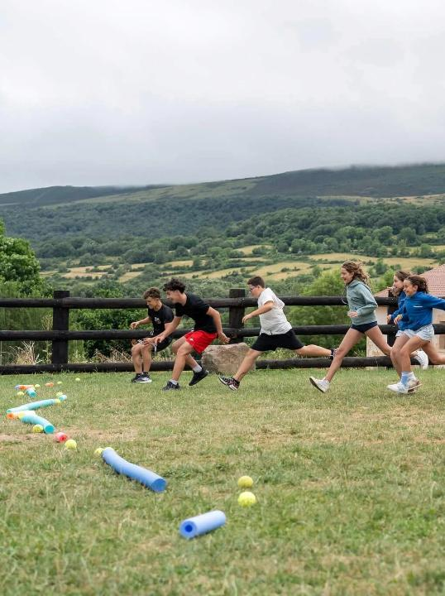
Gymkana de Animación
A lively team competition featuring a variety of physical, agility and problem-solving challenges. Students collaborate, communicate and compete in Spanish while developing teamwork and building confidence through active participation.

Slide 10
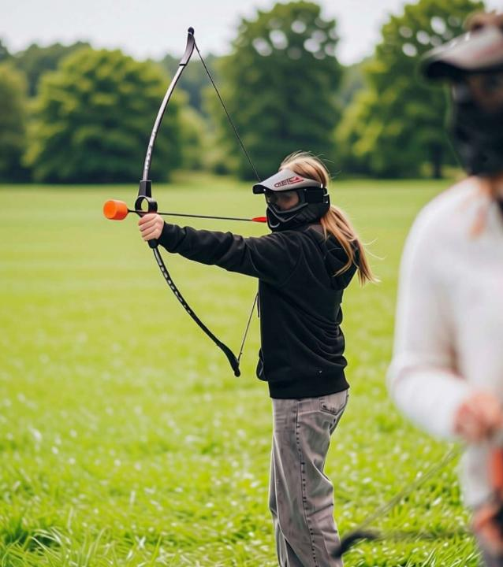
Archery tag
A high-energy team activity combining the strategy of dodgeball with the skill of archery. Students use special bows and patented foam-tipped arrows to eliminate opposing players and knock out target spots, all while practising Spanish in an exciting and supportive environment.

Slide 11
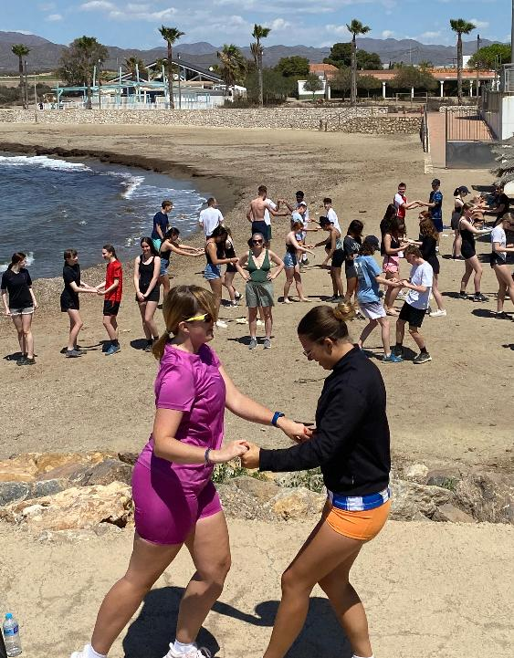
Salsa dancing
Led by the centre's native-speaking monitores, this energetic workshop introduces students to traditional Latin dance while exploring another aspect of Hispanic culture. It's a fun way to build confidence, practise listening skills and experience Spanish beyond the classroom.

Slide 12
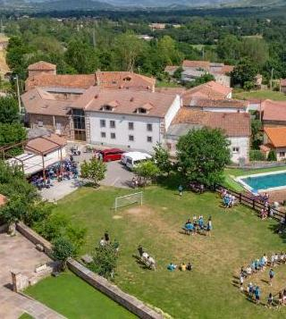
Scavenger hunt
Students work in small groups to complete a series of language-based tasks and challenges around the centre. The scavenger hunt encourages observation, teamwork and spontaneous communication while reinforcing vocabulary in a fun and engaging way.

Slide 13
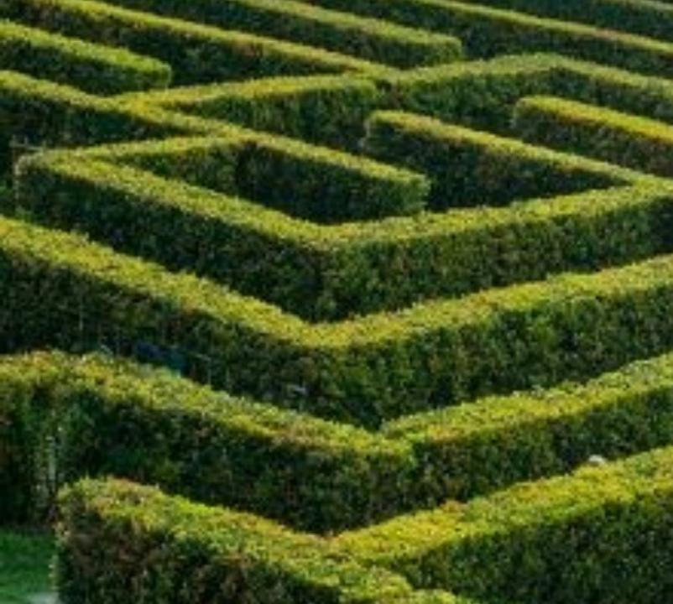
Laberinto el Tilde
Just a short walk from the residential centre, one of Spain's largest mazes provides the setting for a unique language challenge. Students work together to navigate the maze, solve clues and use Spanish throughout the activity, with the option to combine it with a scenic sports trail.

Slide 14
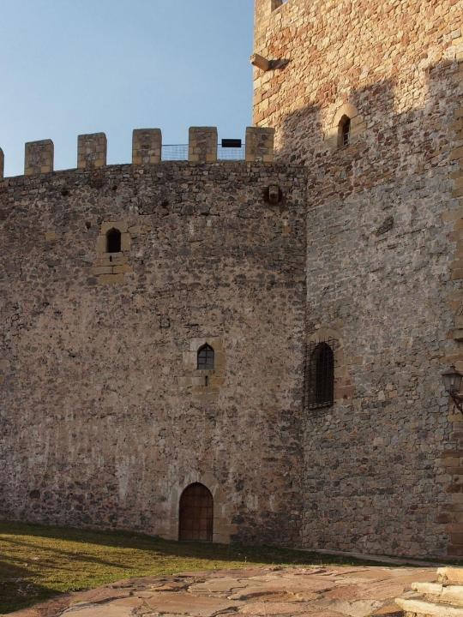
Castillo de Argüeso
Overlooking the Campoo Valley, Castillo de Argüeso is a beautifully restored medieval fortress dating back to the 13th century. Students can explore the castle's towers, battlements and historic rooms while learning about medieval life and the history of Cantabria. The Castillo was declared a site of cultural interest in 1983.

Slide 15
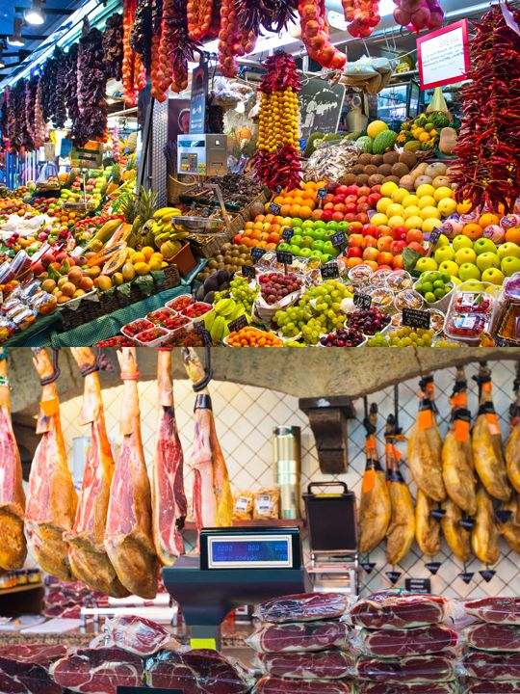
Spanish
market
Visit a local Spanish market where you’ll be challenged with a mission or Spanish quiz
It’s a great opportunity to use your Spanish conversational skills in practice by interacting with the stall owners
Monitores are always on hand to help!

Slide 16
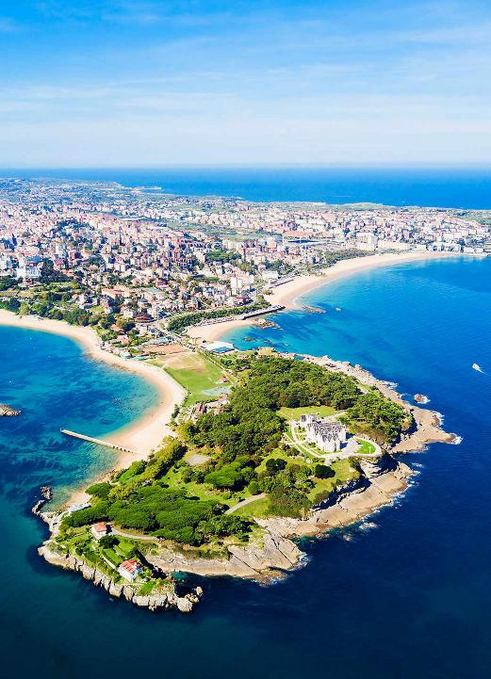
Santander
Santander is the elegant, seaside capital of Spain’s northern Cantabria region. Famed for its sweeping sandy beaches, grand Belle Époque architecture, and the majestic Palacio de la Magdalena, it offers a laid-back, authentically Spanish coastal escape compared to larger, tourist-heavy cities

Slide 17
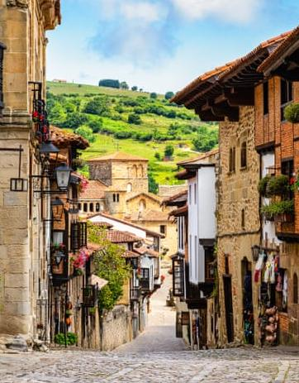
Santillana del Mar
Santillana del Mar is a stunning medieval village in Cantabria, northern Spain. Known for its perfectly preserved cobblestone streets, stone mansions, and aristocratic palaces, it is also the gateway to the world-famous Cave of Altamira, a UNESCO World Heritage Site featuring prehistoric Paleolithic art

Slide 18
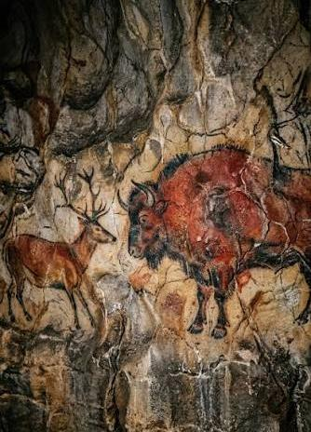
Cave of Altamira
Visit the Neocave, an exact and detailed replica of the original cave, plus the exhibition which is a tour through the “life of the first humans”

Slide 19
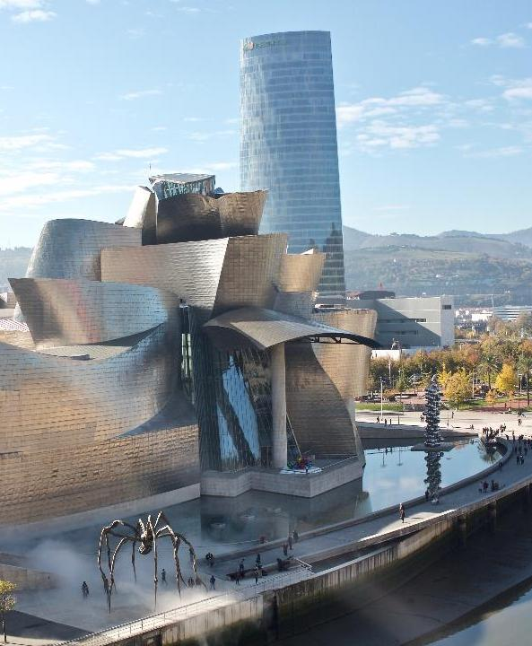
Bilbao
Bilbao is the vibrant, industrial-turned-avant-garde capital of the Basque Country in northern Spain. Famous for its world-class art and culinary scenes, the city is globally renowned for the Frank Gehry–designed Guggenheim Museum and its rich Basque cultural heritage

Slide 20
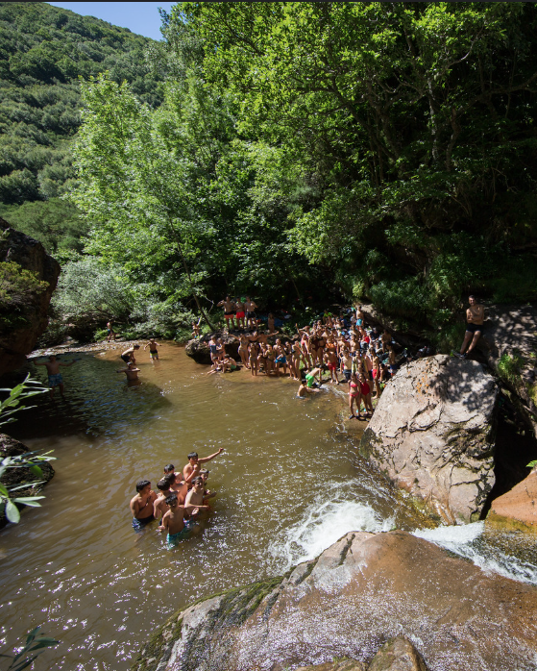
Ebro River
A short hike to see the source of this famous river, the longest in Spain, which flows 930km down to the Mediterranean

Slide 21


Slide 22


Spain is waiting for you!
Click here for more information about the trip!
Find us on

Slide 23

Click here for more information about the trip!
Find us on

