Slide 1
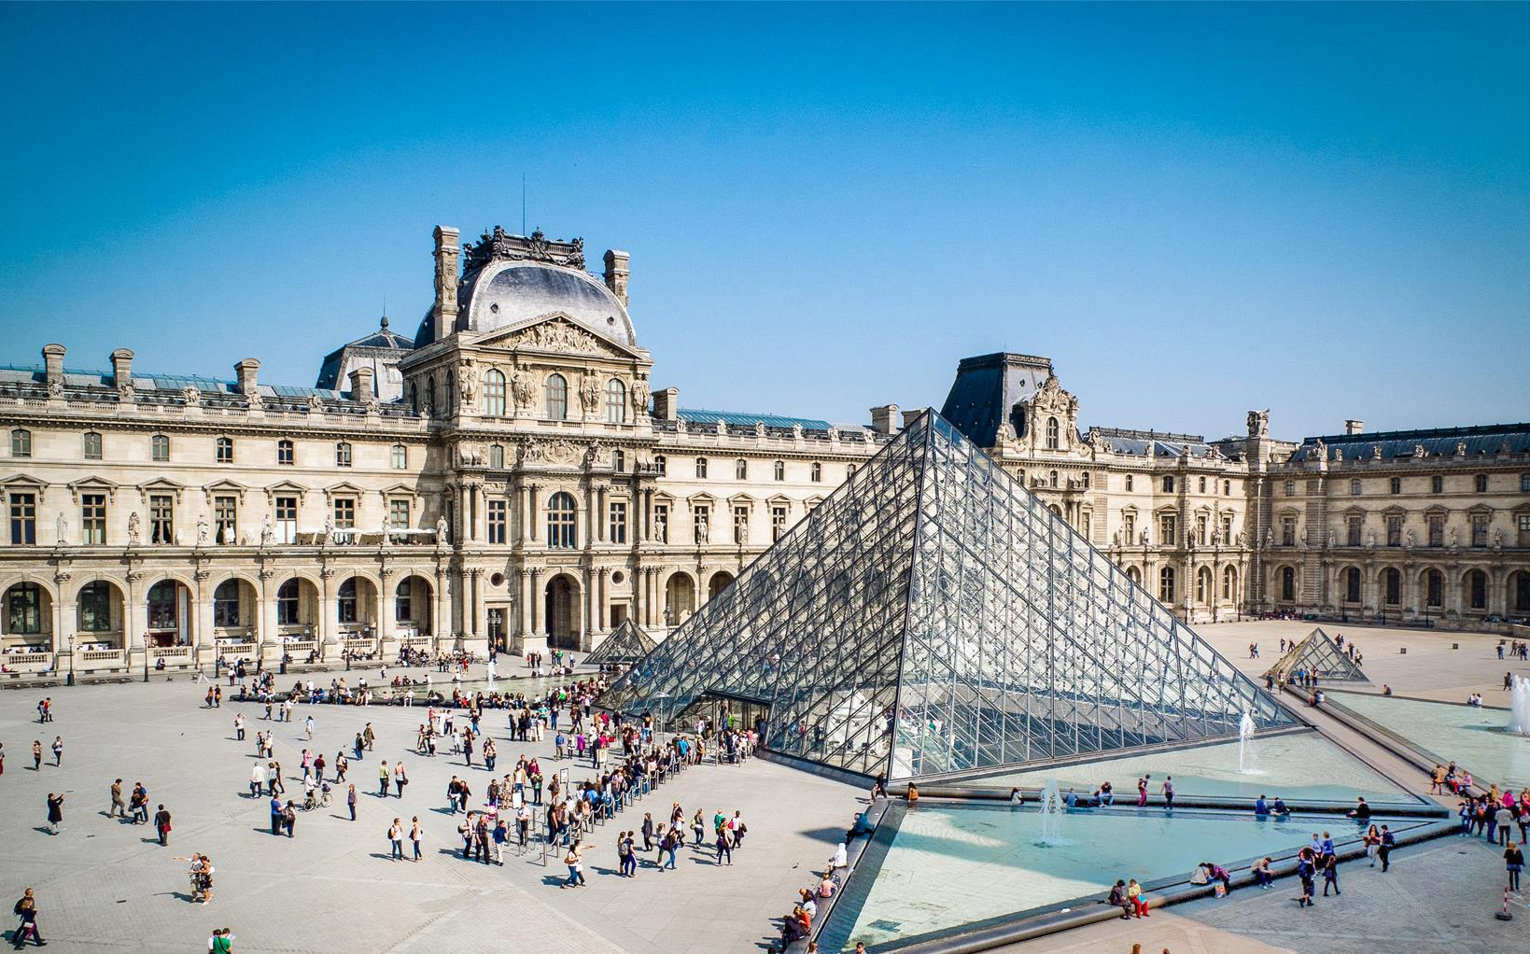
Your trip to Paris
School Name
DD–DD MM YYYY

Slide 2
We help students reach new heights
Voyager School Travel specialises in educational school trips where students can learn, thrive and achieve their potential outside the classroom.
We believe that every school trip should provide students with new experiences, learning activities and exposure to local culture with genuine educational benefit.
Over 35,000 students travel with us each year

Slide 3
You’re in
safe hands
Your child’s safety is our priority and
we ensure the highest standards are met.
ABTA member
ATOL and ABTOT financial protected
School Travel Forum (STF) member
Learning Outside the Classroom (LOtC) Quality Badge holder
AAIAC Adventuremark holder
Audited safety management system
All accommodation audited
More about accreditation.

Slide 4
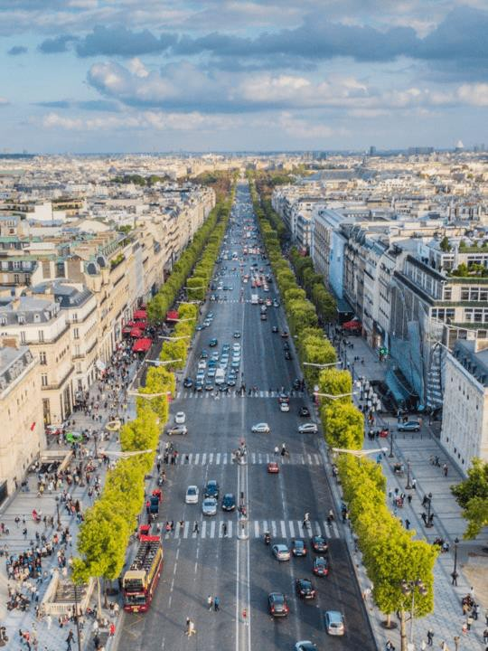
Champs Elysées
Stroll along the Avenue des Champs- Élysées, the most famous avenue in Paris
With its cinemas, cafés, luxury specialty shops and clipped horse- chestnut trees, it remains the most expensive strip of real estate in Europe
Boulogne Town Trail
Your animateur organises this activity with our tailor made Town Trail requiring the students to read, understand and speak French

Slide 5
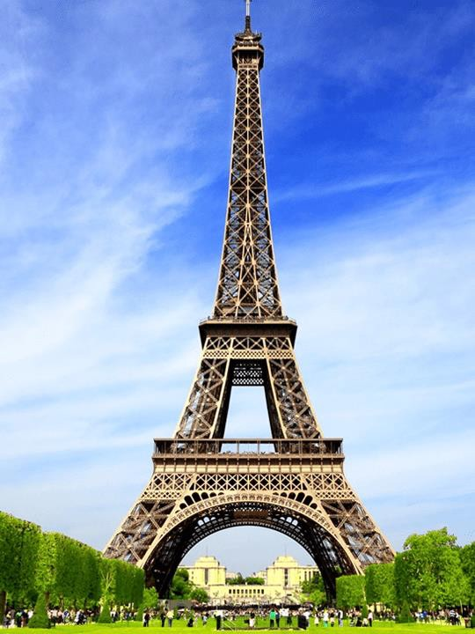
Eiffel Tower
One of the most visited tourist attractions in the world, stop by the famous Eiffel Tower
Created for the 1889 Exposition Universelle, 'La Dame de Fer' stands 324m tall and weighs more than 10,000 tons!
Boulogne Town Trail
Your animateur organises this activity with our tailor made Town Trail requiring the students to read, understand and speak French

Slide 6
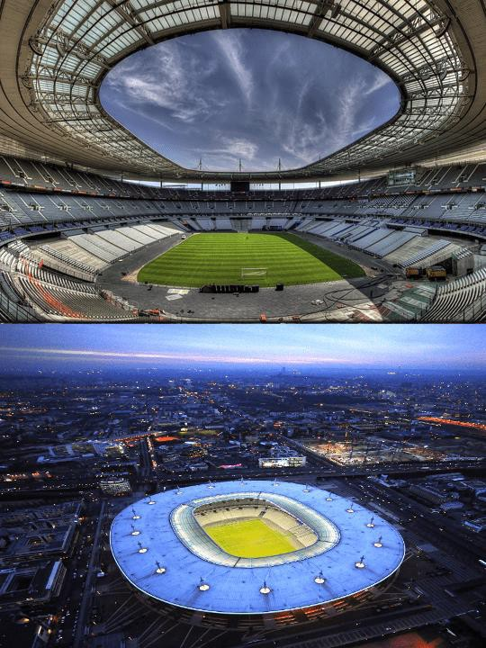
Stade de France
Enjoy a 2-hour guided tour of the 80,000 capacity stadium, which was built specially for the 1998 World Cup
The Stade de France is the biggest stadium in France and is home to the France national football team
Boulogne Town Trail
Your animateur organises this activity with our tailor made Town Trail requiring the students to read, understand and speak French

Slide 7
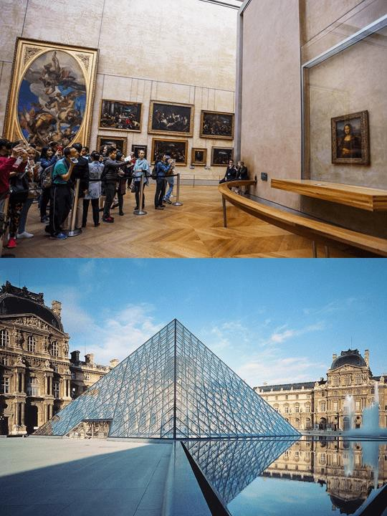
Louvre
Once home to the French Royal family before Louis XIV moved the headquarters to Versailles, the Louvre is now the largest and most visited art museum in the world!
The most famous pieces from its collection include the Venus de Milo and the Mona Lisa
Boulogne Town Trail
Your animateur organises this activity with our tailor made Town Trail requiring the students to read, understand and speak French

Slide 8
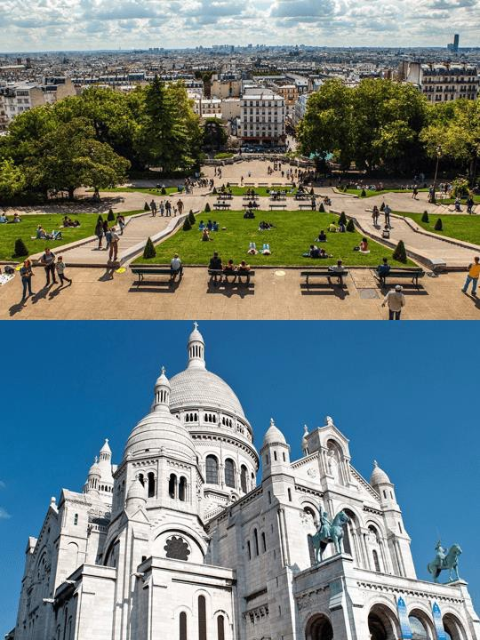
Montmartre & Sacré Cœur
Many artists had studios or worked around the community of Montmartre such as Salvador Dalí, Modigliani, Claude Monet, Pablo Picasso and Vincent van Gogh
Go and see the famous artists’ square, Place du Tertre with today’s collection of painters and caricaturists, and of course don’t miss the beautiful white Sacré Cœur basilica
Boulogne Town Trail
Your animateur organises this activity with our tailor made Town Trail requiring the students to read, understand and speak French

Slide 9
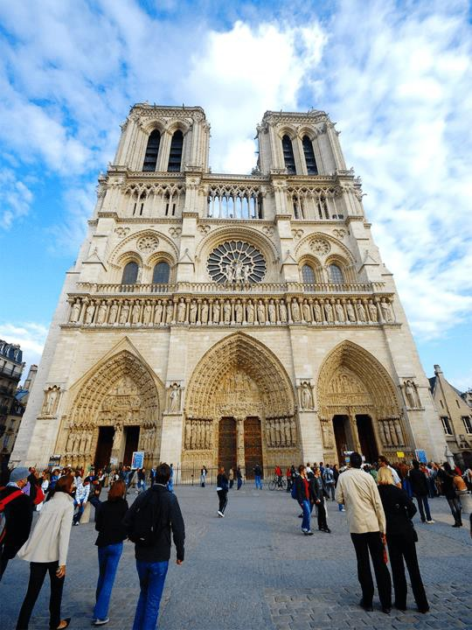
Ile de la Cité
Visit the Ile de la Cité, in the middle of the river Seine
Admire Notre Dame cathedral with its stunning Rose window, or the Sainte Chapelle, which is considered by some to be the most beautiful church in Paris
The Ile de la Cité also plays host to the Palais de Justice, Le Prefecture de Police and Le Hotel-Dieu Hospital
Boulogne Town Trail
Your animateur organises this activity with our tailor made Town Trail requiring the students to read, understand and speak French

Slide 10
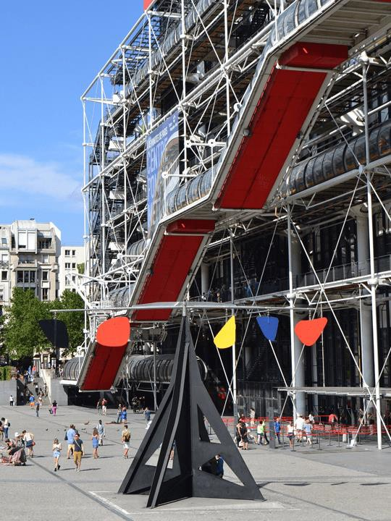
Centre Pompidou
Immediately recognizable by its exterior escalators and enormous coloured tubing, the Centre Pompidou is home to the National Museum of Modern Art
The works are displayed chronologically over two sections: the modern period with the well-known Matisse and Picasso, and the contemporary period with the very popular Andy Warhol, Niki de Saint Phalle and Anish Kapoor
Boulogne Town Trail
Your animateur organises this activity with our tailor made Town Trail requiring the students to read, understand and speak French

Slide 11
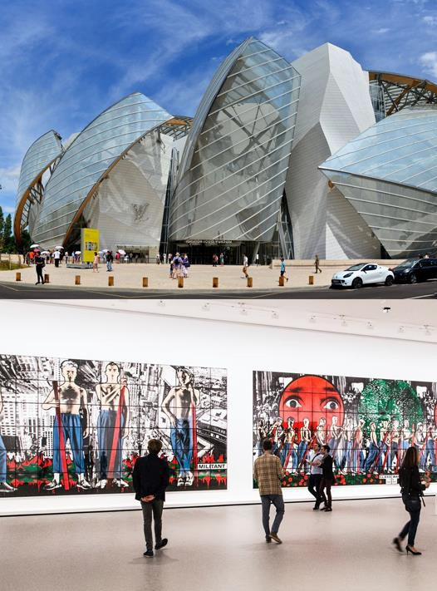
Louis Vuitton Foundation
The Louis Vuitton Foundation is a French art museum and cultural center sponsored by the group LVMH housing works under four categories: Contemplative, Pop, Expressionist, Music & Sound
The building itself is a work of art and there’s also a terrace offering fantastic views
Boulogne Town Trail
Your animateur organises this activity with our tailor made Town Trail requiring the students to read, understand and speak French

Slide 12
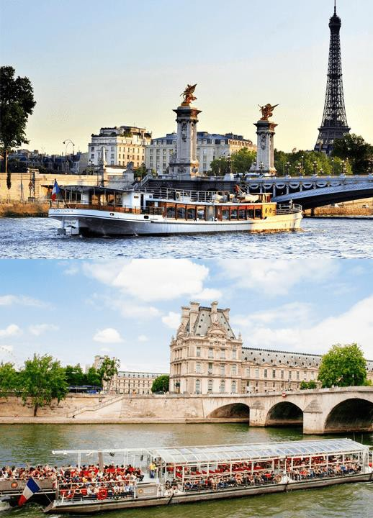
Seine river cruise
Board your boat and enjoy a 1-hour cruise along the River Seine
Admire the main sights of Paris such as the Grand Palais, Invalides, Musée d’Orsay and Notre Dame Cathedral from the water
Boulogne Town Trail
Your animateur organises this activity with our tailor made Town Trail requiring the students to read, understand and speak French

Slide 13
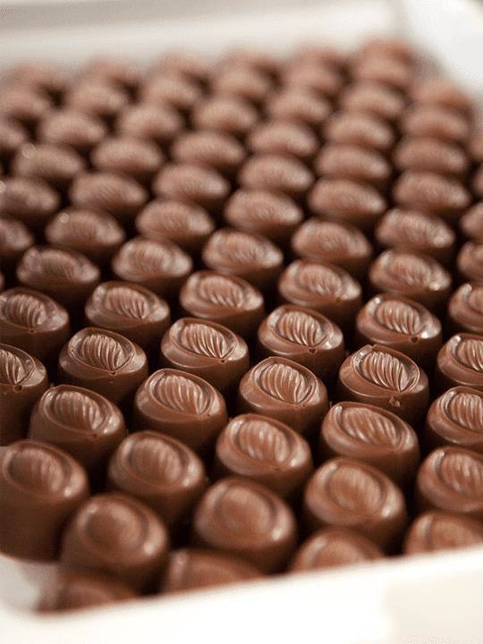
Chocolaterie
Visit a Parisian Chocolaterie and witness how the sweet treat is made by the masters
And of course, you can’t leave
without trying some for yourself!
Boulogne Town Trail
Your animateur organises this activity with our tailor made Town Trail requiring the students to read, understand and speak French

Slide 14
Boulangerie
Visit a local French bakery or “Boulangerie” for a demonstration in French
You will walk away with a croissant
and a pain au chocolat each
Boulogne Town Trail
Your animateur organises this activity with our tailor made Town Trail requiring the students to read, understand and speak French

Slide 15
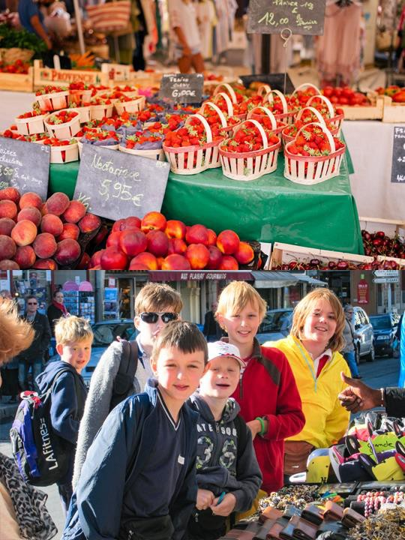
Market
Visit one of Paris’ bustling morning markets where you can pick up a delicious pastry, baguette, fresh fruit or a souvenir
This is a great opportunity to test out your conversational French skills by interacting with the stall owners
Your animateur will be on hand to help you out
Boulogne Town Trail
Your animateur organises this activity with our tailor made Town Trail requiring the students to read, understand and speak French

Slide 16
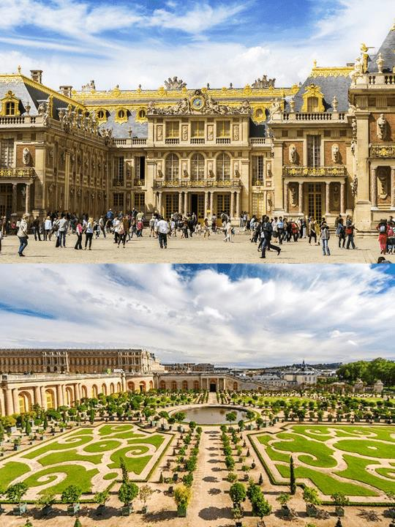
Château de Versailles
Embark on a guided tour through Louis XIV’s extravagant Chateau de Versailles, which was created to reflect the splendour of France to the rest of the World
Visit the Galerie des Glaces and the King and Queen’s apartments where the scale of luxury is most staggering
Boulogne Town Trail
Your animateur organises this activity with our tailor made Town Trail requiring the students to read, understand and speak French

Slide 17
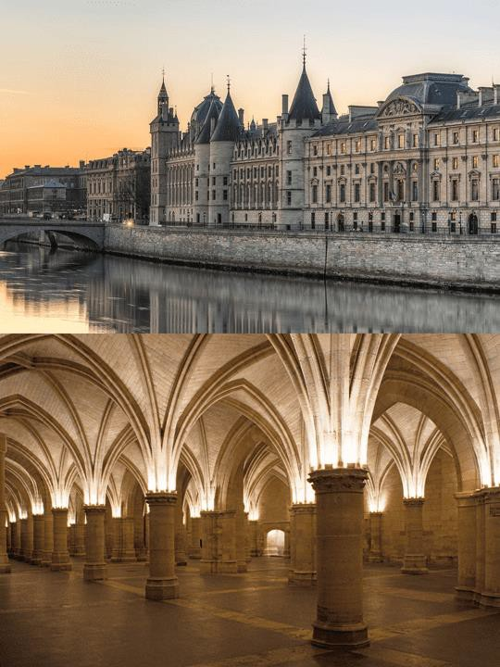
La Conciergerie
Explore the Conciergerie, which has a storied past as both a royal palace and a prison during the French Revolution
Boulogne Town Trail
Your animateur organises this activity with our tailor made Town Trail requiring the students to read, understand and speak French

Slide 18
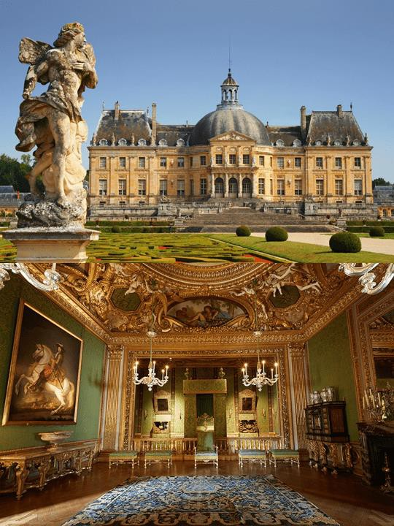
Château de Vaux-le-Vicomte
Visit the Chateau de Vaux-le-Vicomte which was built in 1661 for Nicolas Fouquet, who managed France’s finances under Louis XIV—no easy job!
The château was an influential work of architecture in mid-17th-century Europe and its grandeur hasn’t faded since
Boulogne Town Trail
Your animateur organises this activity with our tailor made Town Trail requiring the students to read, understand and speak French

Slide 19
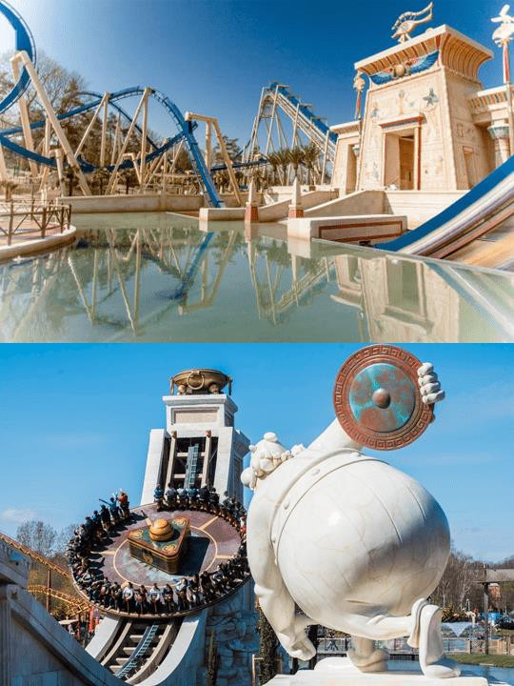
Parc Asterix
Explore the theme park based on the Astérix comic books
Ride the rollercoasters, see the many shows, watch the dolphins or follow the footprint of the man who stole Mona Lisa!
A great laugh guaranteed and also an occasion to test your French
Boulogne Town Trail
Your animateur organises this activity with our tailor made Town Trail requiring the students to read, understand and speak French

Slide 20
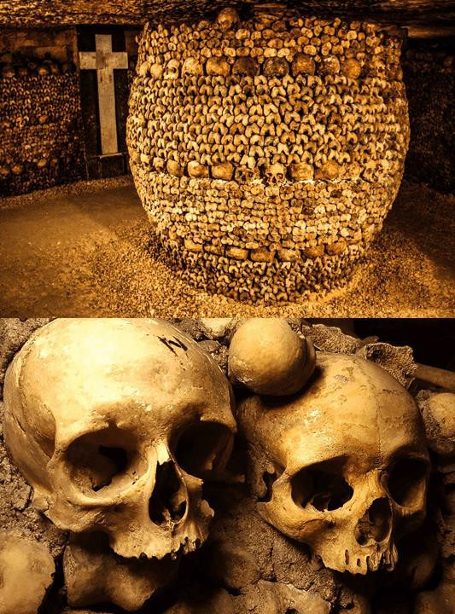
Catacombs of Paris
Not for the faint of heart, this 18th century underground cemetery has welcomed curious visitors since 1874!
Located south of the former city gate, the ossuary holds the remains of approximately six million people in the tunnels of Paris’s historic stone mines
Boulogne Town Trail
Your animateur organises this activity with our tailor made Town Trail requiring the students to read, understand and speak French

Slide 21
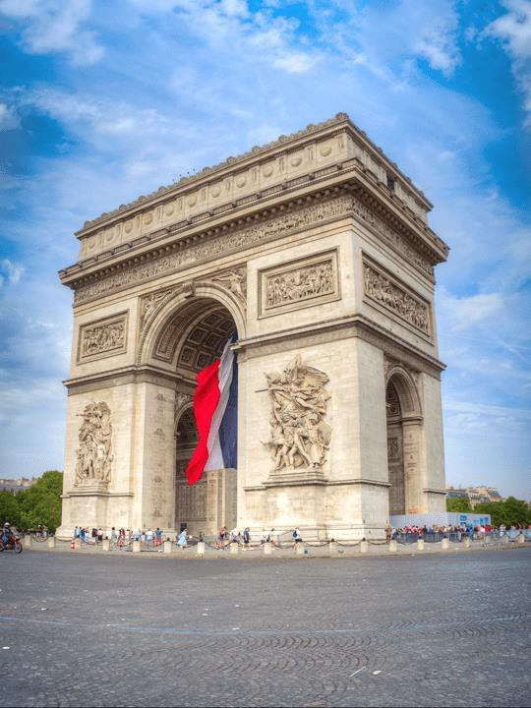
Arc de Triomphe
Lo and behold the biggest arch in the world!
It commemorates the successes of the Napoleonic War, celebrating the victories and the lives of those who died for its cause
Boulogne Town Trail
Your animateur organises this activity with our tailor made Town Trail requiring the students to read, understand and speak French

Slide 22
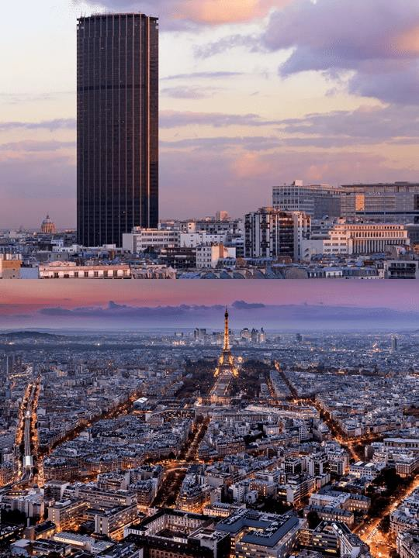
Tour Montparnasse
Step into Europe's fastest lift which will take you up the 56th floor of the Tour Montparnasse
Interactive screens will help your student understand the history of Paris, then carry on further up to the 59th floor and admire the finest view of Paris as the sun sets and the “City of lights” lights up!
Boulogne Town Trail
Your animateur organises this activity with our tailor made Town Trail requiring the students to read, understand and speak French

Slide 23
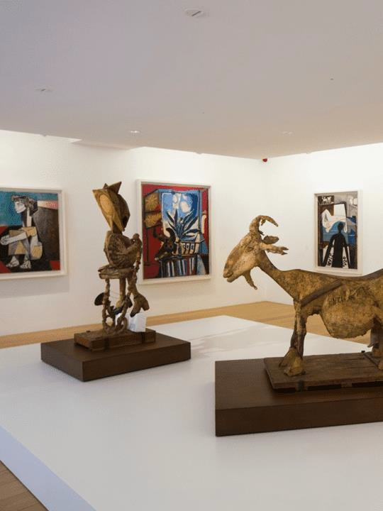
Musée Picasso
Visit Musee Picasso where you will be able to see the artist's creating process
The collection includes sketches and drawings as well as his finished products: paintings, engravings and sculptures
Boulogne Town Trail
Your animateur organises this activity with our tailor made Town Trail requiring the students to read, understand and speak French

Slide 24
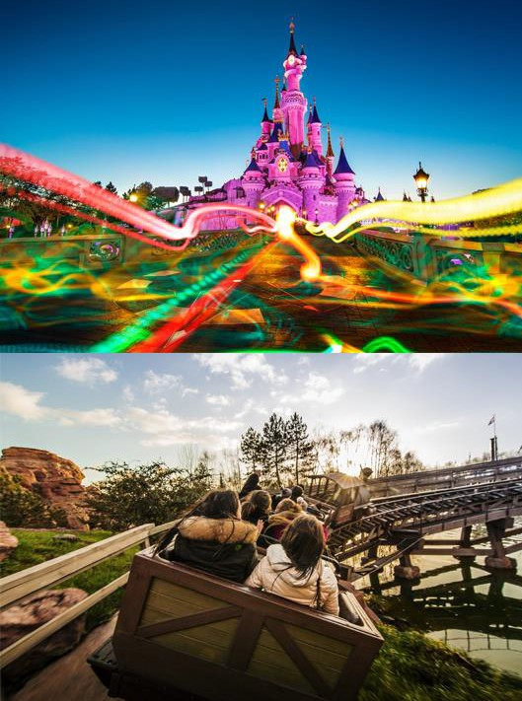
Disneyland Paris
Your tickets give you access to both the Disneyland Park and the Walt Disney Studio Park
Explore Adventureland and beware of the pirates, discover Fantasyland and find your way in Alice’s Curious Labyrinth before jumping on board Space Mountain and travelling through Discoveryland, unforgettable memories guaranteed!
Boulogne Town Trail
Your animateur organises this activity with our tailor made Town Trail requiring the students to read, understand and speak French

Slide 25
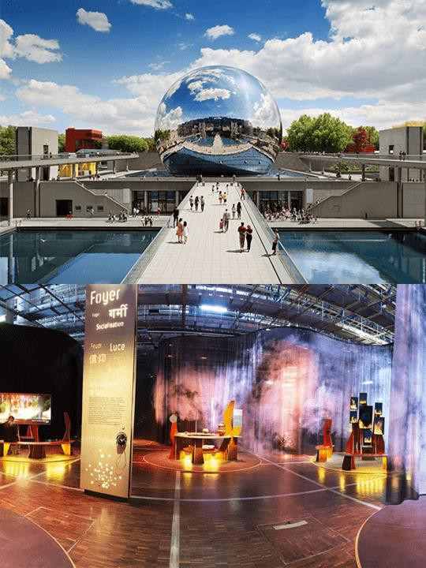
Cité des Sciences et de l'Industrie
The Cité des Sciences et de l'Industrie is the biggest science museum in Europe
This large interactive science museum has numerous exhibits dedicated to making science digestible for those of us who aren’t scientists!
Boulogne Town Trail
Your animateur organises this activity with our tailor made Town Trail requiring the students to read, understand and speak French

Slide 26
France is waiting for you!
Click here for more information about the trip!
Find us on

