Slide 1

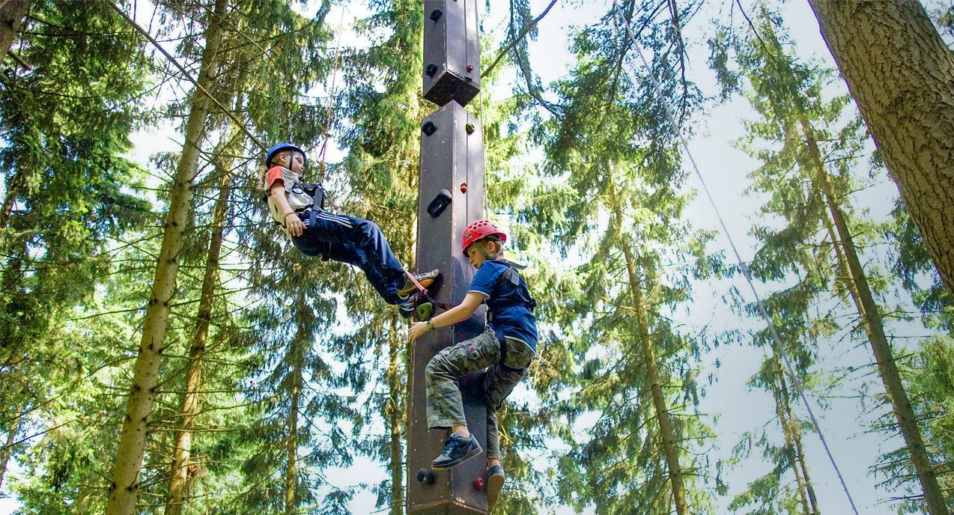
Your trip to Hellenthal, Germany
School Name
DD–DD MM YYYY

Slide 2
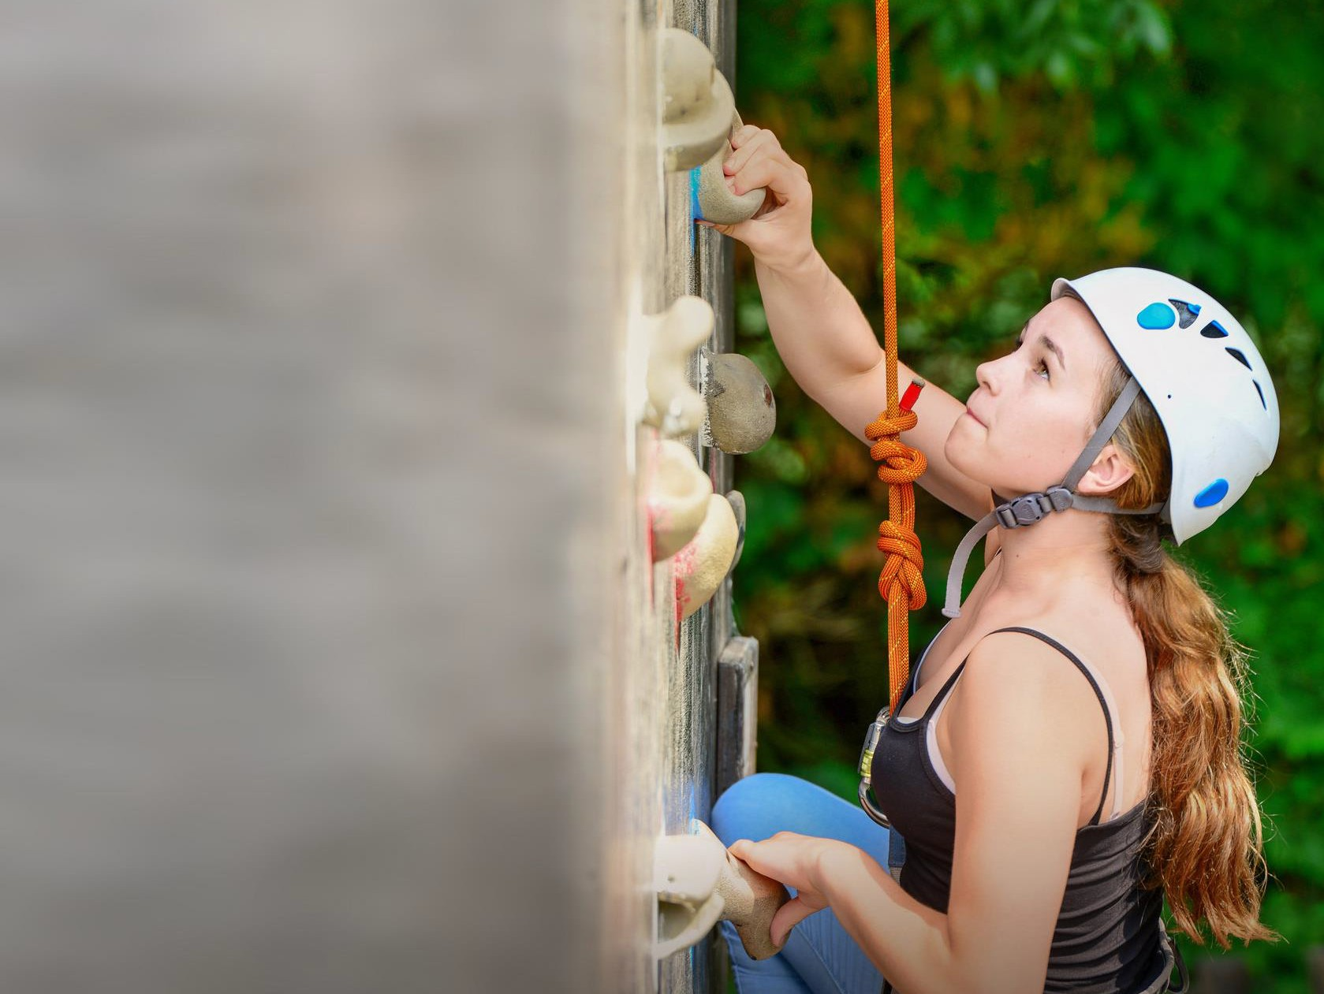
We help students reach new heights
Voyager School Travel specialises in educational school trips where students can learn, thrive and achieve their potential outside the classroom.
We believe that every school trip should provide students with new experiences, learning activities and exposure to local culture with genuine educational benefit.
Over 35,000 students travel with us each year

Slide 3



You’re in
safe hands
Your child’s safety is our priority and
we ensure the highest standards are met.
ABTA member
ATOL and ABTOT financial protected
School Travel Forum (STF) member
Learning Outside the Classroom (LOtC) Quality Badge holder
AAIAC Adventuremark holder
Audited safety management system
All accommodation audited
More about accreditation.

Slide 4
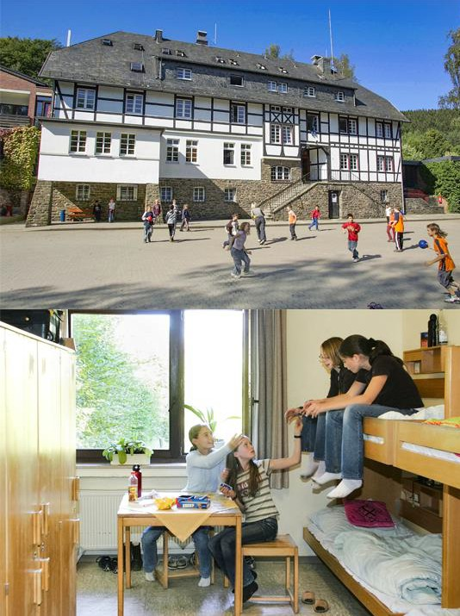
Welcome to the Hellenthal centre
This residential language immersion centre in North Rhine-Westphalia is located near the stunning Eifel National Park
The centre boasts an all-weather high ropes course housed in a huge open barn and a giant swing in the stunning surrounding woodland

Slide 5
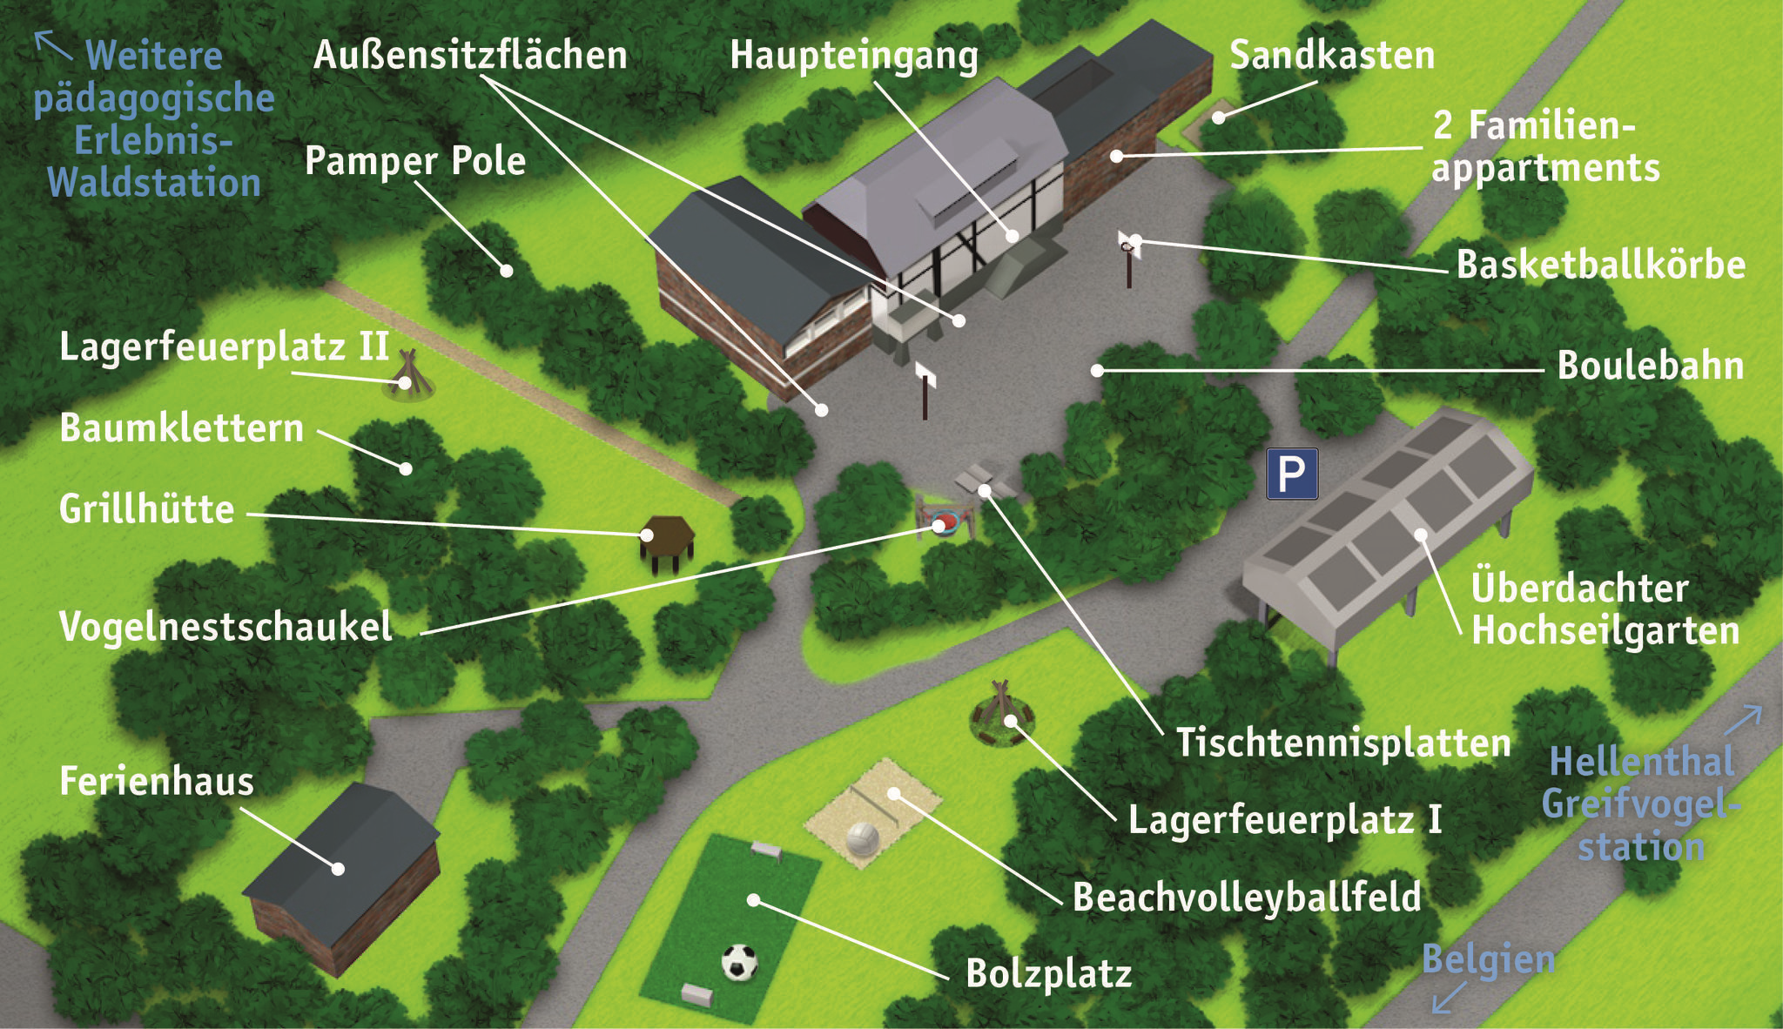

Slide 6
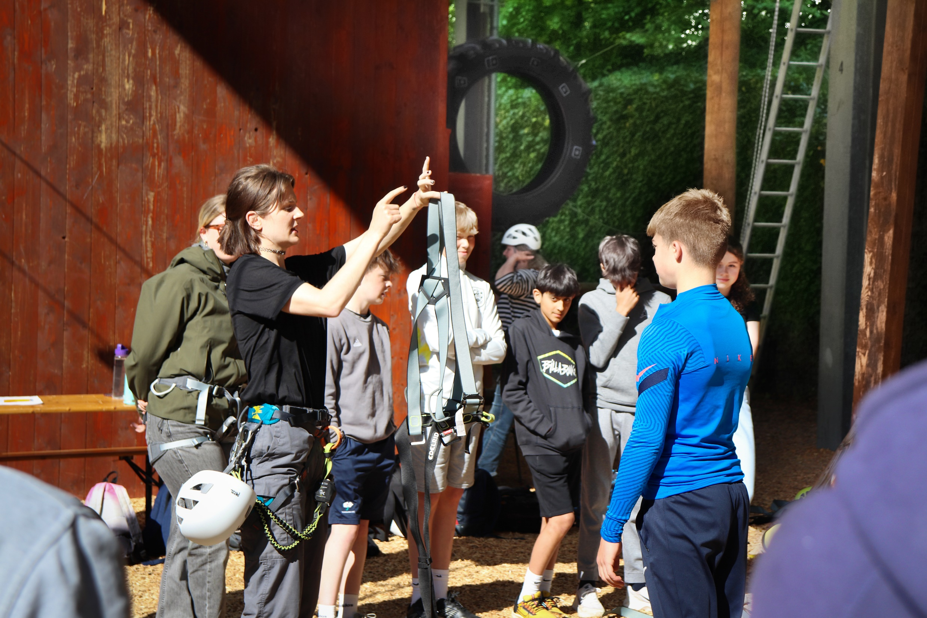
Meet your betreuer
One of our native German-speaking betreuers will ensure you get the most out of your trip
All on-site activities and evening entertainment will be led in German by your betreuers to help you challenge yourselves and improve your German speaking and comprehension skills

Slide 7
Team games
Participate in a variety of on-site team-building and initiative games led in German by your betreuer
Boulogne Town Trail
Your animateur organises this activity with our tailor made Town Trail requiring the students to read, understand and speak French

Slide 8
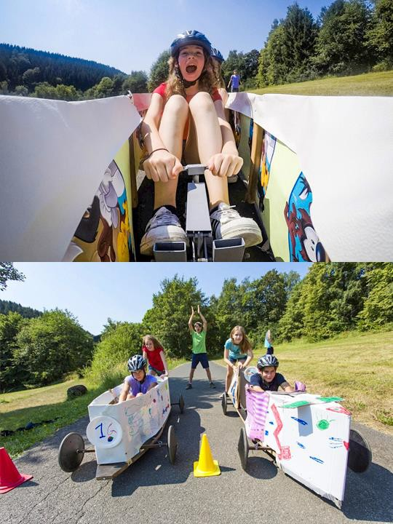
Build a car
Team up with classmates to design, build—and drive—your very own car from repurposed materials!
Take to the test track for a final race where the team with the fastest car will be crowned victorious
Boulogne Town Trail
Your animateur organises this activity with our tailor made Town Trail requiring the students to read, understand and speak French

Slide 9
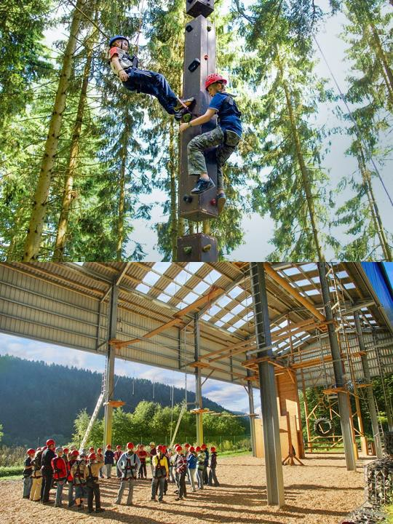
Adventure day
The hostel has a fantastic on-site area for a huge range of activities including climbing, high ropes, archery, giant swings, GPS orienteering and more!
Your betreuers will conduct all the thrilling activities in German
High ropes
Slacklining
Big swing
Ladder climbing
German games
Boulogne Town Trail
Your animateur organises this activity with our tailor made Town Trail requiring the students to read, understand and speak French

Slide 10
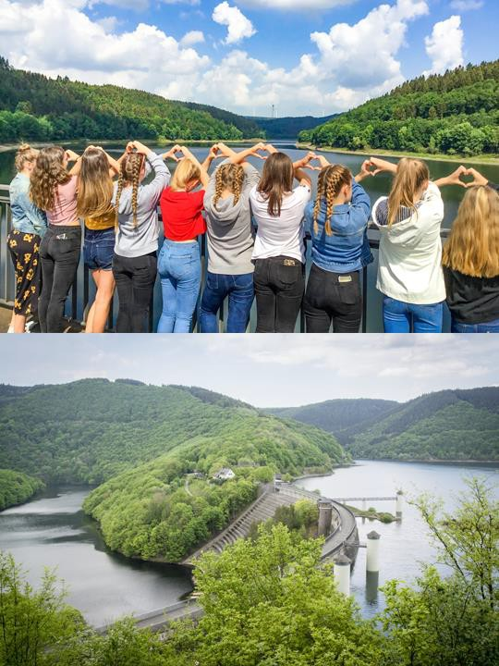
Simmerath Lake & Urft Dam
Pay a visit to the stunning lake where there’s the opportunity for you to go swimming or bask in the sun
Next walk up to the impressive Urft
dam and take in the amazing views
Boulogne Town Trail
Your animateur organises this activity with our tailor made Town Trail requiring the students to read, understand and speak French

Slide 11
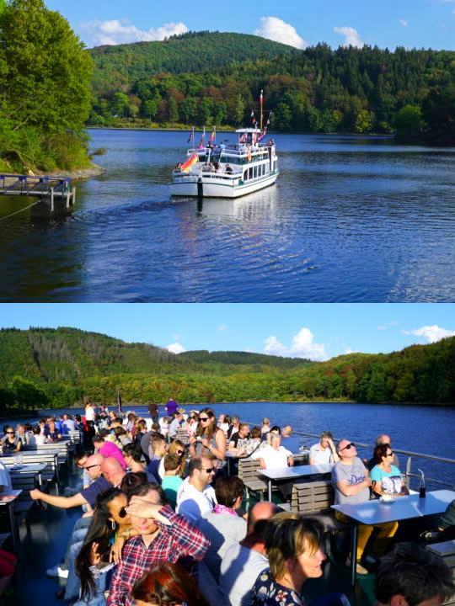
Boat trip
The best way to see the beautiful lake and surrounding greenery is by taking to the water!
Board your boat and enjoy your time as you cruise along the expansive lake and make your way through the valleys
Boulogne Town Trail
Your animateur organises this activity with our tailor made Town Trail requiring the students to read, understand and speak French

Slide 12
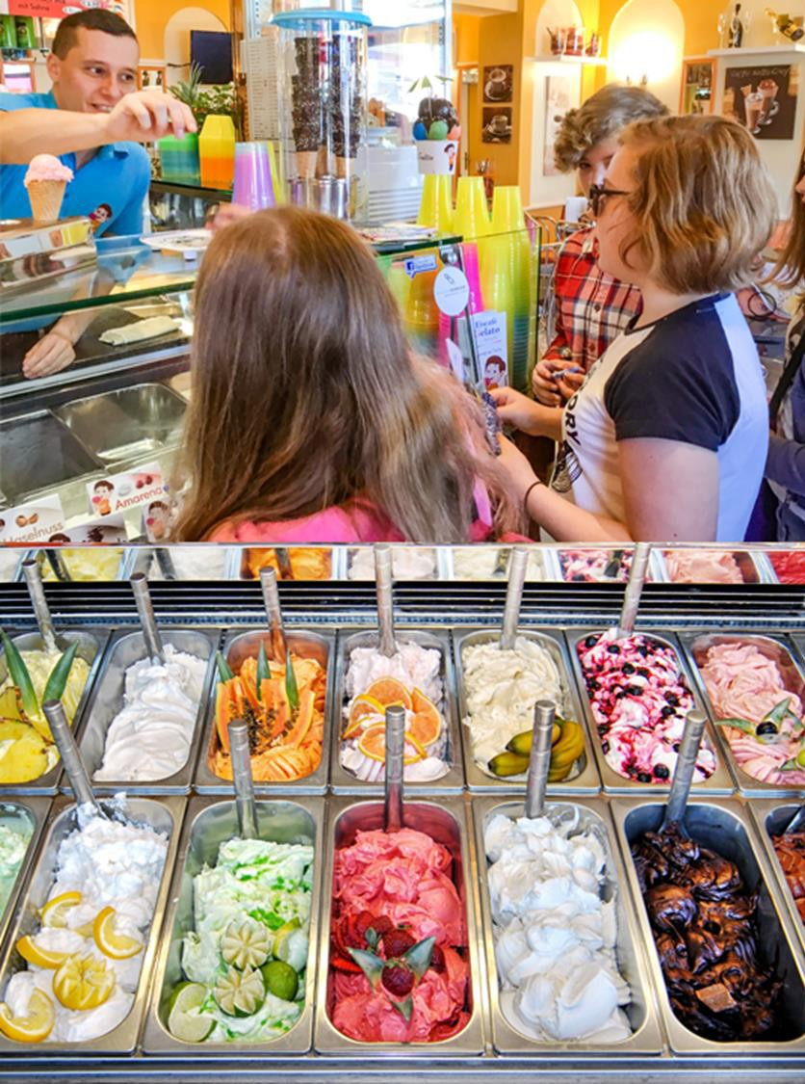
Eiscafé
Take a step inside a German ice cream shop - a wonderful place to practise your language skills by ordering in German and enjoy delicious ice cream!
Boulogne Town Trail
Your animateur organises this activity with our tailor made Town Trail requiring the students to read, understand and speak French

Slide 13
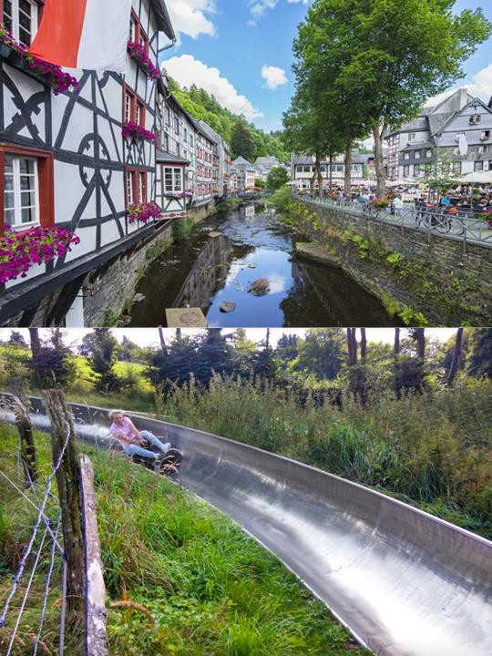
Monschau toboggan
Visit the charming town of Monschau and whizz through the winding hills of the Eifel region on a toboggan slide.
Boulogne Town Trail
Your animateur organises this activity with our tailor made Town Trail requiring the students to read, understand and speak French

Slide 14
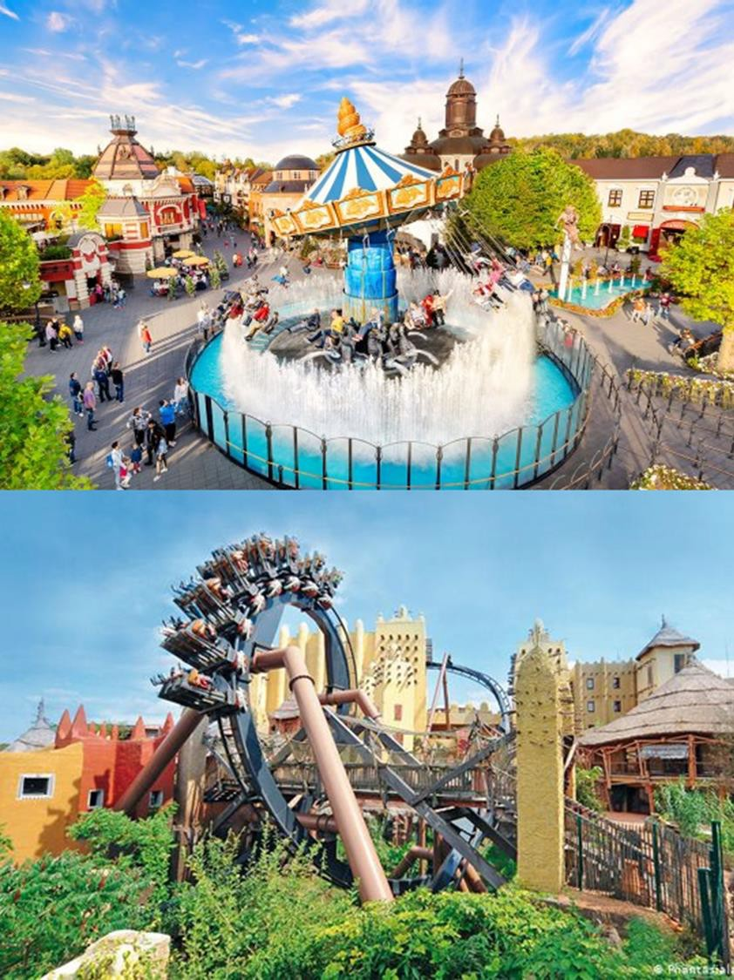
Phantasialand
Spend the whole day at Phantasialnd
This theme park is a combination of amusement park and adventure playground (suitable for all ages), with six different themes giving inspiration to the different zones: Fantasy, Deep in Africa, Berlin, Mexico, Mystery and China Town!
Boulogne Town Trail
Your animateur organises this activity with our tailor made Town Trail requiring the students to read, understand and speak French

Slide 15
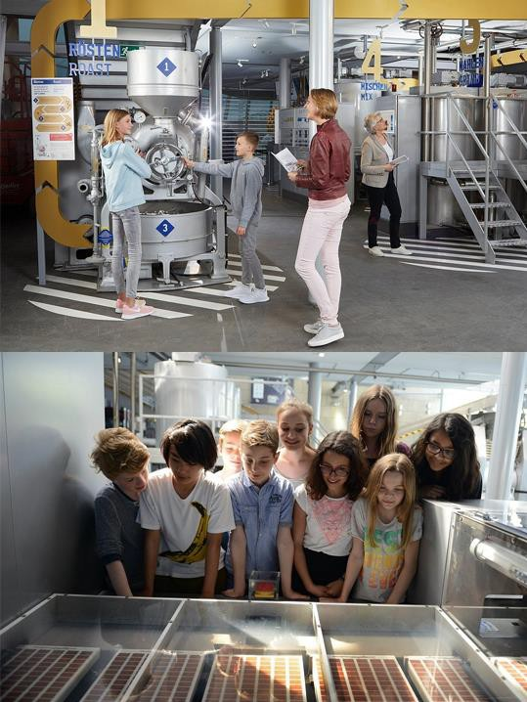
Lindt Chocolate Museum
Satisfy your sweet tooth at the Lindt Chocolate Museum in Cologne
Your Golden Ticket grants you a tour and, of course, some delicious samples!
Learn about the harvesting of cocoa and the process behind the production of chocolate
Boulogne Town Trail
Your animateur organises this activity with our tailor made Town Trail requiring the students to read, understand and speak French

Slide 16
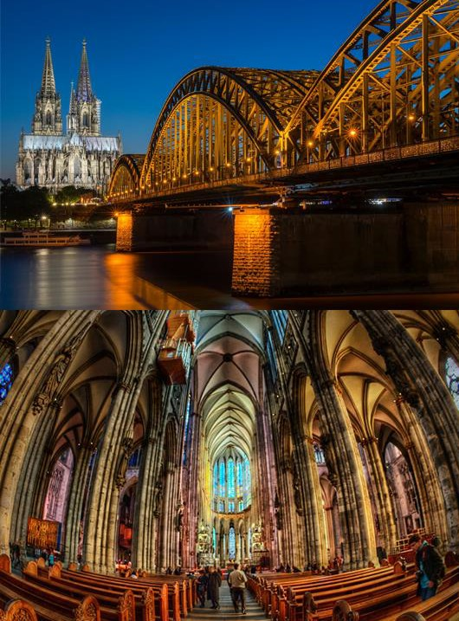
Cologne Cathedral
Step inside one of Germany’s most famous landmarks and marvel at the feat over 500 years in the making!
Boulogne Town Trail
Your animateur organises this activity with our tailor made Town Trail requiring the students to read, understand and speak French

Slide 17

Find us on
Click here for more information about the trip!

