Slide 1

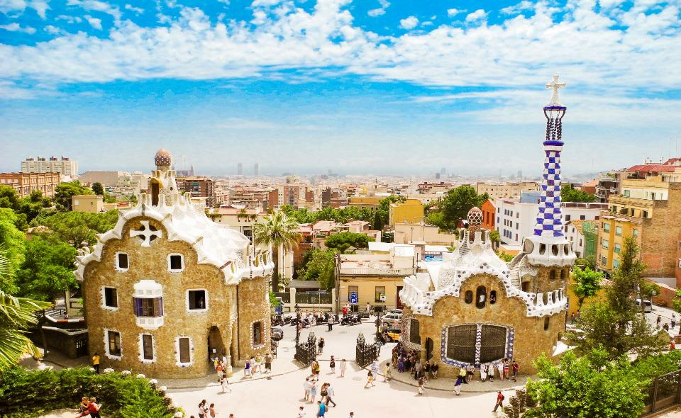
Your trip to Barcelona
School Name
DD–DD MM YYYY

Slide 2
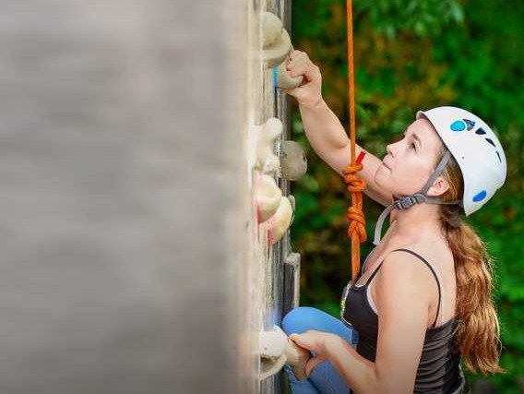
We help students reach new heights
Voyager School Travel specialises in educational school trips where students can learn, thrive and achieve their potential outside the classroom.
We believe that every school trip should provide students with new experiences, learning activities and exposure to local culture with genuine educational benefit.
Over 35,000 students travel with us each year

Slide 3



You’re in
safe hands
Your child’s safety is our priority and
we ensure the highest standards are met.
ABTA member
ATOL and ABTOT financial protected
School Travel Forum (STF) member
Learning Outside the Classroom (LOtC) Quality Badge holder
AAIAC Adventuremark holder
Audited safety management system
All accommodation audited
More about accreditation.

Slide 4
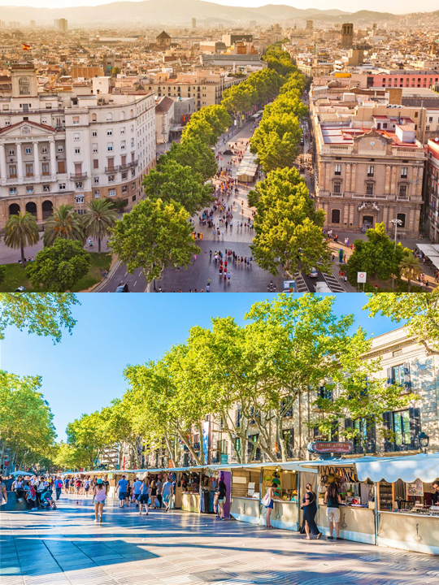
Guided Walking Tour
The best way to see the city is of course on foot! Gear up for a guided walking tour of beautiful Barcelona where you will get a feel of Catalonian life and see the sights that make this Spanish city so distinct.
Boulogne Town Trail
Your animateur organises this activity with our tailor made Town Trail requiring the students to read, understand and speak French

Slide 5
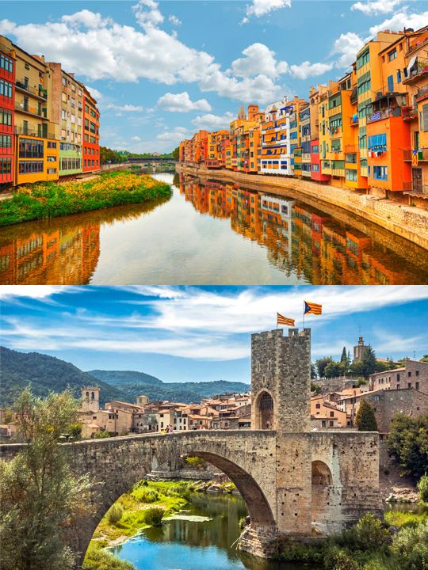

Girona
Explore the city of Girona, known for its medieval architecture and it’s walled Old Quarter

Slide 6
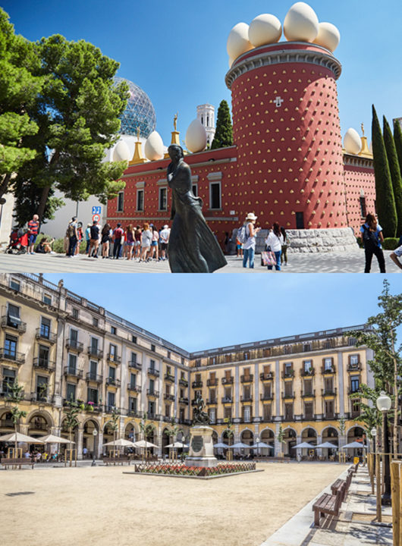

Museu Dalí
Head to the city of Figueres to explore the Salvador Dalí museum.
Dalí designed the museum himself, from the architecture of the building to the art within.
Take some time to wander around the town afterwards.
Boulogne Town Trail
Your animateur organises this activity with our tailor made Town Trail requiring the students to read, understand and speak French

Slide 7
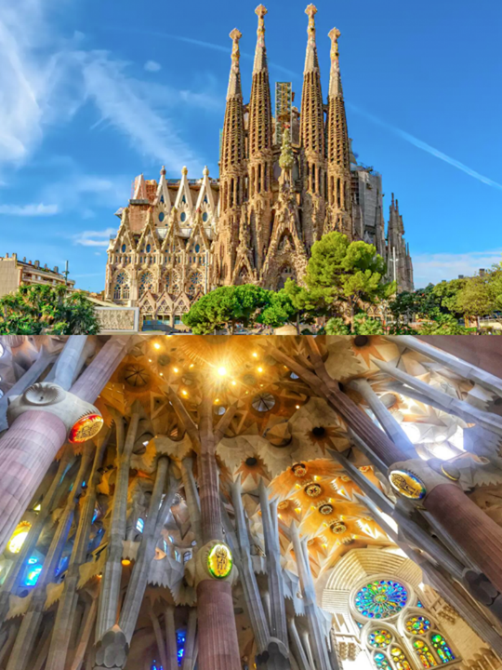
Sagrada Família
This visit is not included in the tour price.
Marvel at Gaudí’s unfinished masterpiece over 130 years in the making. The interior stunning colourful stained-glass windows are a must-see.
Boulogne Town Trail
Your animateur organises this activity with our tailor made Town Trail requiring the students to read, understand and speak French

Slide 8
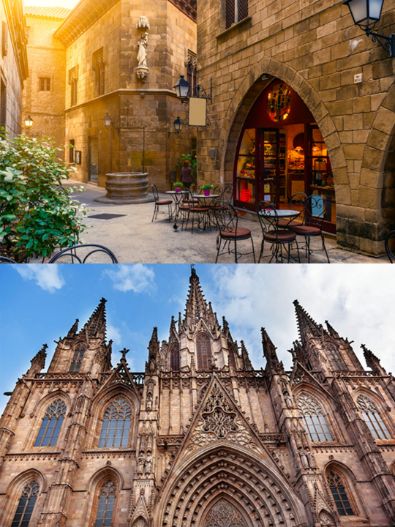
Gothic Quarter
Roman ruins, gothic architecture and plenty of shopping and local delicacies.
Make sure you visit the Cathedral and the winding and narrow streets around it.
Boulogne Town Trail
Your animateur organises this activity with our tailor made Town Trail requiring the students to read, understand and speak French

Slide 9
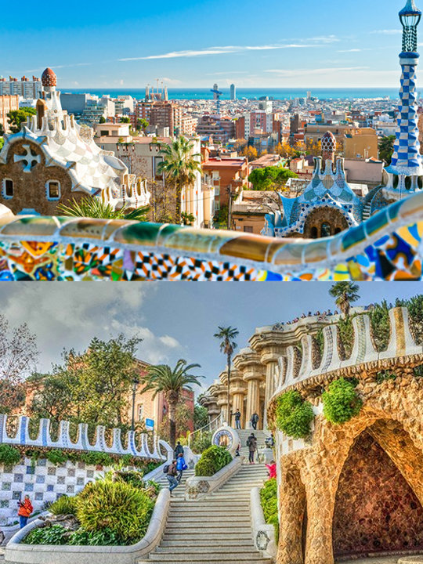
Park Güell
See the architectural features around the park, enjoy the stunning views of the city and learn about Gaudi's life at the House and Museum within the park grounds
Boulogne Town Trail
Your animateur organises this activity with our tailor made Town Trail requiring the students to read, understand and speak French

Slide 10
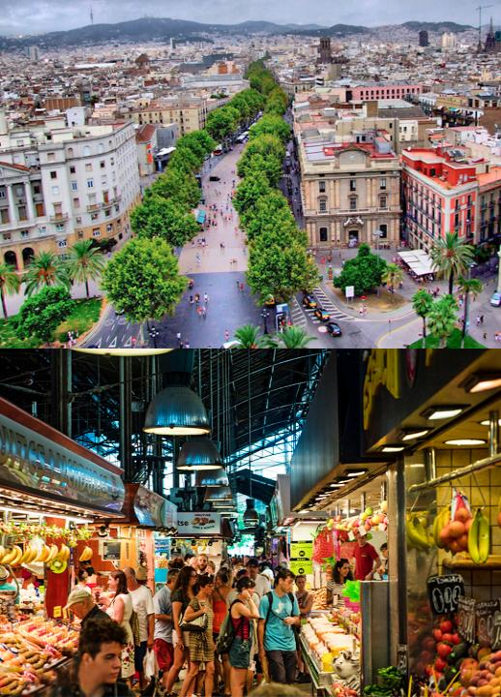
Las Ramblas
Discover the central most boulevard which cuts through the heart of the city centre - a vibrant and lively promenade filled with Barcelona action at its best!
Head to La Boqueria, the most famous market in Barcelona and try some of the great food on offer.
Boulogne Town Trail
Your animateur organises this activity with our tailor made Town Trail requiring the students to read, understand and speak French

Slide 11
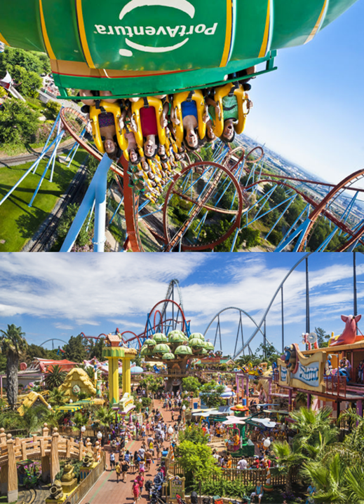
Port Aventura
Spend the full day of thrills at Port Aventura theme park with rides, live entertainment and other amusements!
Boulogne Town Trail
Your animateur organises this activity with our tailor made Town Trail requiring the students to read, understand and speak French

Slide 12
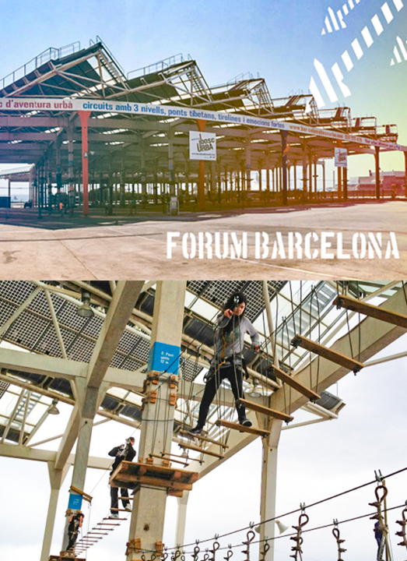
Bosc Urba
Experience the first adventure park in the city. Zip lines, climbing forest networks, bungee jumping and bridges are some of the attractions awaiting you!
Boulogne Town Trail
Your animateur organises this activity with our tailor made Town Trail requiring the students to read, understand and speak French

Slide 13
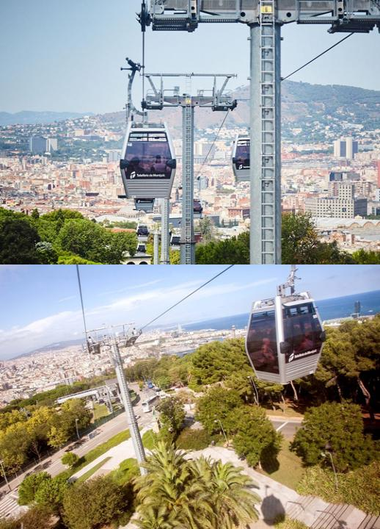
Montjuic Cable Car
You’ve already explored the city on foot, now see it from above! Ride the cable car over Barcelona and catch some amazing views.
Boulogne Town Trail
Your animateur organises this activity with our tailor made Town Trail requiring the students to read, understand and speak French

Slide 14
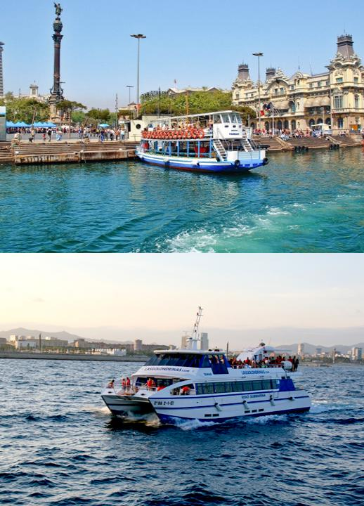
Boat Trip
Take to the water on a Las Golondrinas boat tour of the port of Barcelona
Boulogne Town Trail
Your animateur organises this activity with our tailor made Town Trail requiring the students to read, understand and speak French

Slide 15
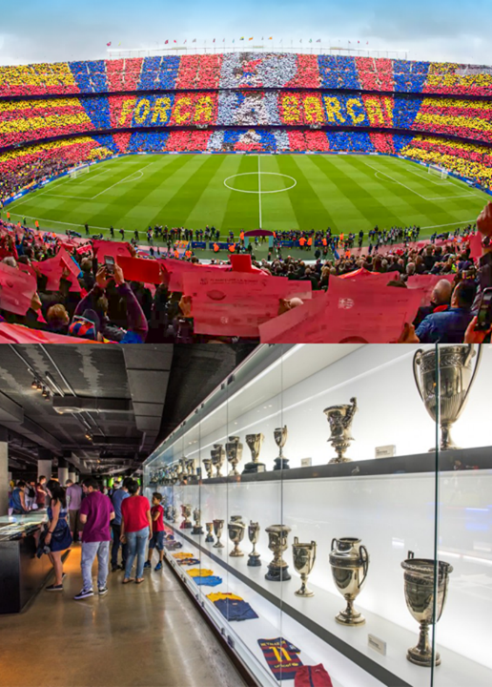
Camp Nou
You can visit every corner of the stadium and get a first-hand look at the places where day to day life takes place at the club and feel the magic of a five-star venue.
The Camp Nou Tour takes you through the past and present of an emblematic stadium for both Barça supporters and other football fans alike.
Boulogne Town Trail
Your animateur organises this activity with our tailor made Town Trail requiring the students to read, understand and speak French

Slide 16
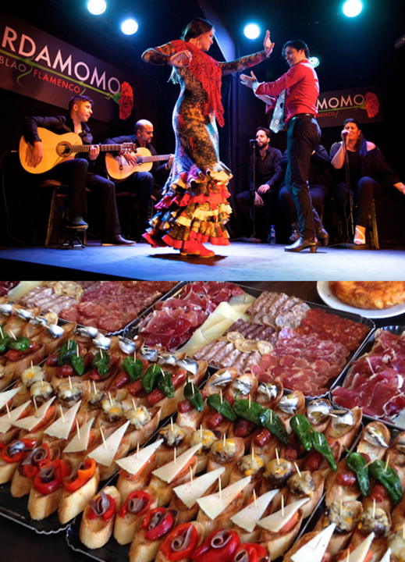
Flamenco and Tapas
Take a Spanish dance class to learn Flamenco, followed by a traditional tapas dinner to get a taste for the local cuisine.
Boulogne Town Trail
Your animateur organises this activity with our tailor made Town Trail requiring the students to read, understand and speak French

Slide 17
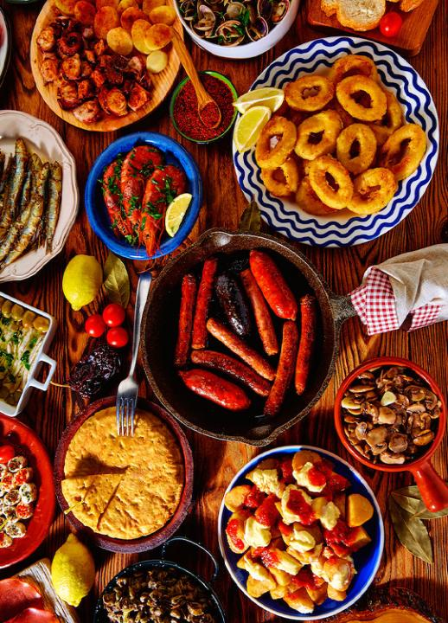
Tapas Dinner
Your students will enjoy a different meal and taste the authentic local tapas
Boulogne Town Trail
Your animateur organises this activity with our tailor made Town Trail requiring the students to read, understand and speak French

Slide 18
Barcelona is waiting for you!
Click here for more information about the trip!
Find us on

