Slide 1

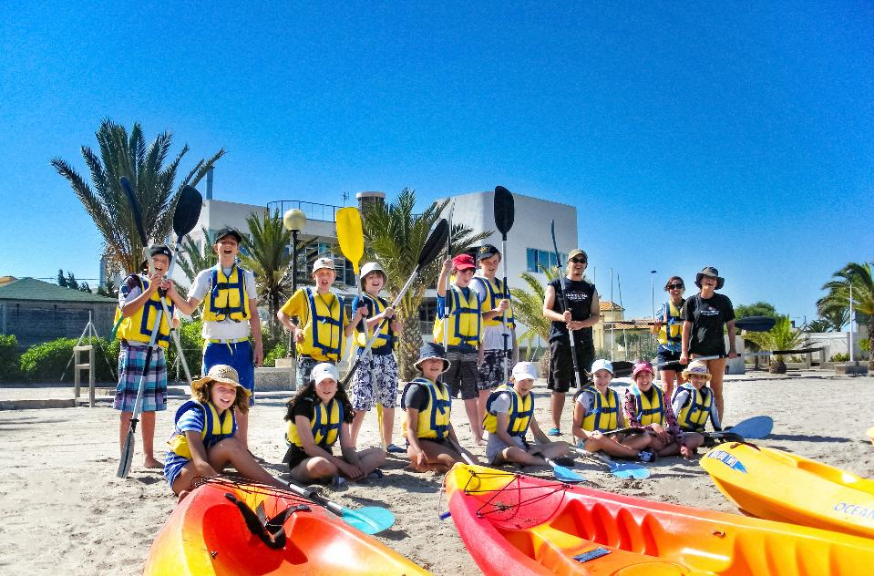
Your trip to Murcia
School Name
DD–DD MM YYYY

Slide 2
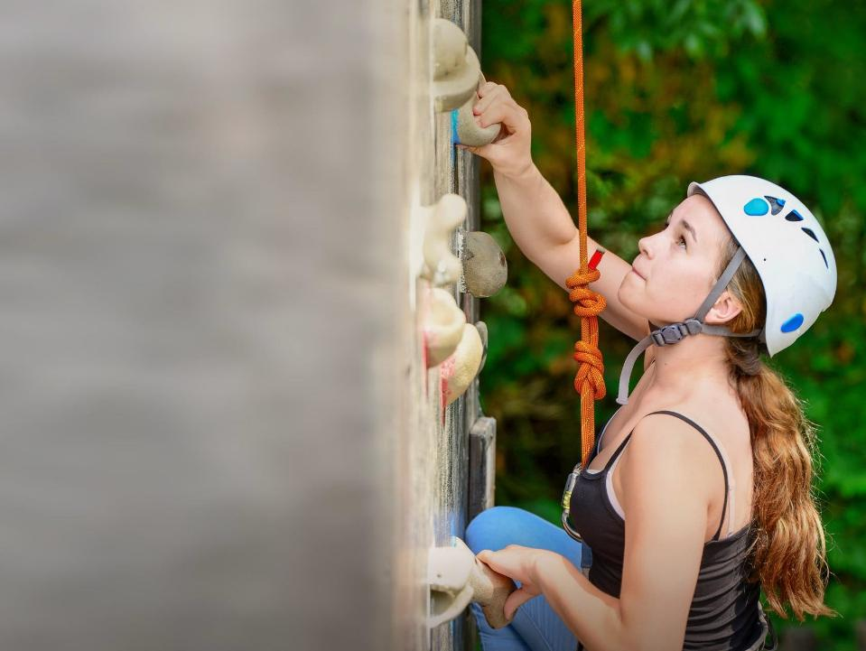
We help students reach new heights
Voyager School Travel specialises in educational school trips where students can learn, thrive and achieve their potential outside the classroom.
We believe that every school trip should provide students with new experiences, learning activities and exposure to local culture with genuine educational benefit.
Over 35,000 students travel with us each year

Slide 3



You’re in
safe hands
Your child’s safety is our priority and
we ensure the highest standards are met.
ABTA member
Protected by ATOL & ABTOT
School Travel Forum (STF) member
Hold the Learning Outside the Classroom (LOtC) Quality Badge
AAIAC Adventuremark holder
Externally audited safety management systems
All accommodation audited
More about accreditation.

Slide 4
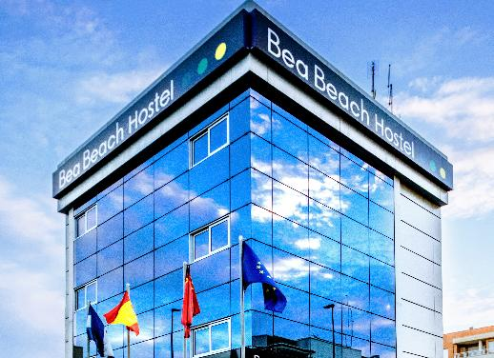
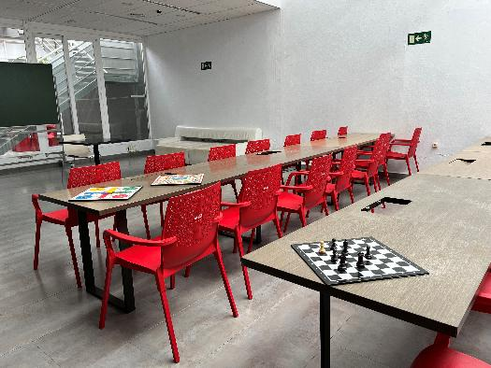
Accommodation
We offer two accommodation options in Águilas, Bea Beach and Nova Beach, both run by the same Arbolar team and offering the same activity programme
Bea Beach has a modern, hotel-style feel with ensuite rooms, a lifeguarded pool, and easy access to the beach and marina for watersports and games
Nova Beach offers ensuite rooms with single beds, lifeguarded pool and exclusive spaces for activities and language learning
Both centers are very close to each other and have free Wi-Fi, activity spaces, and are easily reached from most UK airports

Slide 5
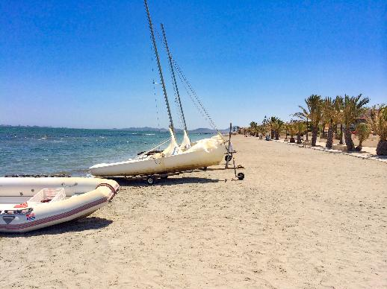
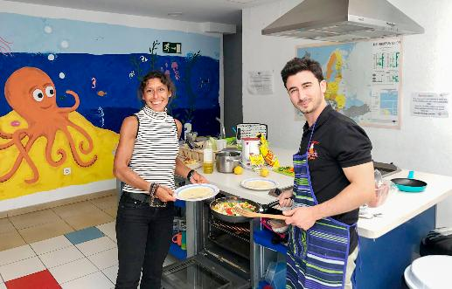
Welcome evening
Meet your monitores, the Spanish team who will be leading your trip and ensuring you have a truly Spanish cultural and linguistic experience
You’ll enjoy your first activity, such as
beach games or a pool party!

Slide 6
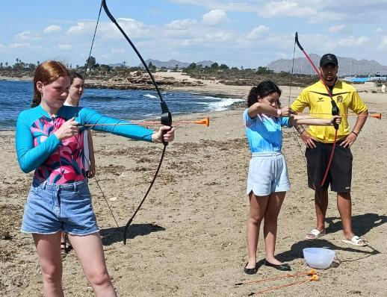
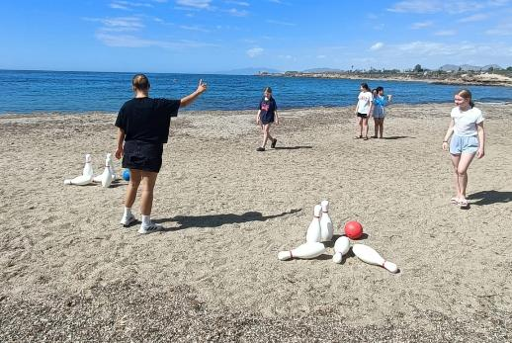
Beach games
Enjoy an afternoon with many different beach games to get your students practising their Spanish language learning, with our native Spanish speakers leading the games
Enjoy games such as archery, bowling and many more!

Slide 7
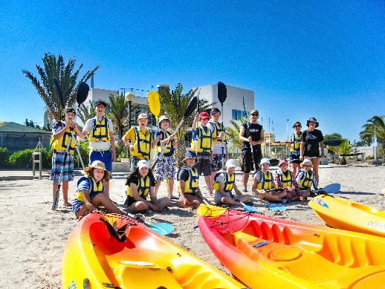
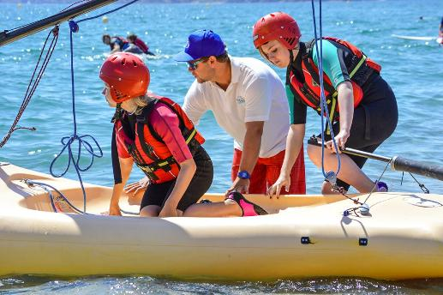
Watersports
Students will take part in a range of exciting watersports including paddleboarding, canoeing, and more
Each session is led by fully trained instructors, ensuring a safe and supportive environment where students can build confidence, develop language learning, and have loads of fun on the water

Slide 8
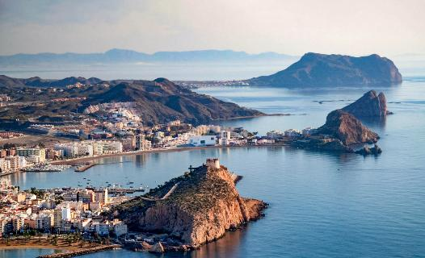
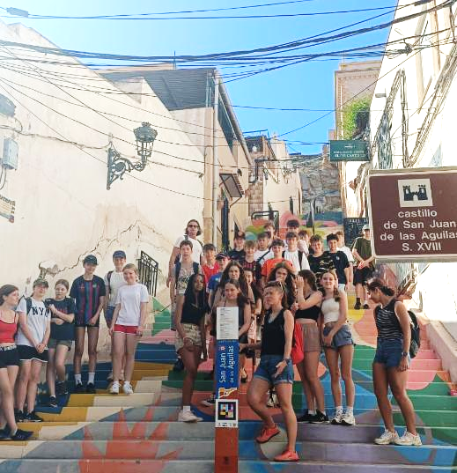
Águilas
Students will explore the charming coastal town of Águilas on a guided excursion, an old Roman fishing port with a rich seafaring flavour, where the group will visit the historic castle and fish market

Slide 9


Slide 10
Spain is waiting for you!
Click here for more information about the trip!
Find us on

