Slide 1

Your trip to
the Opal Coast of France
School Name
DD–DD MM 2022

Slide 2
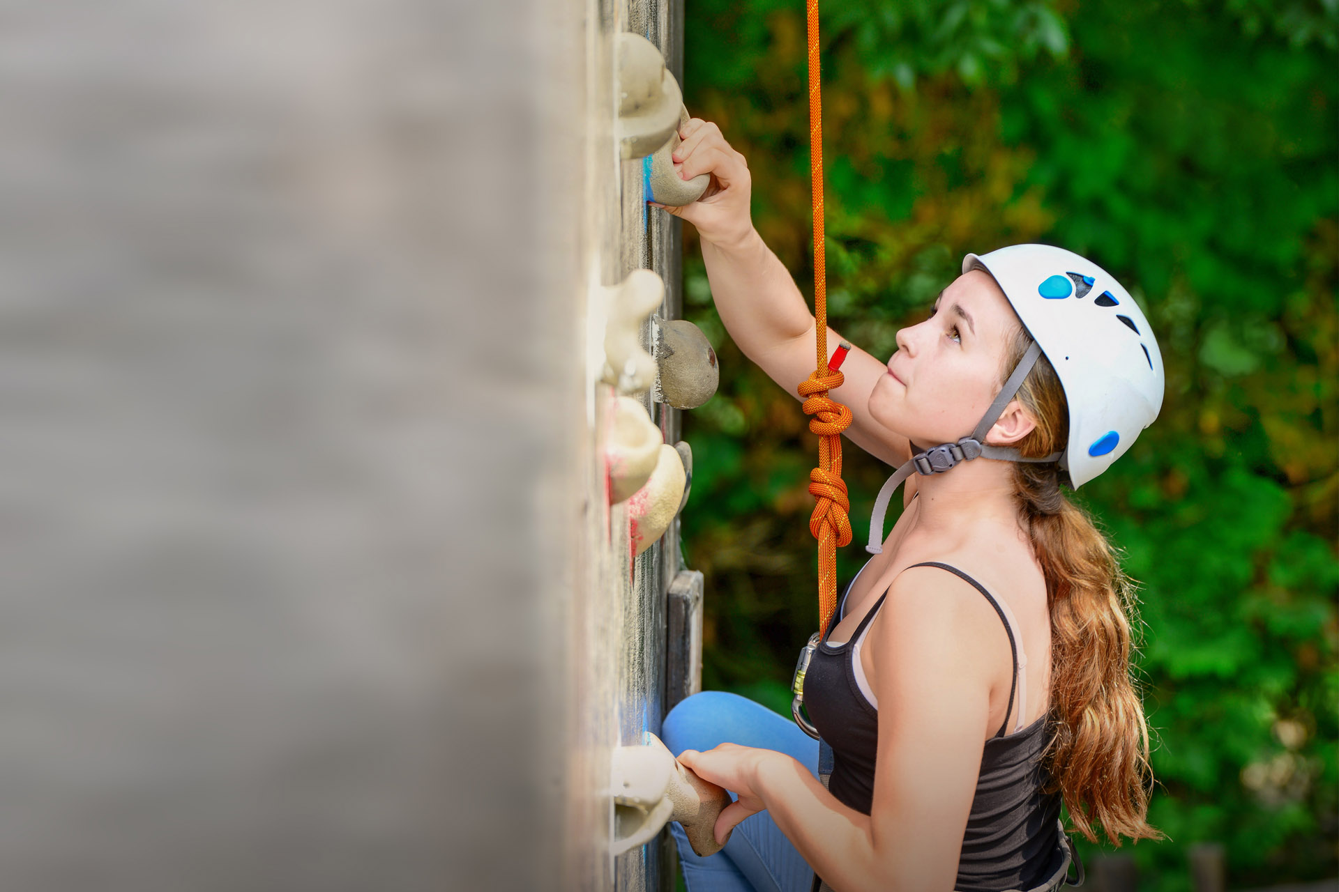
We help students reach new heights
Voyager School Travel specialises in educational school trips where students can learn, thrive and achieve their potential outside the classroom.
We believe that every school trip should provide students with new experiences, learning activities and exposure to local culture with genuine educational benefit.
Over 35,000 students travel with us each year

Slide 3

You’re in safe hands
Your child’s safety is our priority and we ensure the highest standards are met.
ABTA bonded
ATOL protected
School Travel Forum (STF) member
Learning Outside the Classroom (LOtC) Quality Badge holder
AAIAC Adventuremark holder
Audited safety management system
All accommodation audited

Slide 4
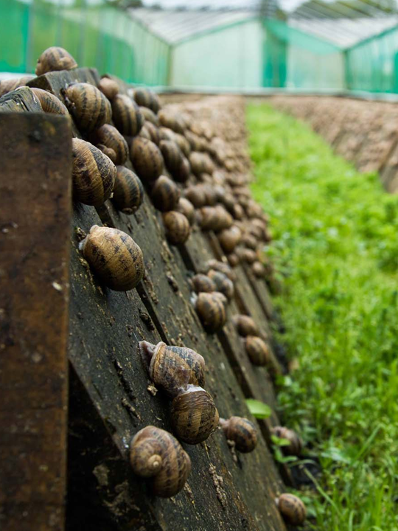
DAY 1 — OPAL COAST
Snail farm
An informative and entertaining introduction to the cultivation of snails
This visit is always a hit with students and they even get to taste some of the products
Boulogne Town Trail
Your animateur organises this activity with our tailor made Town Trail requiring the students to read, understand and speak French

Slide 5
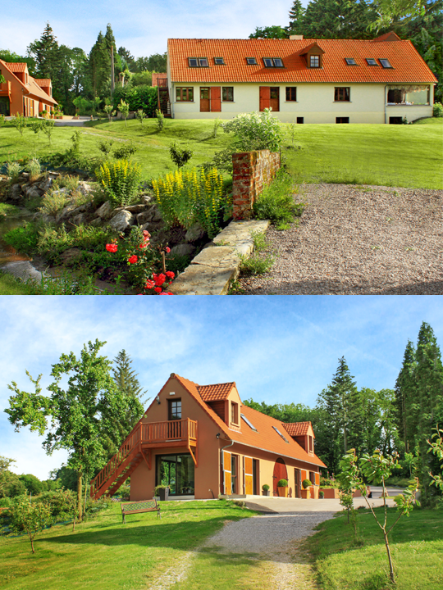
DAY 1 — OPAL COAST
Check in
Check in to the Hotel du Moulin where you will meet your Animateur
One of our Native French animateurs will accompany you throughout your stay, ensuring you get the most out of every visit, both culturally and linguistically

Slide 6
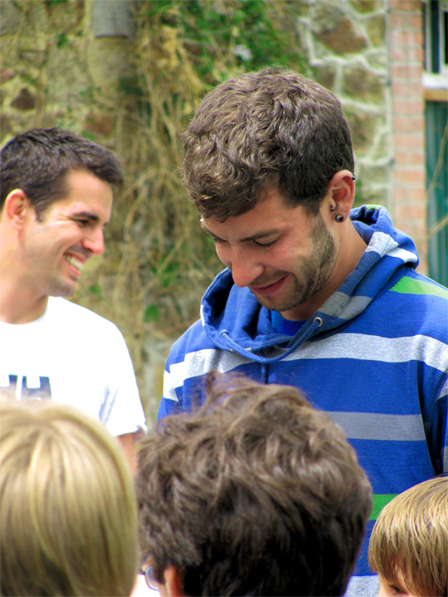
DAY 1 — OPAL COAST
Meet your animateur
Meet your animateur!
Our specially trained French native animateurs will be speaking with and encouraging interactive responses from you throughout your stay to challenge you and improve your language skills.
Your animateur will also lead activity sessions each evening of your trip

Slide 7
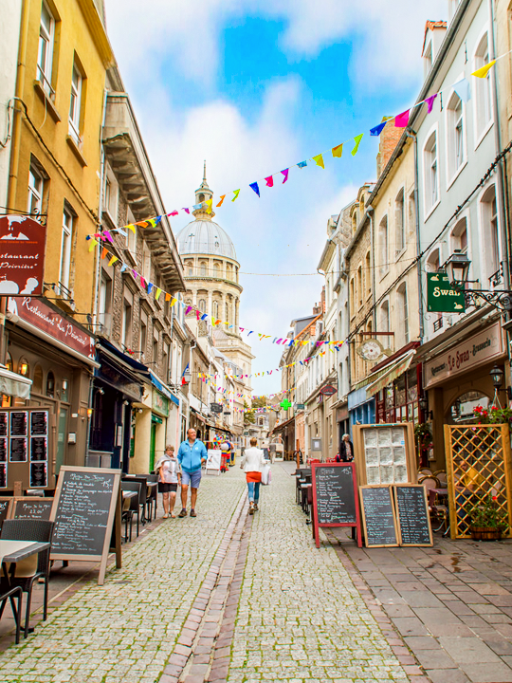
DAY 2 — OPAL COAST
Boulogne
town trail
Your animateur organises this activity with our tailor made Town trail requiring the students to read, understand and speak French
The largest fishing port in France, Boulogne has a lively atmosphere including a vibrant market at the heart of the medieval Old Town
Boulogne Town Trail
Your animateur organises this activity with our tailor made Town Trail requiring the students to read, understand and speak French

Slide 8
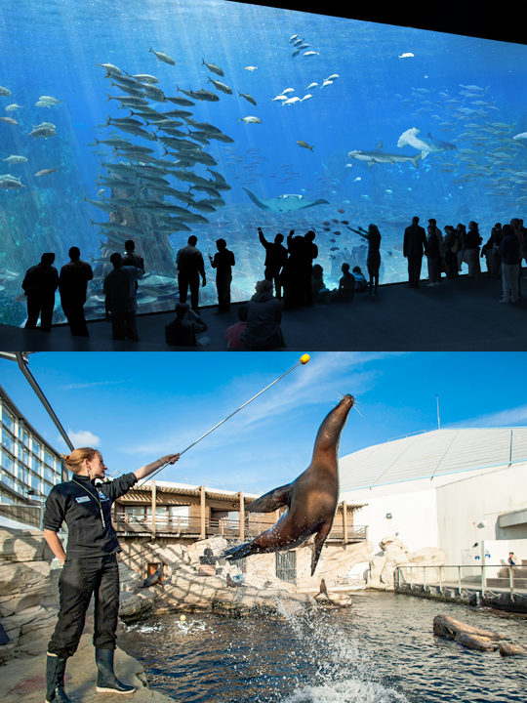
DAY 2 — OPAL COAST
Nausicaa
One of France’s most popular attractions, this world class aquarium is a highlight of the region
With good eco credentials, Nausicaa is home to a wide range of exhibits including a stunning living reef, sea-lion pool and tropical lagoon with sharks
Boulogne Town Trail
Your animateur organises this activity with our tailor made Town Trail requiring the students to read, understand and speak French

Slide 9

DAY 2 — OPAL COAST
Local
bakery
Visit a local French bakery or “Boulangerie” for a demonstration in French
You will walk away with a croissant and a pain au chocolat each
Boulogne Town Trail
Your animateur organises this activity with our tailor made Town Trail requiring the students to read, understand and speak French

Slide 10
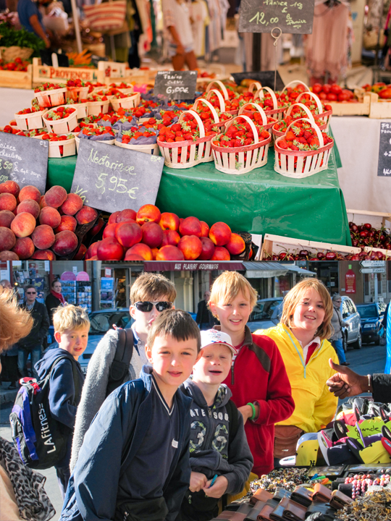
DAY 3 — OPAL COAST
Market
mission
Visit a local market with your animateur. Teams of students will be given money to buy ingredients for a packed lunch and you will also have some general shopping time
Return to your accommodation where your animateur will organise a competition for the best lunch
Boulogne Town Trail
Your animateur organises this activity with our tailor made Town Trail requiring the students to read, understand and speak French

Slide 11
DAY 3 — OPAL COAST
Treetop adventure
Climb and zip your way around the beautiful forest at Camiers Sainte-Cecile
With courses ranging from beginner to an adrenaline pumping ‘black’ course that includes biking and wake boarding through the tree tops
Boulogne Town Trail
Your animateur organises this activity with our tailor made Town Trail requiring the students to read, understand and speak French

Slide 12
DAY 4 — OPAL COAST
Vimy
Ridge
Taking a morning visit to the striking Vimy Ridge memorial
A humbling reminder of those who bravely helped, fought and died in the Battle of Arras during WWI
Boulogne Town Trail
Your animateur organises this activity with our tailor made Town Trail requiring the students to read, understand and speak French

Slide 13
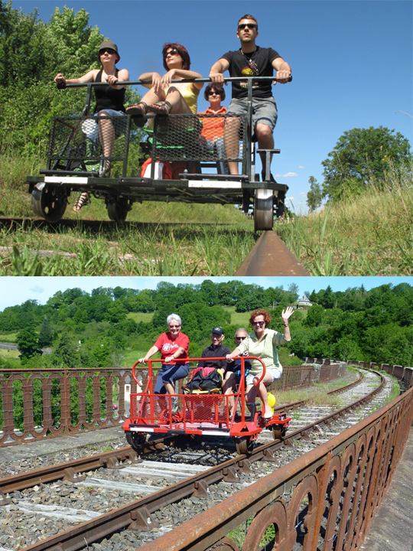
DAY 4 — OPAL COAST
Rando
Rail
Is it a bike or a go-kart? It is something between the two
Each vehicle takes 4 people at a time, as you pedal along the 10 km-long scenic disused railway track you’ll reach quite a speed when you roll down to the bottom
Boulogne Town Trail
Your animateur organises this activity with our tailor made Town Trail requiring the students to read, understand and speak French

Slide 14
DAY 5 — OPAL COAST
Check out
Check out after breakfast and make your way back to Calais for your crossing home
Arrive back at school in the afternoon

Slide 15

France is waiting for you!
Find us on

