Slide 1

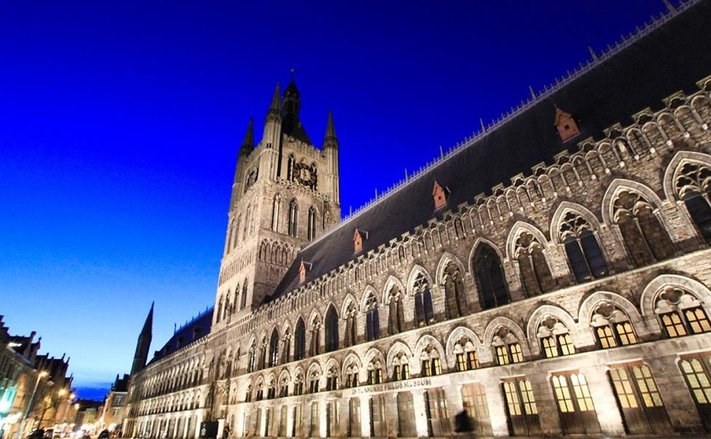
Your trip to the Belgian Battlefields
School Name
DD–DD MM YYYY

Slide 2
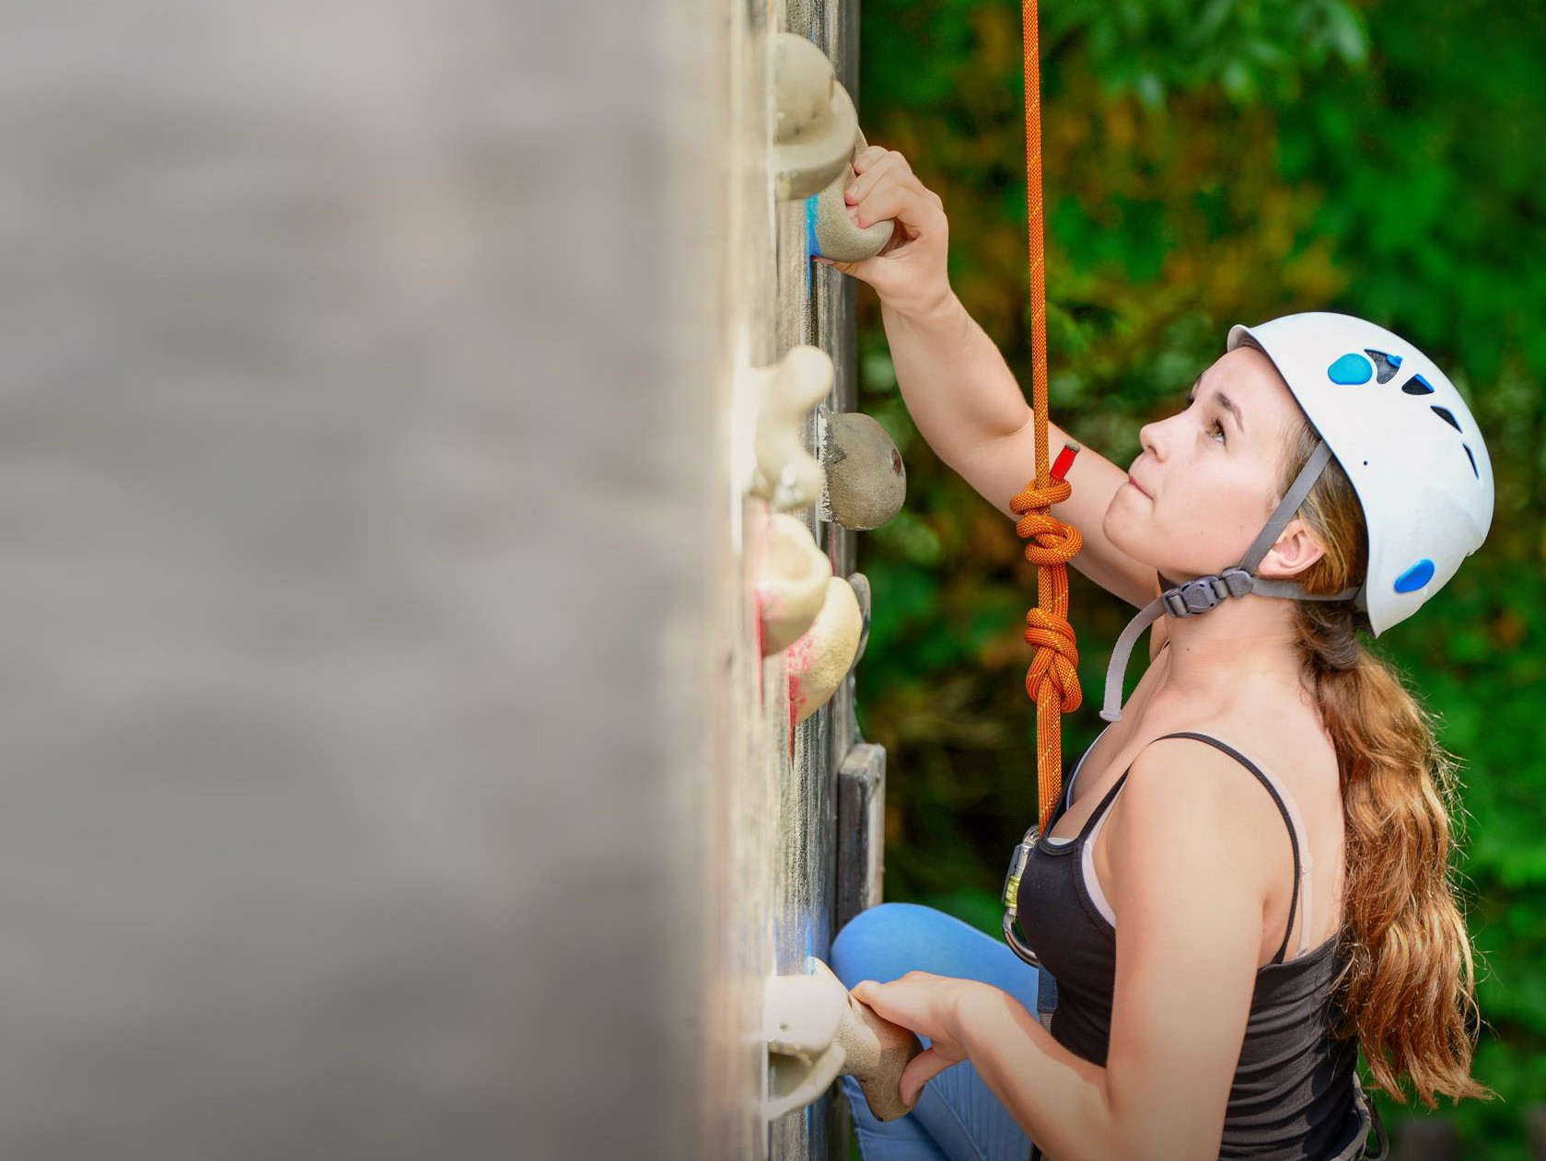
We help students reach new heights
Voyager School Travel specialises in educational school trips where students can learn, thrive and achieve their potential outside the classroom.
We believe that every school trip should provide students with new experiences, learning activities and exposure to local culture with genuine educational benefit.
Over 32,000 students travel with us each year

Slide 3



You’re in
safe hands
Your child’s safety is our priority and
we ensure the highest standards are met.
ABTA member
ATOL and ABTOT financial protected
School Travel Forum (STF) member
Learning Outside the Classroom (LOtC) Quality Badge holder
AAIAC Adventuremark holder
Audited safety management system
All accommodation audited
More about accreditation.

Slide 4
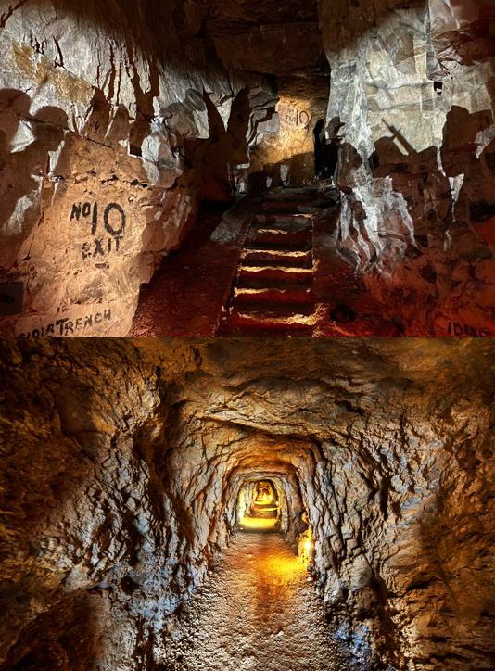
Wellington Quarry
At The Carrière Wellington museum in Arras, students can walk the same network of WWI tunnels which were utilised by the British troops in a surprise attack on the Germans.
Boulogne Town Trail
Your animateur organises this activity with our tailor made Town Trail requiring the students to read, understand and speak French

Slide 5
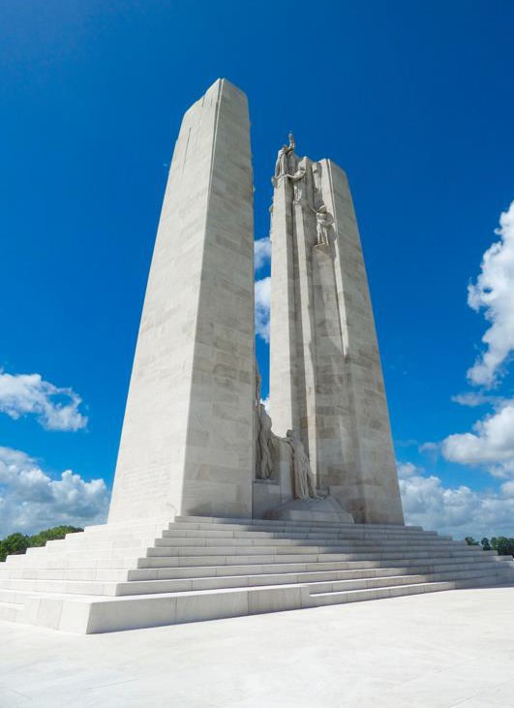
Vimy Ridge Memorial
The striking Canadian National Vimy Memorial is dedicated to the memory of the Canadian servicemen who lost their lives in WWI—particularly in the Battle of Vimy Ridge.
Boulogne Town Trail
Your animateur organises this activity with our tailor made Town Trail requiring the students to read, understand and speak French

Slide 6
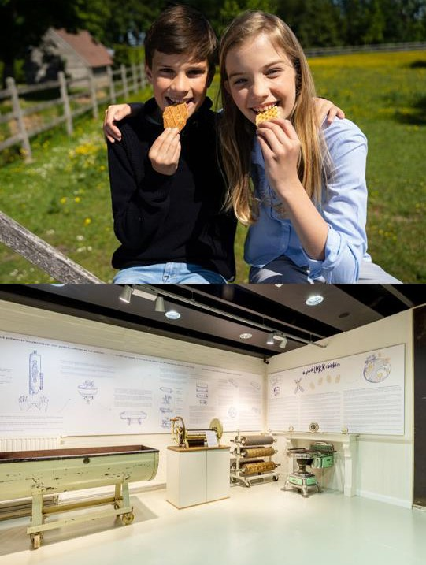
Jules Destrooper Biscuit Factory
Is there a waffle iron with diamonds?
How did they deliver all those biscuits back in the day?
How does Jules Destrooper select the natural ingredients for its biscuits?
You’ll find all the answers during a visit to the Jules Destrooper Visitors Center. From the old family recipes from 1886 to the latest production processes, you’ll see—and taste— everything!
Boulogne Town Trail
Your animateur organises this activity with our tailor made Town Trail requiring the students to read, understand and speak French

Slide 7
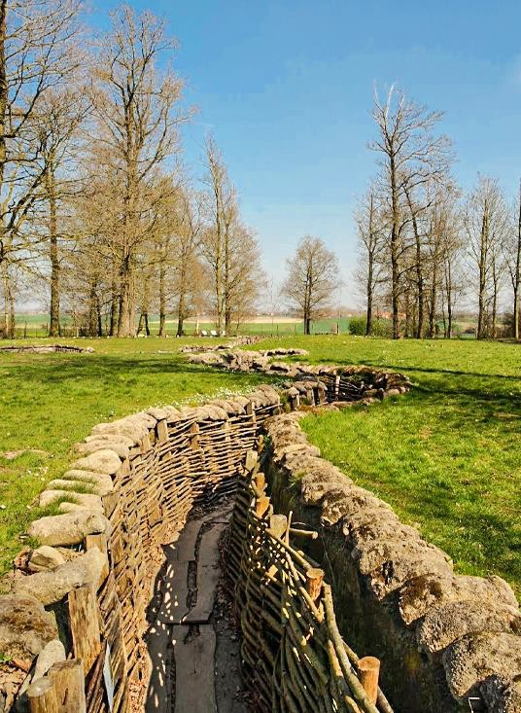
Bayernwald Trenches
Step back in time on this guided tour and experience the intricate network of World War I trenches firsthand.
Take a unique glimpse into the life of soldiers during the conflict as you explore the well-preserved trenches, bunkers, and artefacts
Boulogne Town Trail
Your animateur organises this activity with our tailor made Town Trail requiring the students to read, understand and speak French

Slide 8
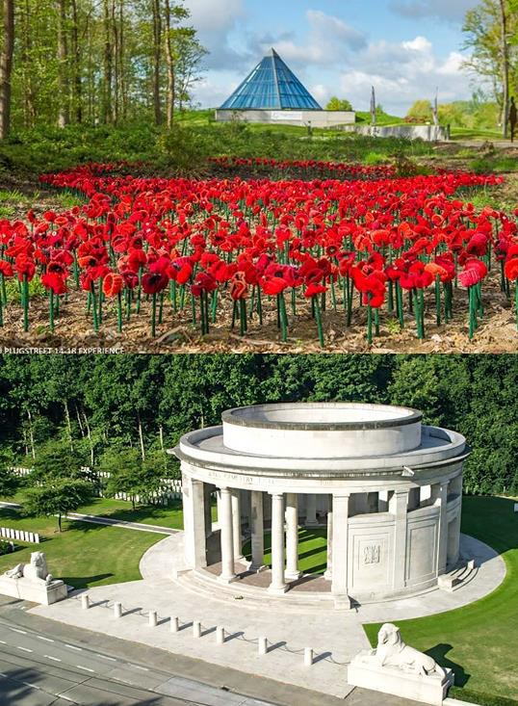
Plugstreet 14-18
This museum is dedicated to the heavy fighting that took place at Ploegsteert during WWI.
It takes students on an interactive journey into the lives of civilians and soldiers, from an Anglo-Germanic perspective.
A major site of interest includes the Memorial to the Missing commemorating 11,369 men with no known grave.
Boulogne Town Trail
Your animateur organises this activity with our tailor made Town Trail requiring the students to read, understand and speak French

Slide 9
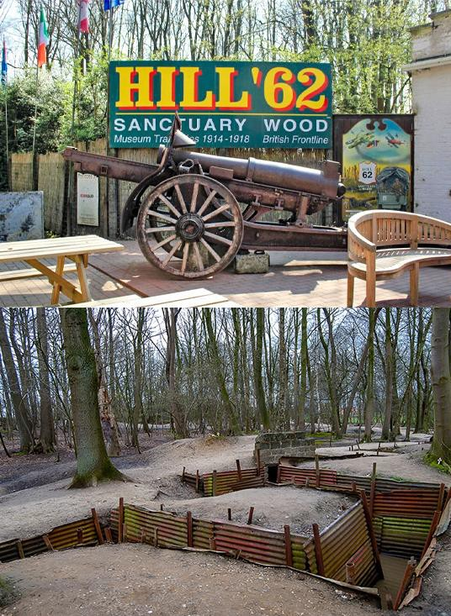
Sanctuary Wood Museum
Discover how casualties were tended to during the first battle of Ypres.
Visit the museum and walk through a
series of well-preserved trenches.
Boulogne Town Trail
Your animateur organises this activity with our tailor made Town Trail requiring the students to read, understand and speak French

Slide 10
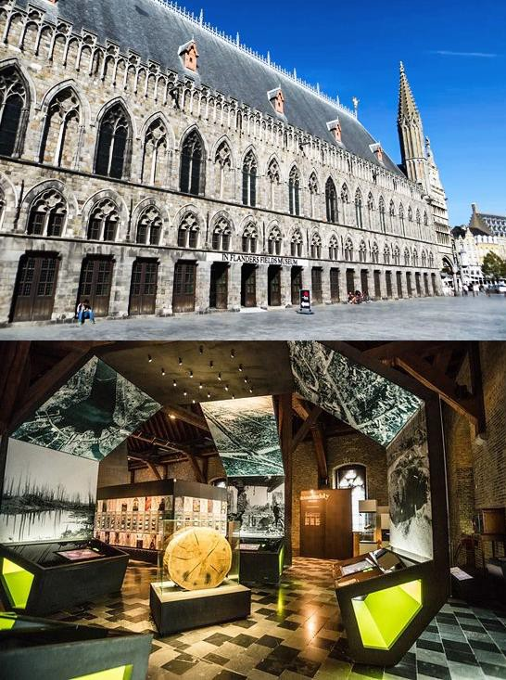
In Flanders Fields Museum
Delve into the rich history of World War I and gain a greater understanding of the conflict's impact on the region through immersive exhibits and interactive displays.
Explore the personal stories of soldiers, see artefacts and feel the resilient spirit of those who lived through the war.
Boulogne Town Trail
Your animateur organises this activity with our tailor made Town Trail requiring the students to read, understand and speak French

Slide 11
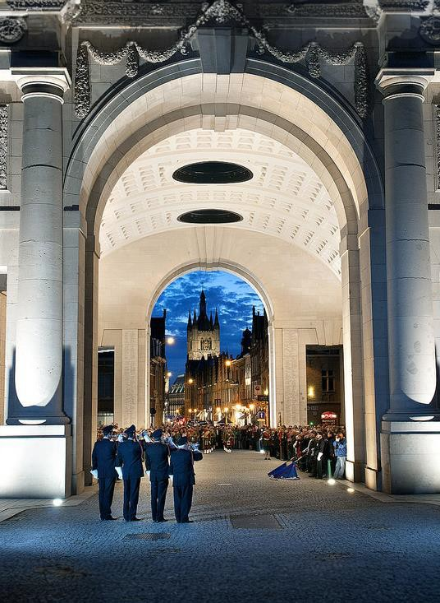
The Last Post Ceremony
The Last Post ceremony at the Menin Gate Memorial in Ypres, Belgium, is a poignant nightly tradition which takes place at 8pm.
Local buglers from the fire brigade come together to play "The Last Post," commemorating the bravery of the soldiers who served during World War I.
Boulogne Town Trail
Your animateur organises this activity with our tailor made Town Trail requiring the students to read, understand and speak French

Slide 12
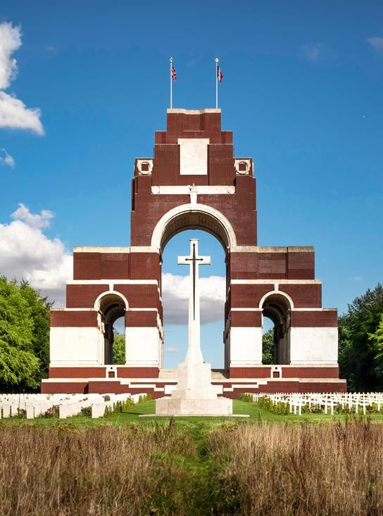
Thiepval Memorial & Visitor Centre
The largest British war memorial in the world is known as the "Memorial to the Missing".
A moving tribute to the 72,000+ servicemen who died in the Battles of the Somme in WWI.
Boulogne Town Trail
Your animateur organises this activity with our tailor made Town Trail requiring the students to read, understand and speak French

Slide 13

Somme and the French battlefields
Morning visit to Arras and visit the Market in Grand Place
Explore Wellington Quarry, a maze of underground tunnels that housed 24,000 British soldiers preparing a surprise attack in 1917. Learn about the mission in the adjoining museum
Visit Vimy Ridge, Canada’s largest overseas National Memorial dedicated to the 11,000 Canadians who died in France & Belgium
Boulogne Town Trail
Your animateur organises this activity with our tailor made Town Trail requiring the students to read, understand and speak French

