Slide 1
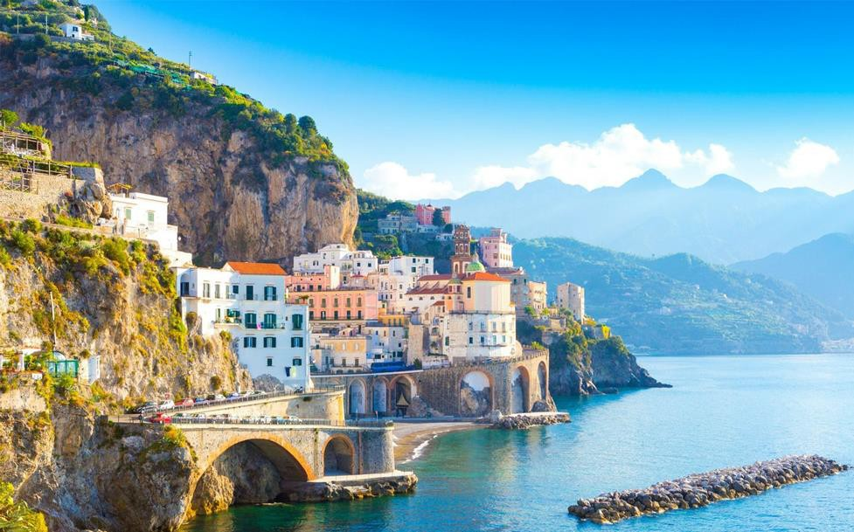
Your trip to Sorrento & Naples
School Name
DD–DD MM YYYY

Slide 2
We help students reach new heights
Voyager School Travel specialises in educational school trips where students can learn, thrive and achieve their potential outside the classroom.
We believe that every school trip should provide students with new experiences, learning activities and exposure to local culture with genuine educational benefit.
Over 32,000 students travel with us each year

Slide 3
You’re in
safe hands
Your child’s safety is our priority and
we ensure the highest standards are met.
ABTA member
ATOL and ABTOT financial protected
School Travel Forum (STF) member
Learning Outside the Classroom (LOtC) Quality Badge holder
AAIAC Adventuremark holder
Audited safety management system
All accommodation audited
More about accreditation.

Slide 4
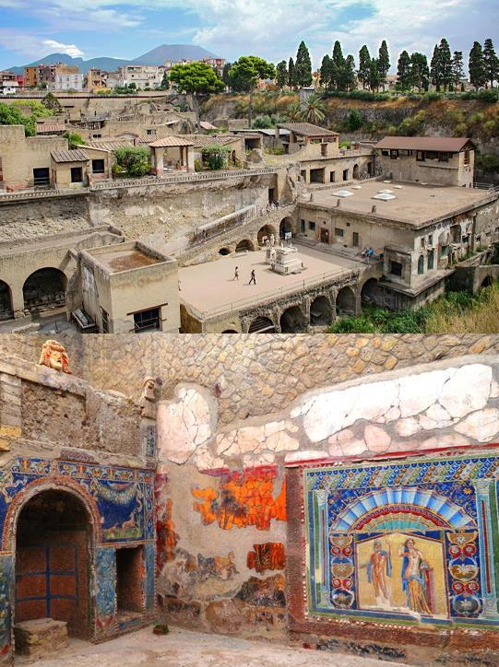
Herculaneum
Located in the shadow of Mount Vesuvius, Herculaneum is the sister city of Pompeii
Herculaneum is a popular visit with our groups because it is better preserved than Pompeii as the city was buried in mud rather than volcanic ash—and it tends to draw fewer crowds
Boulogne Town Trail
Your animateur organises this activity with our tailor made Town Trail requiring the students to read, understand and speak French

Slide 5
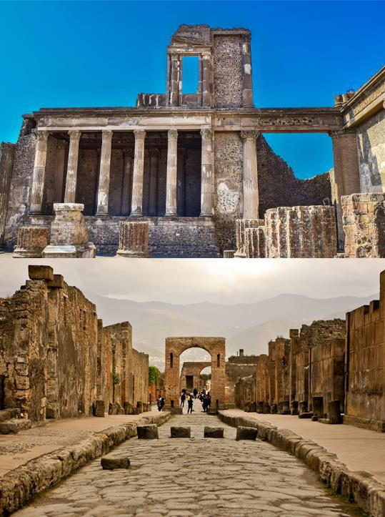
Pompeii
Once a thriving and sophisticated Roman city, Pompeii was buried under meters of ash and pumice after the catastrophic eruption of Mount Vesuvius in 79 A.D.
The preserved site features excavated ruins of streets and houses that students can freely explore
Boulogne Town Trail
Your animateur organises this activity with our tailor made Town Trail requiring the students to read, understand and speak French

Slide 6
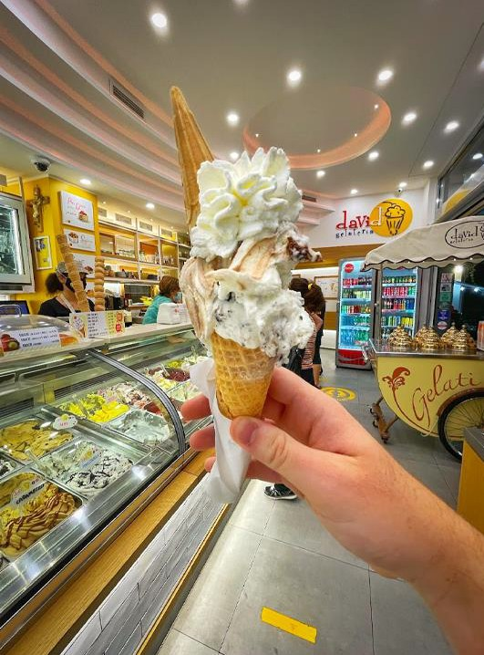
Ice Cream Demonstration
This is one sweet experience!
Step inside an Italian gelateria where a gelato artisan will share the secrets behind creating this frozen treat
End the demonstration by tasting some for yourself
Boulogne Town Trail
Your animateur organises this activity with our tailor made Town Trail requiring the students to read, understand and speak French

Slide 7
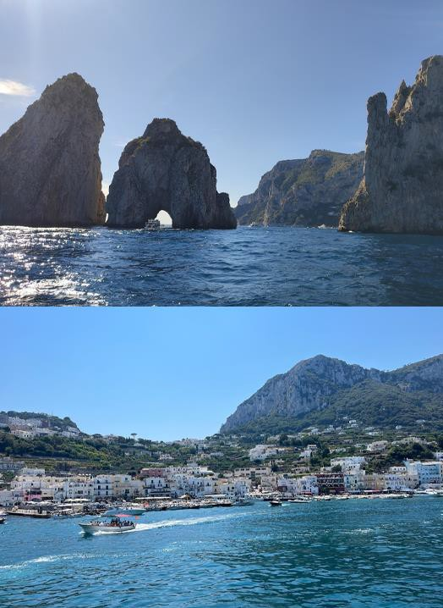
Capri boat tour
See the stunning island of Capri from the water on this mesmerising boat tour
Stop at various sights along the coast including Natural Arch, Statue of the Scugnizzo and Lighthouse of Punta Carena
Boulogne Town Trail
Your animateur organises this activity with our tailor made Town Trail requiring the students to read, understand and speak French

Slide 8
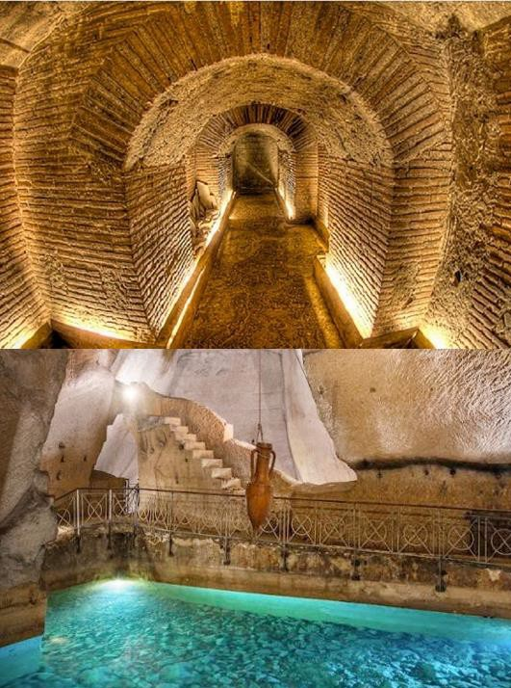
Napoli Sotterranea
Forty meters below the lively streets of the Historic Centre of Naples, you find a different world, unexplored, isolated by time, but deeply connected with the world above
Embark on a fascinating underground tour of a network of tunnels beneath Naples
Boulogne Town Trail
Your animateur organises this activity with our tailor made Town Trail requiring the students to read, understand and speak French

Slide 9
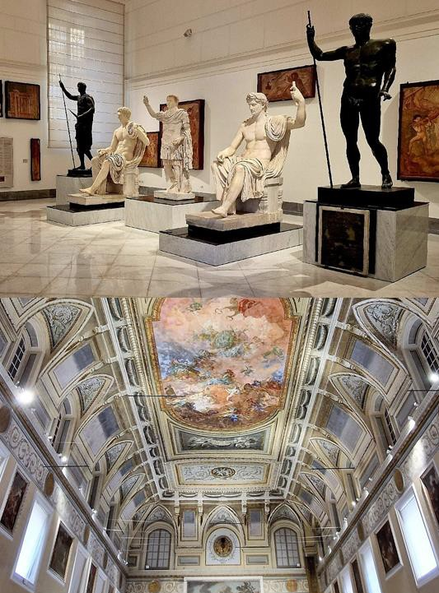
Naples National Archaeological Museum
This museum is a fantastic stop to complement your visit to Pompeii, with an array of mosaics, frescoes and artefacts from the ruins of Pompeii and Herculaneum on display
Boulogne Town Trail
Your animateur organises this activity with our tailor made Town Trail requiring the students to read, understand and speak French

