Slide 1

Your trip to
Normandy, France
School Name
DD–DD MM YYYY

Slide 2
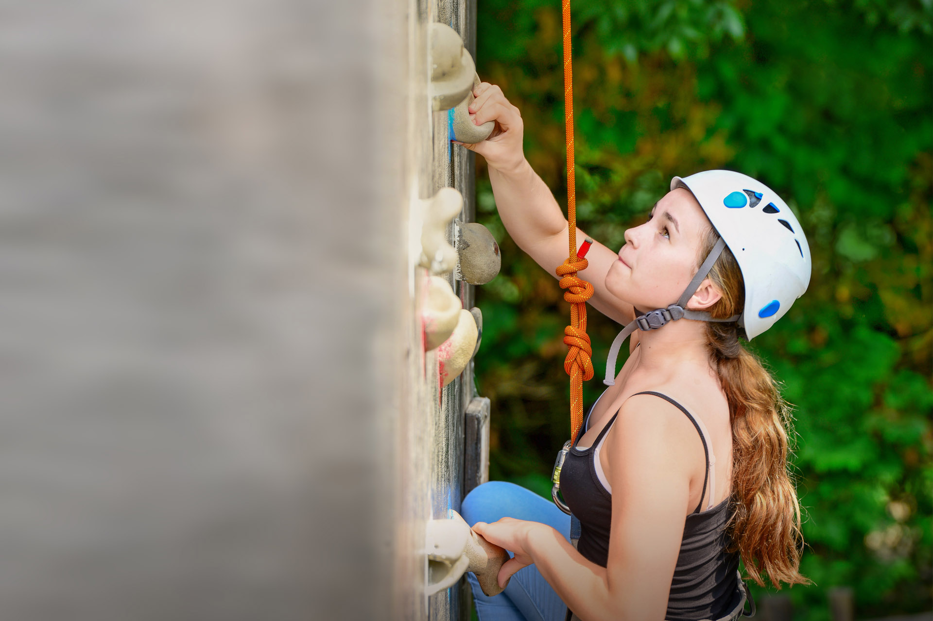
We help students reach new heights
Voyager School Travel specialises in educational school trips where students can learn, thrive and achieve their potential outside the classroom.
We believe that every school trip should provide students with new experiences, learning activities and exposure to local culture with genuine educational benefit.
Over 35,000 students travel with us each year

Slide 3



You’re in safe hands
Your child’s safety is our priority and we ensure the highest standards are met.
ABTA bonded
ATOL protected
School Travel Forum (STF) member
Learning Outside the Classroom (LOtC) Quality Badge holder
AAIAC Adventuremark holder
Audited safety management system
All accommodation audited
More about accreditation.

Slide 4
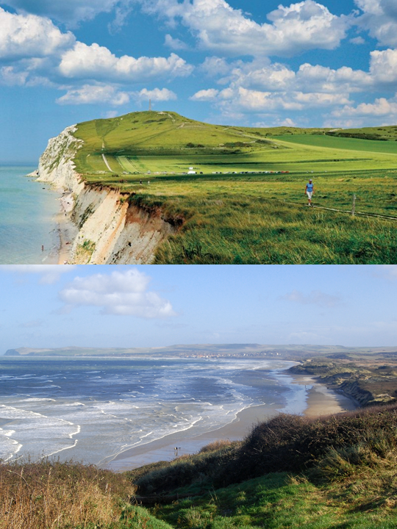
Les
Deux Caps
These two headlands offer spectacular views across the channel and up and down the Opal Coast. On clear days The White Cliffs of Dover seem no distance away at all
It is possible to walk along the coastal paths from the car-parks located at both headlands, and observe the birdlife as well as the former defensive buildings from WW2
Boulogne Town Trail
Your animateur organises this activity with our tailor made Town Trail requiring the students to read, understand and speak French

Slide 5
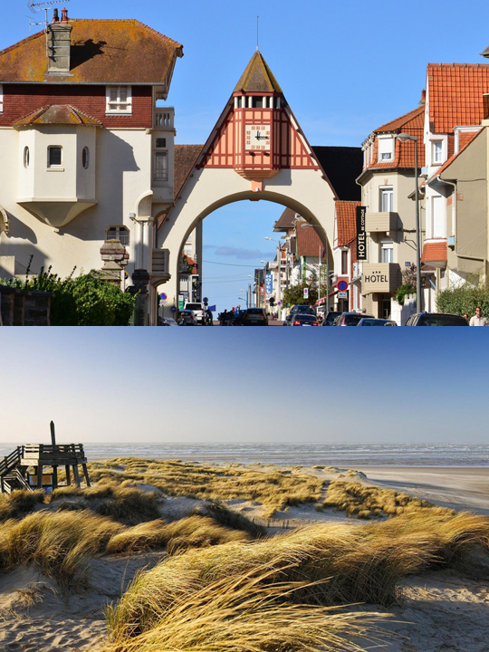
Le
Touquet
Visit the seaside town of Le Touquet with miles of stunning white sand beach to explore the morning market
Boulogne Town Trail
Your animateur organises this activity with our tailor made Town Trail requiring the students to read, understand and speak French

Slide 6
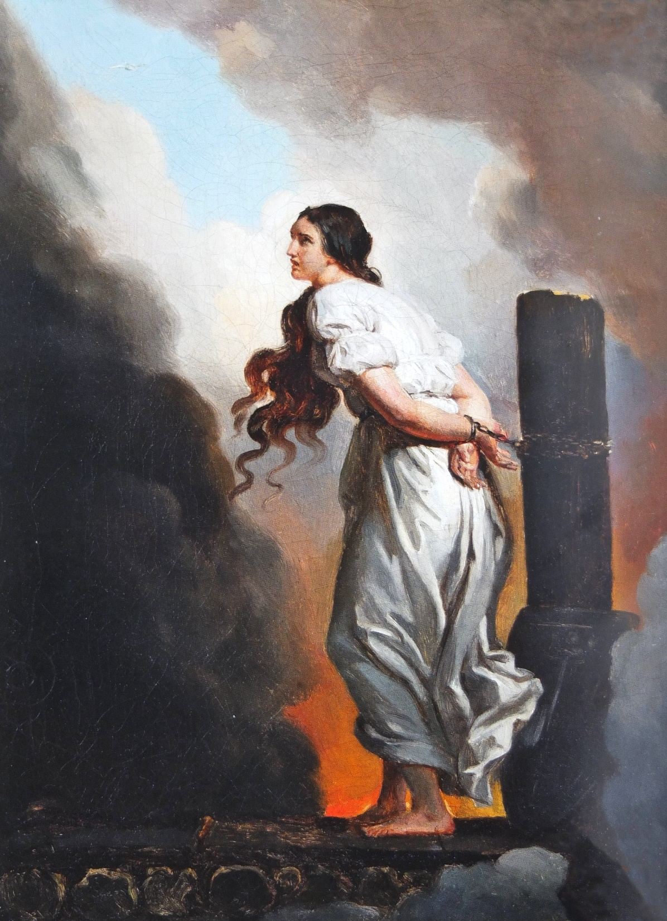
Rouen and Jean d’Arc
In Rouen, her memory permeates the walls. An outstanding figure in French history, Jeanne has become a myth that arouses international interest.
Feel the pulse of the last hours of the Pucelle in the Norman capital.
Boulogne Town Trail
Your animateur organises this activity with our tailor made Town Trail requiring the students to read, understand and speak French

Slide 7
NORMANDY — FRANCE
Bienvenue au Château de Chantereine
A short walk to the beach at Criel-sur-Mer, the 17th-century Château de Chantereine is a fantastic place for students to immerse themselves in French language, culture and way of life.
Set in four acres of grounds, there is plenty of green space for on-site outdoor activities.

Slide 8

Chocolate factory
Take a trip to Les Chocolats de Beussent to see how the world’s most popular food is made
You will have the opportunity to experience a guided English or French tour of the workshop, and see the process of melting, moulding and coating, you will even be offered the chance to taste some for yourself
Boulogne Town Trail
Your animateur organises this activity with our tailor made Town Trail requiring the students to read, understand and speak French

Slide 9
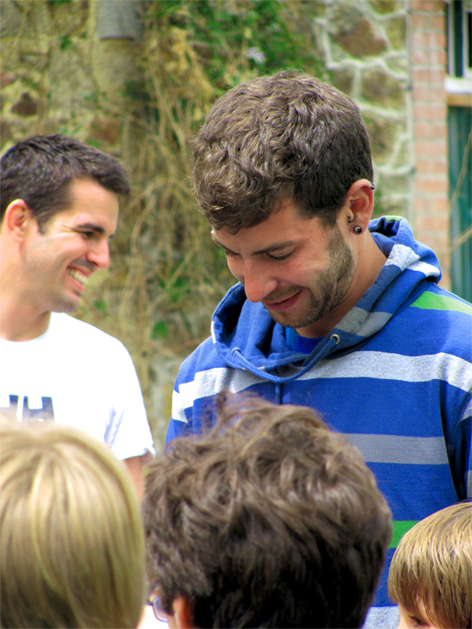
NORMANDY — FRANCE
Meet your animateur
Meet your animateur!
Our specially trained French native animateurs will be speaking with and encouraging interactive responses from you throughout your stay to challenge you and improve your language skills.
Your animateur will also lead activity sessions each evening of your trip

Slide 10
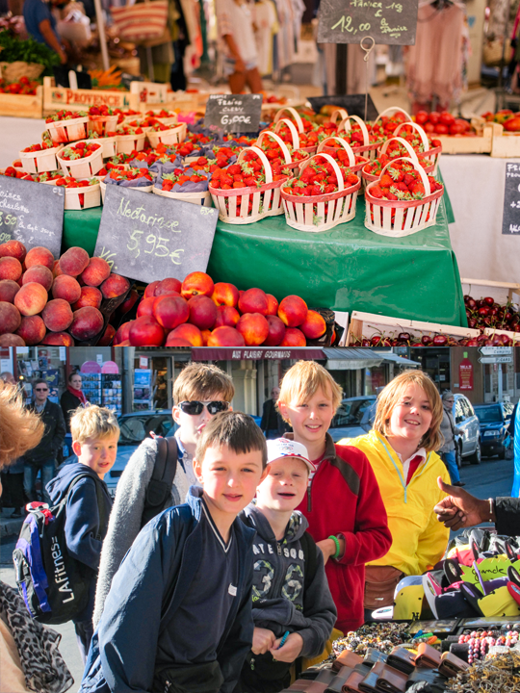
NORMANDY — FRANCE
Market
mission
Visit a local market with your animateur. Teams of students will be given money to buy ingredients for a packed lunch and you will also have some general shopping time
Return to your accommodation where your animateur will organise a competition for the best lunch
Boulogne Town Trail
Your animateur organises this activity with our tailor made Town Trail requiring the students to read, understand and speak French

Slide 11
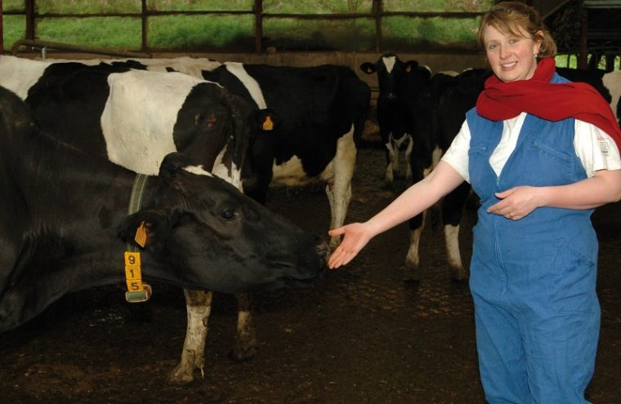
NORMANDY — FRANCE
LA VACHE DE LOUVICAMP
Cheese farm
Located in the heart of the Pays de Bray, Lucie shares her love through a fun visit of the farm (calves, cowshed). You will be able to taste the farm’s products (biscuits, fresh milk, butter, salted butter caramel) and take part in the milking of the cows.

Slide 12


Click here for more information about the trip!
Find us on

