Slide 1
Your trip to Andalucía
School Name
DD–DD MM YYYY

Slide 2
We help students reach new heights
Voyager School Travel specialises in educational school trips where students can learn, thrive and achieve their potential outside the classroom.
We believe that every school trip should provide students with new experiences, learning activities and exposure to local culture with genuine educational benefit.
Over 35,000 students travel with us each year

Slide 3
You’re in
safe hands
Your child’s safety is our priority and
we ensure the highest standards are met.
ABTA member
ATOL and ABTOT financial protected
School Travel Forum (STF) member
Learning Outside the Classroom (LOtC) Quality Badge holder
AAIAC Adventuremark holder
Audited safety management system
All accommodation audited
More about accreditation.

Slide 4
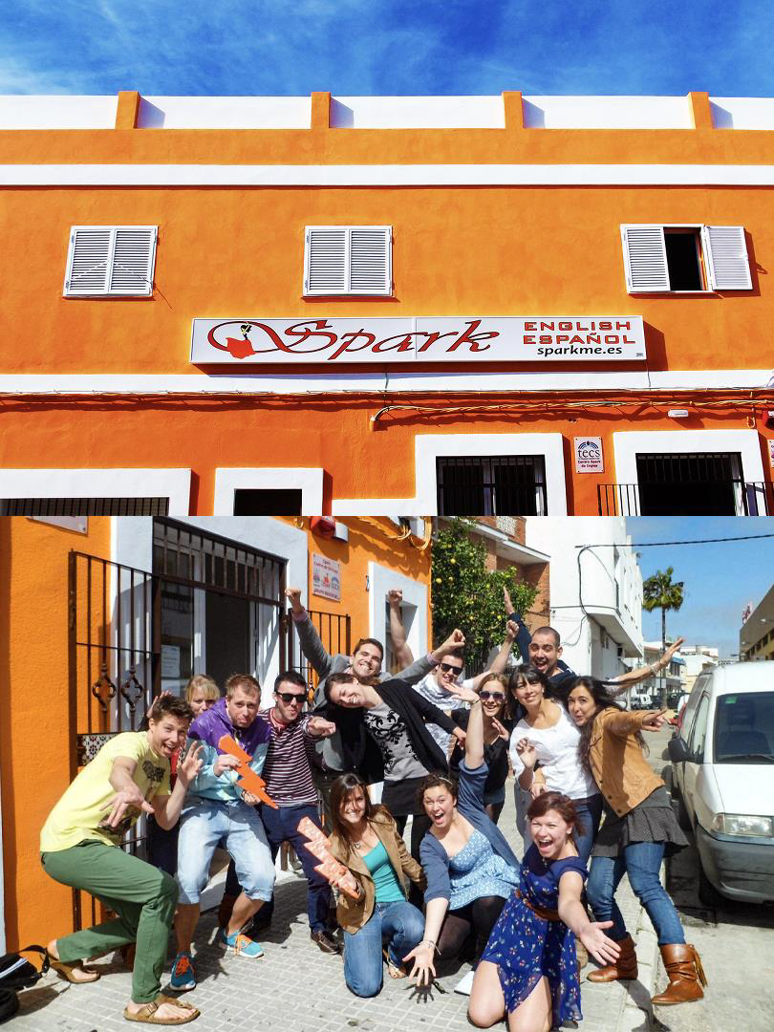
Spark
ACCOMMODATION
The Spark residential language centre is a renovated hostel just for schools
The accommodation is located in an enviable position just a 15-minute walk from the town centre and beach, and has numerous chill out areas and a big roof terrace great for barbecues and dance lessons!
All meals are included and dietary requirements can be catered for
Many evening activities are based onsite and are Spanish-themed such as cooking paella cooking and salsa dancing

Slide 5
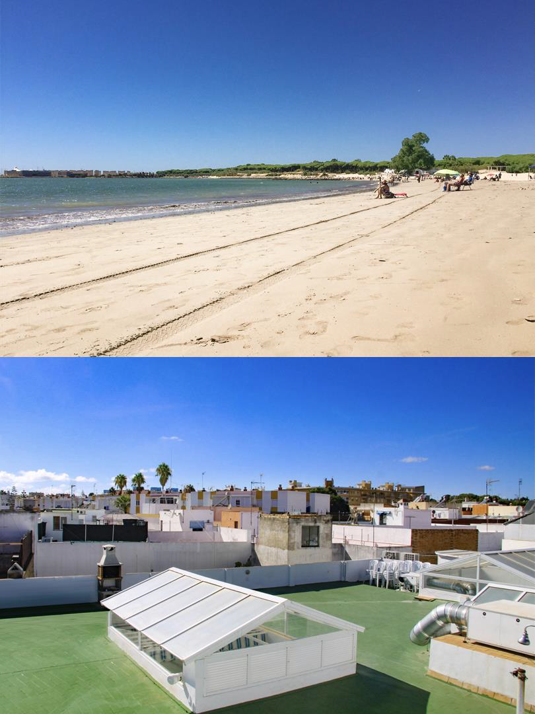
Welcome evening
Arrive at your accommodation late afternoon
Meet your monitores, the Spanish team who will be leading your trip and ensuring you have a truly Spanish cultural and linguistic experience
You’ll enjoy your first activity such as
beach games or bowling
Settle in with a BBQ on the roof terrace!

Slide 6
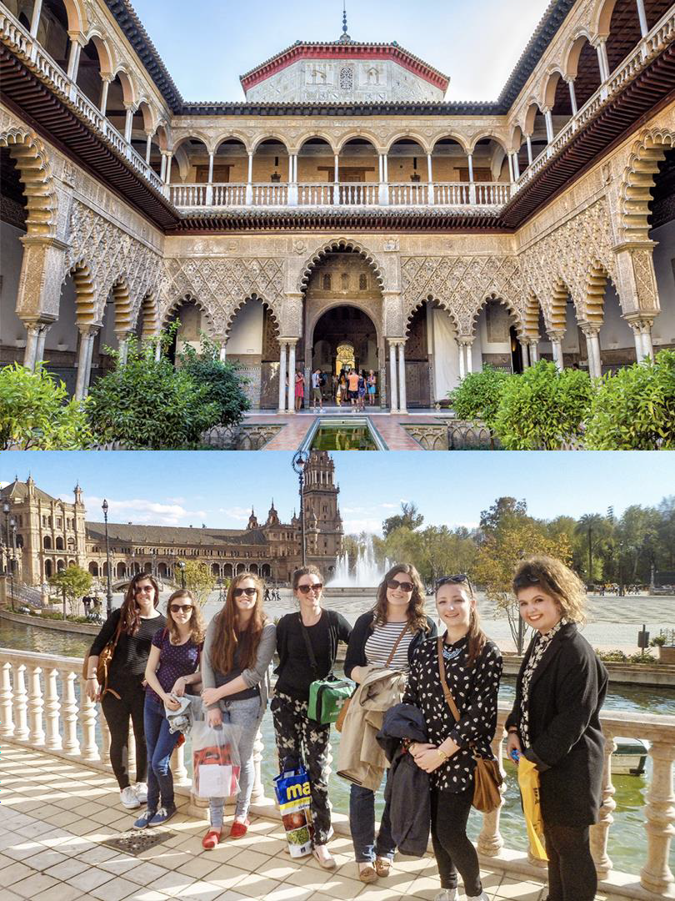
Day trip to Seville
Spend today in the beautiful and vibrant Seville!
Visit La Giralda Cathedral
Guided tour of the Alcázar
Free time to explore Barrio Santa Cruz
Walk to Plaza de España
Evening games and quiz night

Slide 7
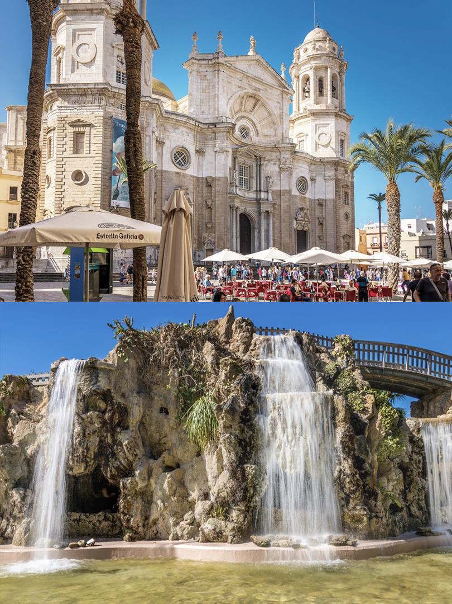
Day trip to Cádiz
After a two-hour Spanish lesson, enjoy a ferry ride to spend your day at the historic coastal city of Cádiz!
Guided tour of the Torre Tavern watchtower
Explore the scenic Parque Genoves botanical garden
Satisfy your sweet tooth with a churros and chocolate tasting!
Evening tapas meal in a Cádiz restaurant

Slide 8
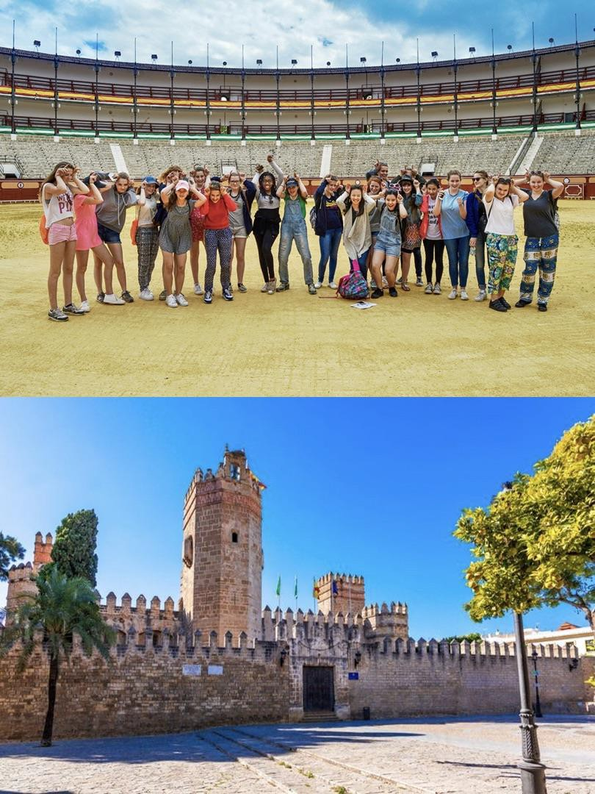
El Puerto
Two-hour Spanish lesson
Guided tour of El Puerto Bullring
Guided tour of Castillo de San Marcos
Visit the local market
Spend the afternoon on the beach either kayaking or playing games
Evening Spanish cooking class

Slide 9
Spain is waiting for you!
Click here for more information about the trip!
Find us on

