Slide 1
Berlin
School
DD – DD MM YYYY

Slide 2
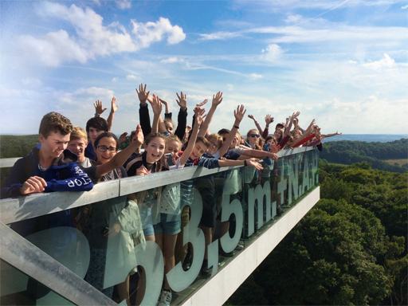
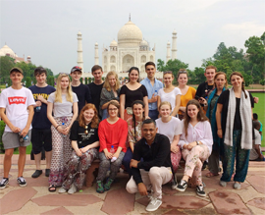
Who we are
Voyager School Travel specialises in educational school trips where students can learn, thrive and achieve their potential outside the classroom. We believe that every school trip should provide students with new experiences, learning activities and exposure to local culture with genuine educational benefit.
Over 35,000 students travel with us each year
Over 120 years combined experience in school travel
3 company owned accommodation centres in France
8 tried & tested programmes across France, Spain and Germany
Adventure, Ski and Worldwide divisions

Slide 3
Health & safety
All accommodation audited for health & safety
Audited Safety Management System
ABTA bonded
ATOL protected
Accredited by LOTC (Council for Learning Outside the Classroom)
Assured members of STF (School Travel Forum)
AAIAC Adventuremark holder

Slide 4
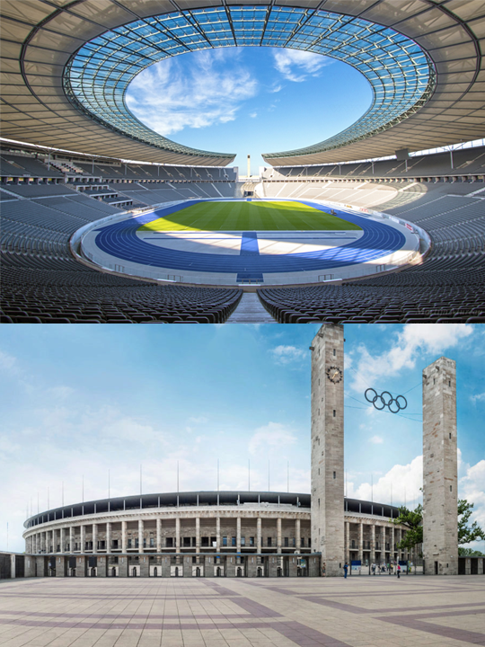
Day x
Olympic Stadium
Tour the historic Olympiapark Berlin, the stadium built for the 1936 Summer Olympics.

Slide 5
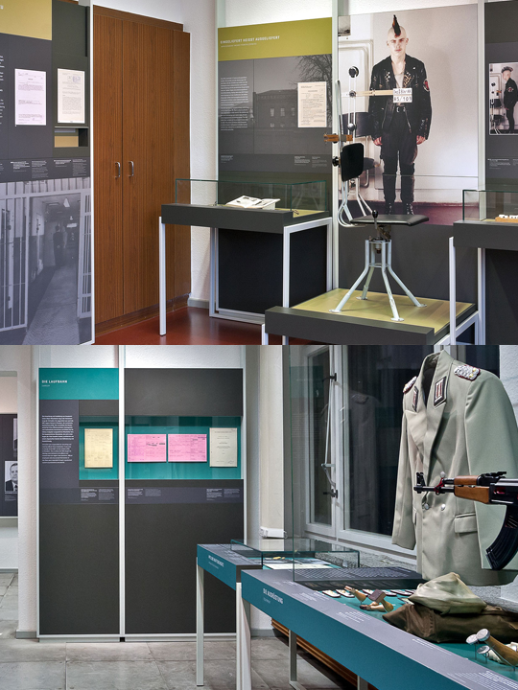
Day x
Stasi Museum
Students of the Cold War will get a real insight into life in the former East Berlin at the Stasi Museum. This is the centre of the archives from the former East German Security Services.
The centrepiece of the exhibition is the office and working quarters of the former Minister of State Security, the head of Stasi

Slide 6
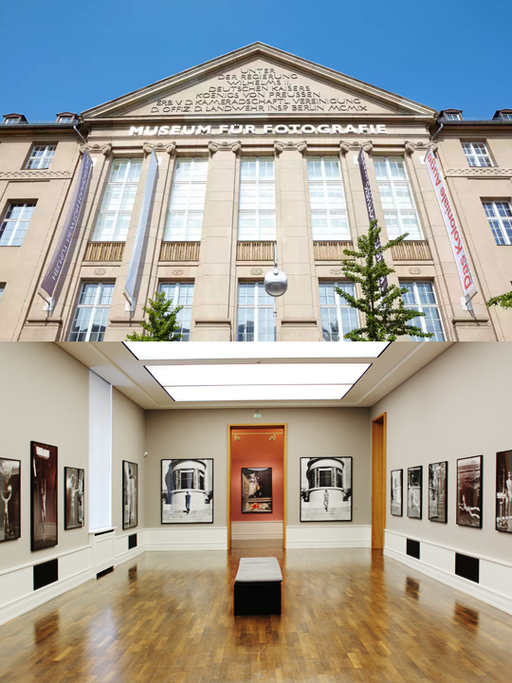
Day x
Museum of Photography
This museum is regarded as a world leader in photography.
In the last few years alone, over 700,000 visitors have flocked to see exhibitions organised by the Helmut Newton Foundation, ranging from ‘Sex and Landscapes’ to ‘Newton, Nachtwey, Lachapelle: Men, War & Peace’ and ‘Pigozzi and the Paparazzi’.

Slide 7
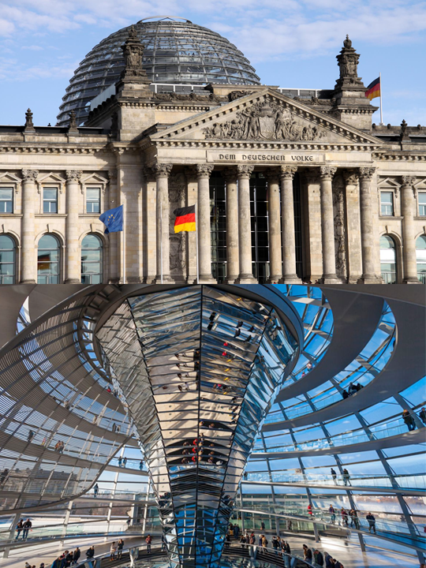
Day x
Reichstag
Explore the Old and New Reichstag to get a sense of political Germany. The restored older structure contrasts beautifully with the new Reichstag.
The striking glass dome symbolises the transparency of the democratic process in Germany and how far it has come since its darker days throughout the 20th century.

Slide 8
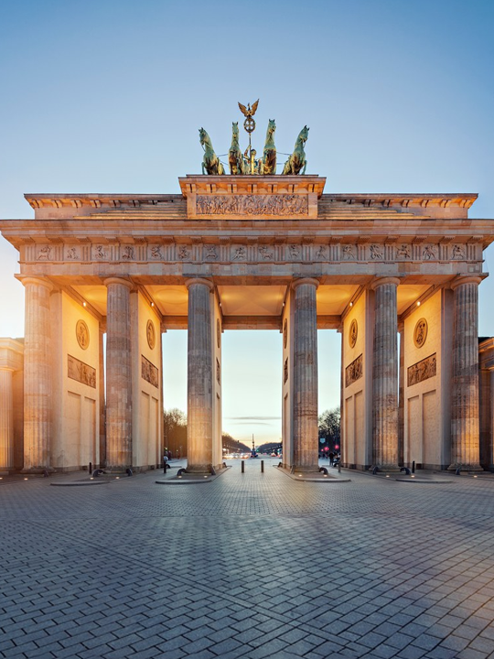
Day x
Brandenburg Gate
One of the most recognisable German landmarks, Brandenburg Gate was a symbol of Berlin and German division during the Cold War, it is now a national symbol of peace and unity.

Slide 9
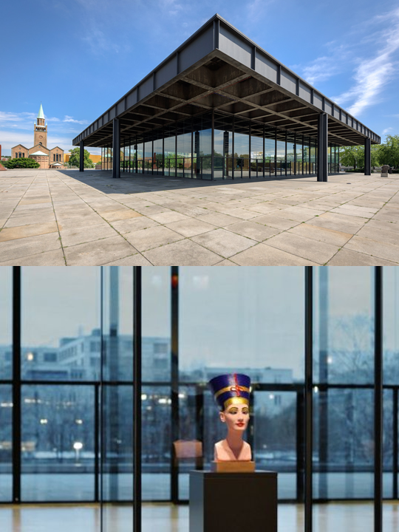
Day x
New National Gallery
The New National Gallery is dedicated to modern art and is free to visit.
The focus of the collection is on works by representatives of cubism, expressionists, of the Bauhaus, surrealism of the Group Zero and of American color-field painting as well as artists like Pablo Picasso, Ernst Ludwig Kirchner, Paul Klee, Max Beckmann,Otto Dix and from the era after 1945 Yves Klein, Lucio Fontana, Barnett Newman, Morris Louis, etc.

Slide 10
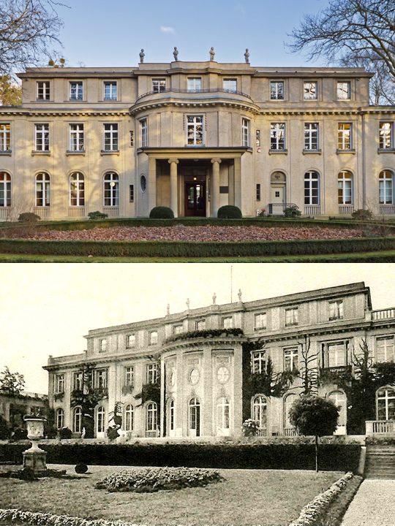
Day x
Wannsee Villa
Wannsee Villa is where Hitler, senior officials and SS leaders of the Nazi party came up with ‘Final Solution to the Jewish Question’ leading to the extermination of 6 million Jewish people murdered in WWII.
The Villa is now a Holocaust Museum and memorial site.

Slide 11
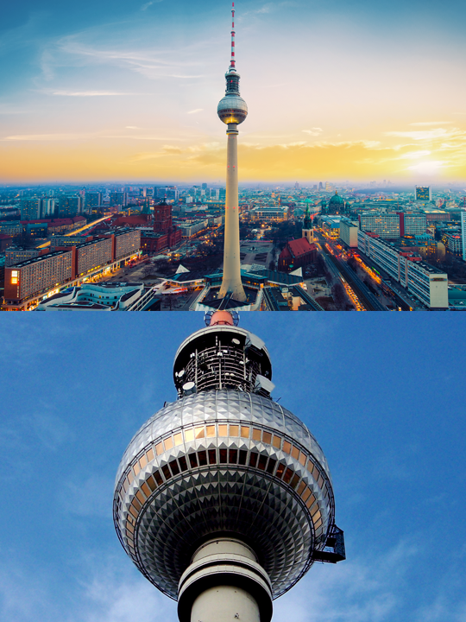
Day x
Fernsehturm TV Tower
This afternoon you and your group will ascend the TV Tower: built in the sixties by the East German government to demonstrate the power and strength of the socialist system.
The tower is still Berlin's highest structure and offers fantastic views of the city
Take a moment out in the revolving café at the top!

Slide 12
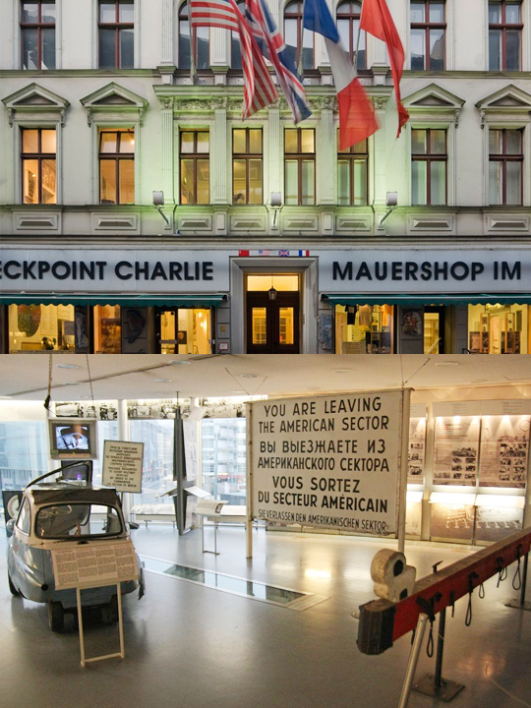
Day x
Checkpoint Charlie Museum
The Checkpoint Charlie Museum is a private museum in Berlin. It is named after the famous crossing point on the Berlin Wall, and was created to document the so-called "best border security system in the world".

Slide 13
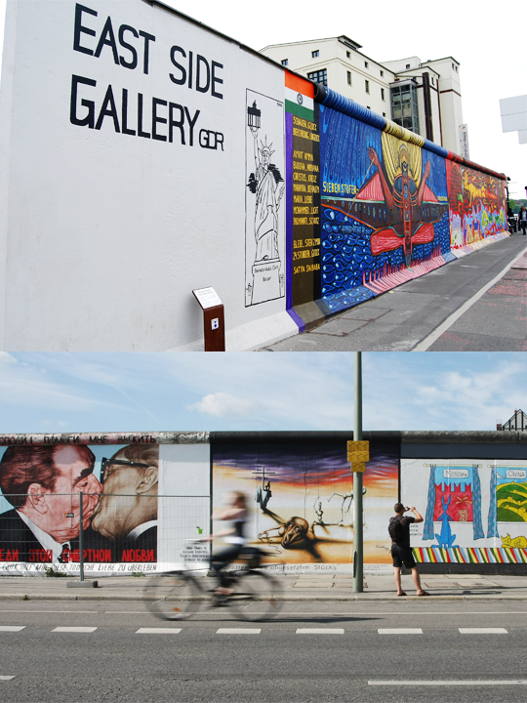
Day x
East Side Gallery
Throughout the city you will see a wide range of street art but the Berlin Wall East Side Gallery is where to go if you are a fan. A 1.3 km-long section of the wall is dedicated to art with approximately 106 paintings to see making it the largest open air gallery in the world!

Slide 14
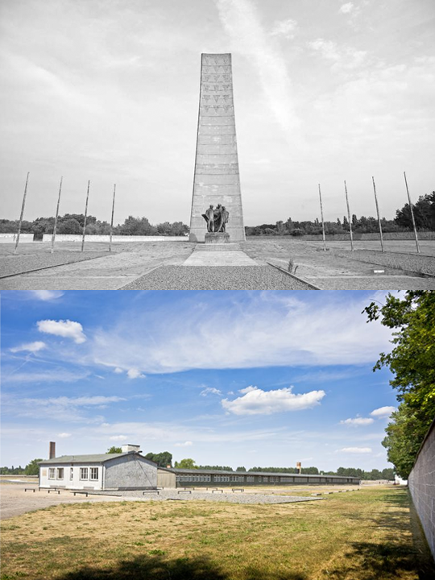
Day x
Sachsenhausen
Self-guided tour of the former Nazi concentration Camp at Sachsenhausen, 31km from Berlin.
From 1936 to 1945 more than 200,000 people were imprisoned here and only 3,000 sick prisoners were liberated in 1945.
It is an important historical site for students of 20th century European history and the atrocities perpetrated by the Nazis and then the Soviet Union.

Slide 15
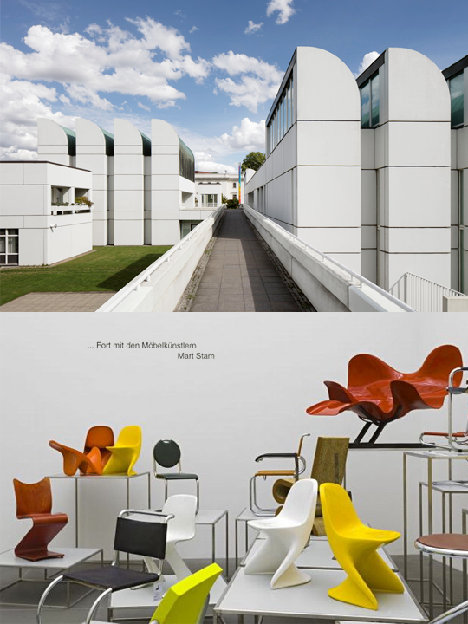
Day x
Bauhaus Archive Museum of Design
For anyone with an interest in architecture, design or art, the Bauhaus archive will tell you a story that will fascinate and inspire.
The Bauhaus movement was possibly the most important in the school of architecture over the whole of the 20th Century. From furniture and ceramics to photography, stage pieces and everything in between, you’ll be given an insight into the origins of the movement and its ongoing legacy

Slide 16
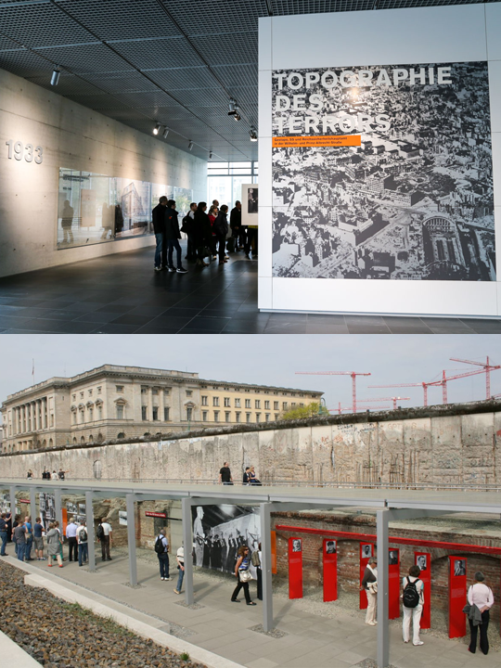
Day x
Topography of Terror
Explore the Topography of Terror, a permanent exhibition featuring information on the brutal regime run by Nazi officials and held at the site of buildings where the Gestapo and SS were located from 1933 to 1945

Slide 17
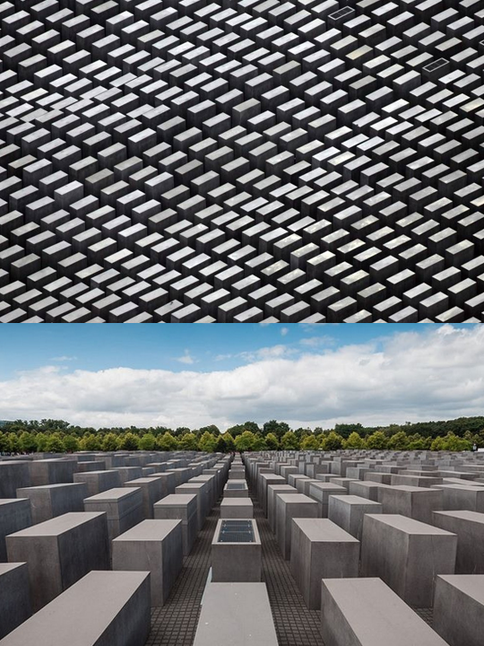
Day x
Memorial to the Murdered Jews of Europe
Located in the centre of Berlin, the memorial honours and remembers the six million Jewish victims of the Holocaust. The striking display features 2,711 concrete blocks, arranged to appear like graves, and is called the Field of Stelae.

Slide 18
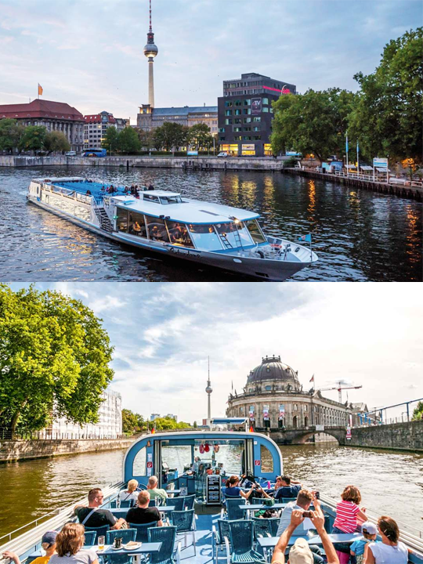
Day x
Berlin River Cruise
Cruise along the Spree River to see Berlin from the water

Slide 19
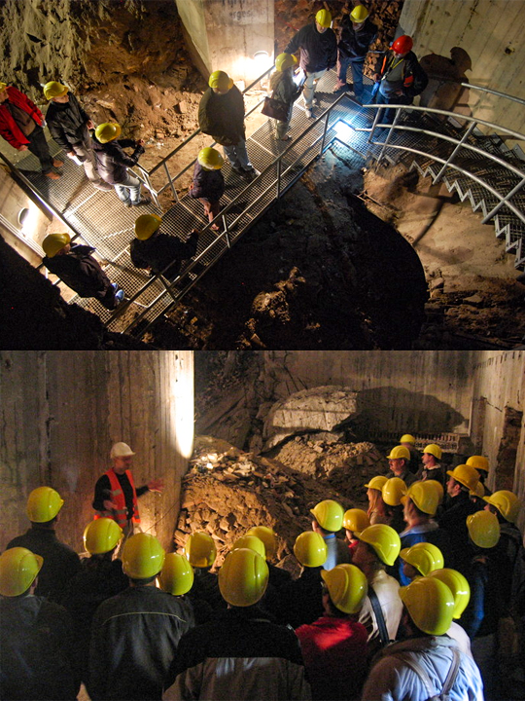
Day x
Underground Tour
Hundreds of people walk past a green door in the Gesundbrunnen underground railway station, unaware that, behind it, lies a subterranean labyrinth full of history just waiting to be experienced.
Don your hard hat and head down beneath the city!

Slide 20
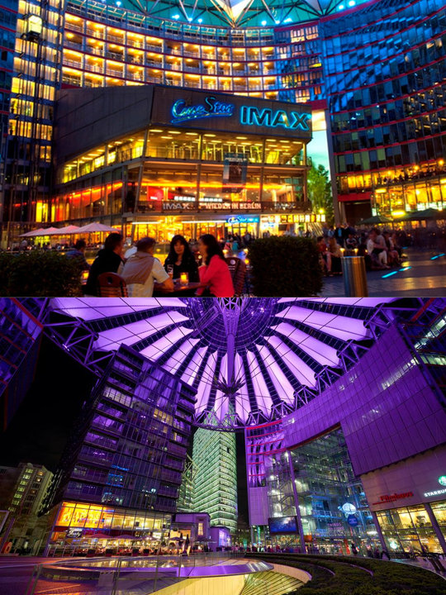
Day x
Cinestar Berlin & IMAX Potsdamer Platz
Tonight enjoy a film at Cinestar Berlin & IMAX, the largest mullti screen cinema in Berlin in the bustling Sony centre

Slide 21
Thank you!

